Slide 1
General Education@ASU
Joan McGregor
Professor of Philosophy
School of Historical, Philosophical, and Religious Studies
Past-President Tempe Campus

Slide 2
Task force members
Frederick Corey Convener
Vice Provost for Undergraduate Education
Office of University Provost
Joan McGregor
Professor
School of Historical, Philosophical and Religious Studies
Shirley Rose
Professor
Department of English
Tannah Broman
Principal Lecturer
College of Health Solutions
Megha Budruk
Associate Professor
School of Community Resources and Development
Scott Barclay
School Director and Professor
School of Social and Behavioral Sciences
Sara Brownell
Associate Professor
School of Life Sciences
Sukhwant Jhaj
Vice Provost for Academic Innovation and Student Achievement
Office of University Provost
Darryl Morrell
Associate Professor
The Polytechnic School
This proposal was developed by a
task force, building upon the work from the 2013 NextGenEd Working Group,
Ariel D. Anbar, Mark Lussier,
Patience Akpan-Obong, Stephani
Etheridge-Woodson, Richard Herrera,
Helene Ossipov and Michael Stancliff.

Slide 3
Motivations for the revision
1. Current General Education Requirements developed in 1983
Courses lack relationship to one another—based on covering certain large areas of knowledge
No requirement of integrating knowledge
Students move through them without larger purpose, as a “checklist”
Don’t produce the skills and habits needed in 21st century
2. Arizona Board of Regents in January 2019 required a revision of the General Education requirements.
“Constructive engagement with complex challenges require that today's graduates develop the ability to integrate knowledge and perspectives across disciplines and cultures in a purpose-driven, creative, and problem-solving manner.”
“skill-based learning outcomes” oral and written communication, critical thinking, teamwork, intercultural competency, application of idea to real-world situations
Produce life-long learners

Slide 4
General Education
General education integrates rapidly changing knowledge and perspectives across multiple disciplines through four intellectual habits and skills: inquiry, collaboration, innovation and engagement. Such habits and skills cultivate learning, persistence, adaptability and resiliency to address society's greatest and most pressing challenges through purpose-driven and creative problem-solving.

Slide 5
General studies:
A thematic approach

Slide 6
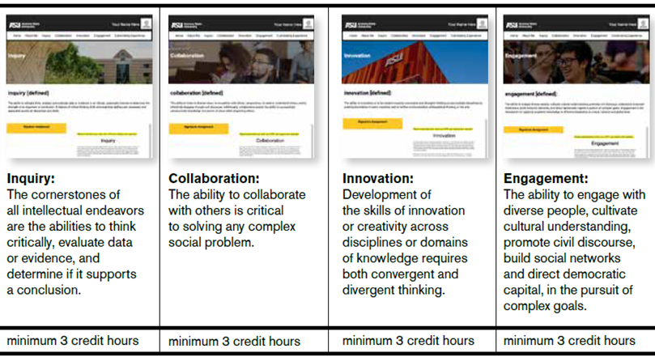
A thematic approach
Four Competencies:
Introduction course (3 hours)
Curated content courses (minimum 12 hours)
Culminating experience (3 hours)
Current distribution requirements remain

Slide 7
What the themes do?
They encourage thoughtful inquiry and the ability to recognize and interpret evidence to drive informed solutions
They require the ability to work effectively and efficiently with people from across disciplines,
They foster the ability to think creatively, work collaboratively to affect change

