Slide 1
ASU Faculty Senate Informational Report: Mirabella at ASU
Lifelong Learning and Engagement
Lindsey Beagley Tempe campus Monday, February 3, 2020
Notes:
This version is often used by the President’s office.

Slide 2
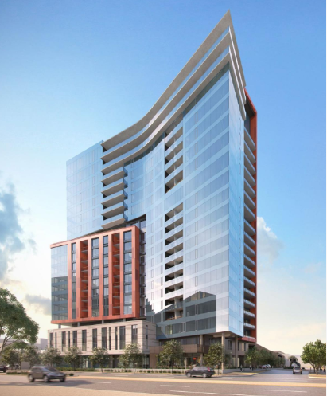
Mirabella at ASU
The Basics
20 story high-rise “Life Plan Community”
Mill Ave and University Dr
Opens September 2020
Jointly owned between Enterprise Partners (University Realty) and Pacific Retirement Services (owner-operator)
252 independent living units/460 residents
University-Based Retirement Community (UBRC) model
Minimum age and health requirements
Notes:
A Life Plan Community (or “Continuing Care Retirement Community”) offers accommodations for multiple levels of living and care – independent living, assisted living, acute nursing and memory care. The idea is that a person can spend the rest of her life in this kind of community and move between the levels of care as needed. If one partner in a couple breaks their hip, that person can receive treatment and recover in acute nursing on the 3rd floor not far from their spouse who can remain in independent living 2 floors above them.
In order to be eligible for this kind of community you have to meet a minimum level of health at the time of entry, however people like this model because it gives them peace of mind to know that, should they experience a sudden health event, their needs are already provided for and they or their family don’t have to scramble to come up with the funds or arrangements for care. So, it works well for people with no children or who don’t want to burden their children with assuming responsibility for these events.
In addition to being a Life Plan Community, the fact that this is a university-based retirement community is another unique feature that is compelling to retirees.
So, here you have a high-end Life Plan community on Mill and University (Mill is not known for its high end shopping and restaurants!) that sold out faster than anyone expected?
=There is a demand for a different retirement lifestyle options. Many people don’t want to retreat into an isolated “elderly island” full of people just like them. They are healthy at 65, 70, and some event at 80. They are looking for a period of continued, purposeful engagement and learning. They want to be around young people who are thinking about and preparing for the future.

Slide 3
Mirabella is a demonstration of Universal Learning. ASU’s commitment to meeting the needs of learners at every stage of life and work.

Slide 4
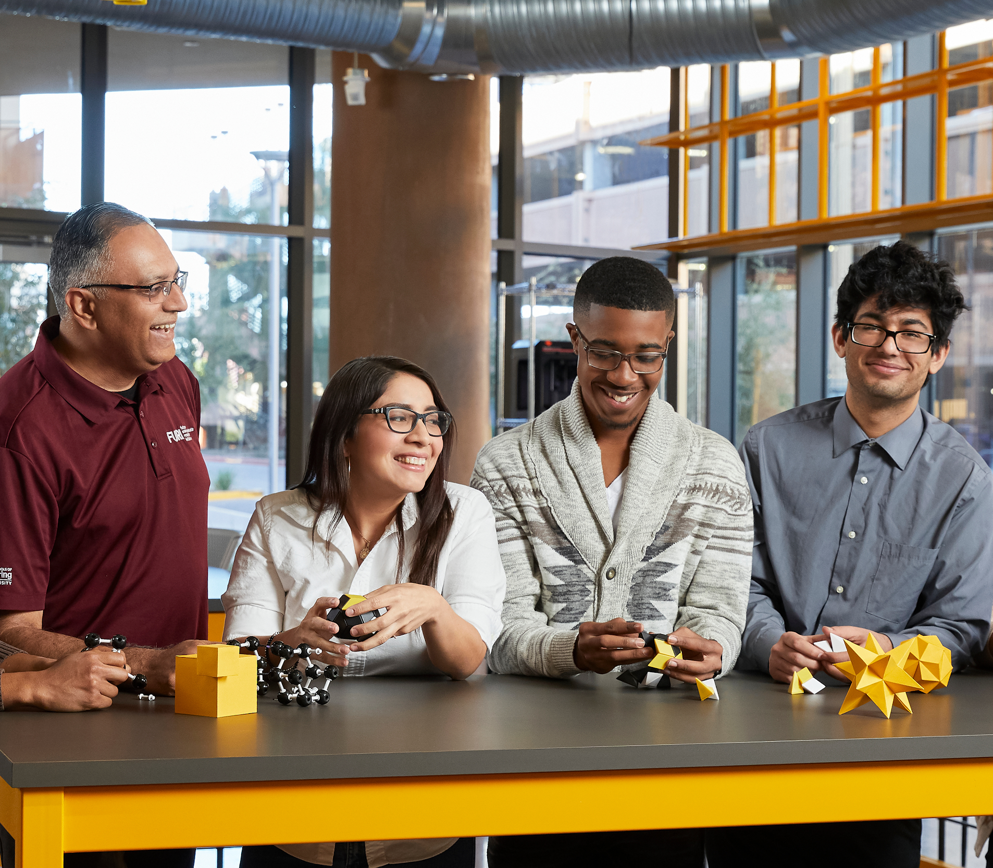
Mirabella at ASU
The Model
Full campus immersion
Variety of learning pathways
Residents are both learners and contributors of ASU’s mission
Notes:
UBRCs are not a new model, but MOST are only loosely affiliated with the university – in name only, or perhaps they share a college town but may even be miles away from a campus. So, It is significant that Mirabella is located on a prominent corner and a gateway to campus. It signals that this community is designed to be fundamentally integrated into the campus community and into our university ecosystem.
It is our opportunity to be a leader in re-imagining how the future of engaged retirement can center around what universities uniquely offer. How might we deploy our learning technologies and assets differently to meet the needs of learners at ALL stages of life? That is the premise of President Crow’s focus on Universal Learning.
Furthermore, what most UBRCs and senior living providers get wrong is that they assume retirees are not a critical role in achieving our societal and institutional goals. Not only do many retirees not WANT to be isolated, but we cannot afford to dismiss or underutilize such a valuable resource – people with a lifetime of experience and knowledge from extensive careers.
Most UBRCs are doing this for the revenue generation – both the land lease and the potential for philanthropic returns from resient estates. Hoever, we see a bigger opportunity here to discover a population of learners and contributors and to figure out what the university’s role in engaging this population is.

Slide 5
Challenging assumptions
Modern retirees
Learning How does the modern retiree want to integrate with the university to discover, learn and engage? | Contributing How might we deploy their professional expertise, community leadership, industry knowledge to advance ASU’s mission? | Connecting How might we build an intergenerational campus community that is generative and mutually beneficial?
Notes:
Because this level of capus integration is unprecedented for UBRCs, we have an opportunity to create models that advance the idea of universal learning and also emerge as models for how universities can tap into the power and potential of seniors as learners and contributors

Slide 6
Mirabella resident profile
Demographics
ASU integration
Most are mid-60’s to mid-70’s
About 85% currently live in Arizona or own a second home in Arizona
They have retired from careers in such industries as: healthcare, social work, business, medicine, academia, finance, etc.
Only 28% have an existing ASU affiliation
90% indicated they want to contribute to ASU or be a resource to students
They want to keep learning, interacting with future-minded people and do something purposeful
Notes:
Who ARE these people that want to live at Mill and University? They MUST be retired faculty or alumni, right?
We might be surprised at the profile of the average resident.
What we find is that many are new to ASU but not new to Arizona, many are rather young retirees and all are healthy, and emerging from successful careers in a wide variety of industries. Most hope to be engaged as a contributor in some way to ASU, its mission, or our students.
We have a lot of work to do in terms of educating them about what ASU is all about and how they can engage in our work.

Slide 7
Lifelong Learning Pathways
Informal
Occasional/intermittent
Pre-selected topics
Low commitment
Formal
Consistent
Variety of topics
High commitment
Campus Lectures
Sporadic Topic pre-selected Includes Mirabella Signature Lecture Series
Guest Learners (selected courses)
Curated set of courses are made available to residents each semester Suitable for casual/intermittent participation
Custom classroom engagement
Required instructor approval Negotiate expectations for participation or contribution
Auditing
Formal enrollment and applicable tuition and fees Pre-reqs required
Credential-seeking
Formal enrollment and applicable tuition and fees Pre-reqs required
Future:
Possible Tempe campus-based Osher Lifelong Learning Institute (OLLI) site
Learning opportunities through ASU Online
Notes:
We are working to design a spectrum of learning pathways for residents who may have a variety of goals and expectations for their learning experiences. Some come with somewhat outdated ideas about classrooms and don’t have experience learning in classrooms which leverage project and community-based experiential learning approaches. Many have never learned online before. So, there is lots to explore about which pathways are popular, though we fully expect that the more casual intermittent learning experiences will be how the majority of folks want to learn.
So, these are pathways provide varying levels of scheduling consistency, interaction with students, or required commitment to meet the needs of a wide variety of people.
Campus lectures/Mirabella Signature Lectures: lectures offered through schools and units on campus that are open to the public, but this will be a convenient way to get a taste of new topics. We will develop a Mirabella Signature Lecture (probably monthly) to get exposure to new faculty, new topics.
Guest Learners: Deans would select a variety of classes each semester that Mirabella residents could join as guest learners. These are classes in which instructors are already aware and enthusiastic about welcoming Mirabella residents in their classes, but would be suitable for casual learning (inconsistent attendance would not be disruptive).
Custom Engaged Learning (Case-by-Case upon instructor approval) : If the curated listed of courses did not meet a resident’s objective or interest, they may identify a course from the catalog and i can direct them to an appropriate instructor(s) who offer that course. They will be responsible for connecting with the instructor, and seeking approval to join the class as a learner or engage in some other way as a contributor, guest lecturer, project mentor, student coach, etc. (Orientations/trainings will be offered to assist residents with navigating these kinds of interactions in order to arrive at clear expectations when joining a class). It may be that this interaction reveals a mismatch between the participation requirements of the course format and the expectations/goals of the resident, or it could be that the faculty and the resident hit it off and devise some other form of mutually beneficial engagement.
Audit: If a resident wants a greater commitment, and I willing to formally enroll as a non-degree seeking students, they can audit just like anyone else. We suspect these will be few and far between given the variety of learning opportunities which do not require an additional cost.
Credential-seeking: required formal enrollment, tuition/fees, (includes Continuing Education Courses)

Slide 8
In addition to learners, Mirabella residents might serve in roles such as:
Professional teaching assistants
Career/professional development mentors
Project coaches
Panel judges
Industry/community partnership brokers (connectors)
Guest lecturers
Event participants
Notes:
The opportunity here is not to prescribe for them how they might engage on campus based off of what we believe to be true about retirement and old age – we are in a new era now and this is a notoriously misunderstood population
We will use of co-creative strategies to explore and design new roles, new mechanisms for engaging these folks and discovering mutually beneficial scenarios. This might include:

Slide 9
How to engage
Welcome residents into your class/research initiative as appropriate
Offer a lecture at Mirabella
Host a campus site visit
Serve as a consultant in developing resident orientation materials
Share how you’ve successfully engaged residents to inspire other faculty
Notes:
Shirley asked me to include how faculty might get involved or support this project.

Slide 10
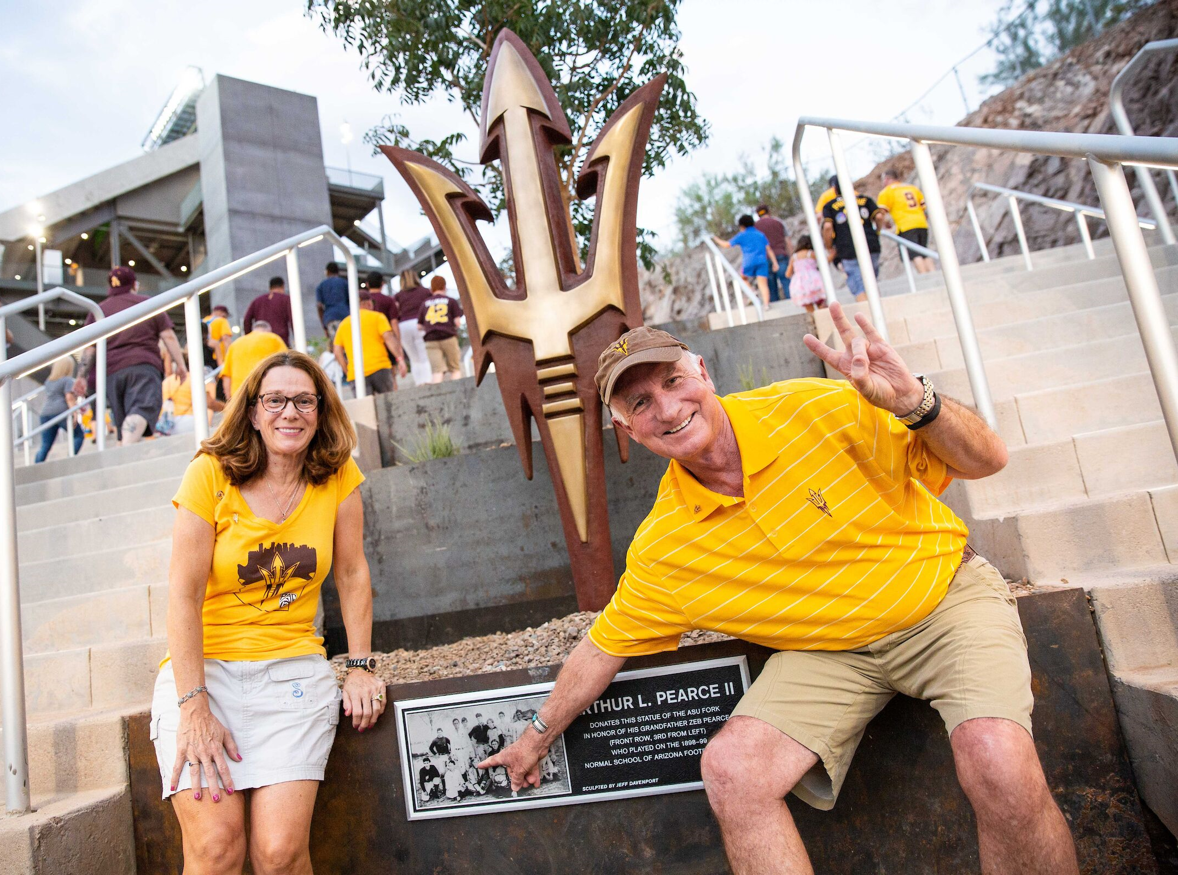
Questions?
Lindsey Beagley
Director
Lifelong University Engagement
Lindsey.Beagley@asu.edu
480-965-5156
Notes:
Please feel free to contact me with ideas, questions, concerns. I am here to make this a successful integration.

