Slide 1
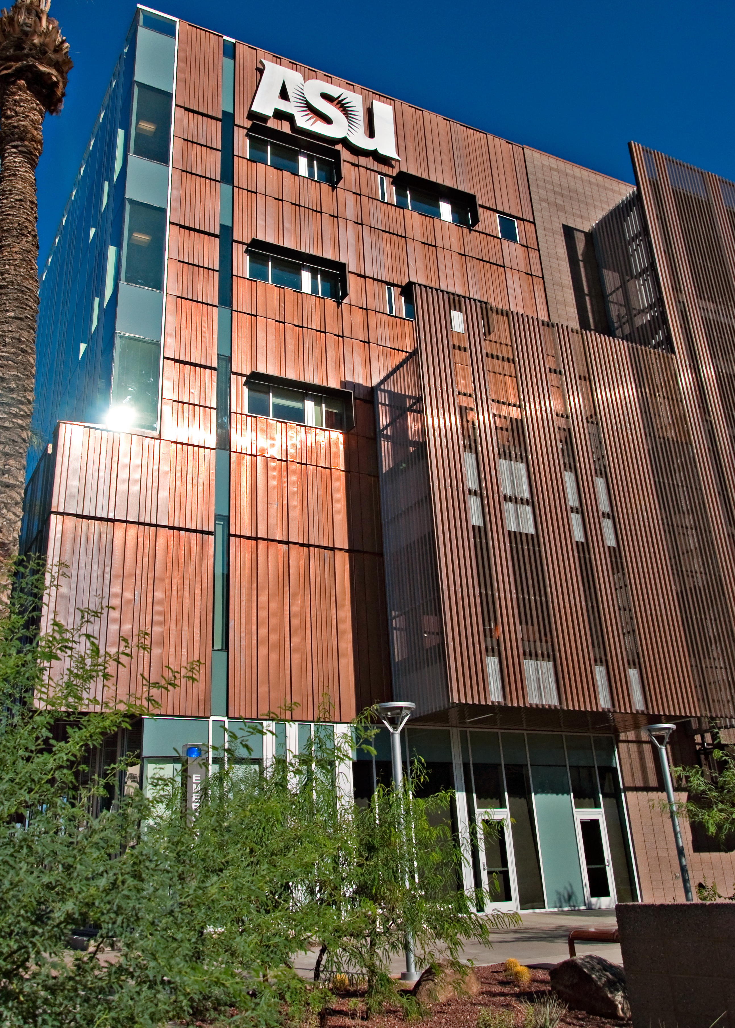
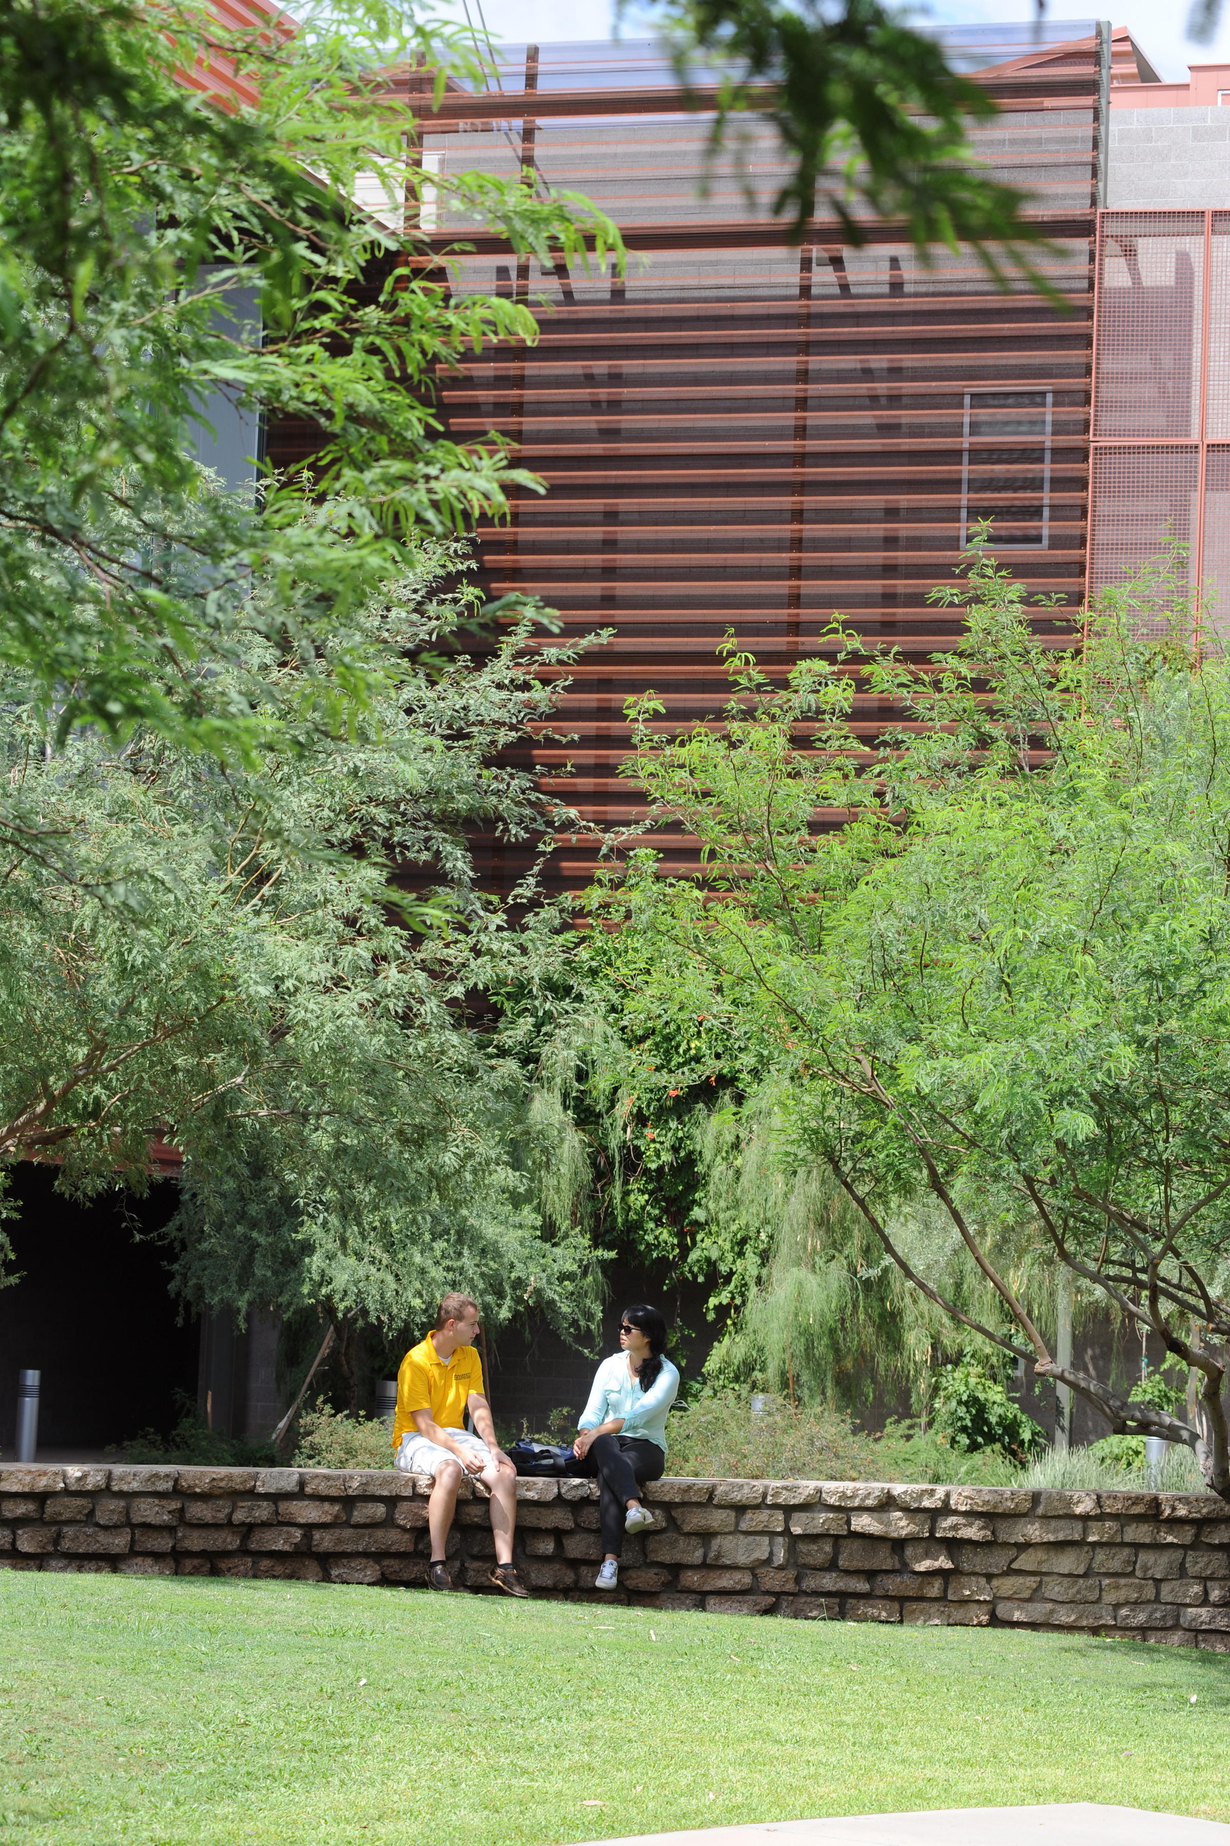
Four campuses, one Senate…your voice!
Downtown Phoenix
Polytechnic campus
Tempe campus
West campus
campus
Arizona State University Senate
Welcome orientation

Slide 2
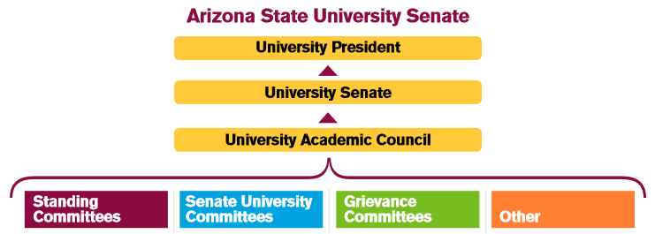
The university Senate: the big picture
Welcome
The university Senate 1 2 3 4 5 6 7
Role of senators
Senate terminology and processes 1 2 3 4 5
Reviewing new course proposals 1 2 3
FAQs
Topics reviewed by the Senate require a big picture perspective of Arizona State University. When senators embrace the big-picture view, and use their unit level expertise, the Senate is able to efficiently and effectively execute its shared governance responsibilities.

Slide 3
Representation
Welcome
The university Senate 1 2 3 4 5 6 7
Role of senators
Senate terminology and processes 1 2 3 4 5
Reviewing new course proposals 1 2 3
FAQs
The University Senate has the power* to act for and represent the Academic Assembly under existing regulations in all matters including but not limited to:
academic affairs, personnel affairs, faculty-student policies, financial affairs and university services and facilities
the Senate also works diligently to enhance the reputation of the university, as well as communicate the outstanding accomplishments of our faculty and academic professionals.
University President
University Senate
Faculty members and academic professionals
*ABOR Policy 6-201 and A.R.S. §15-1601

Slide 4
Who runs the Senate?
Welcome
The university Senate 1 2 3 4 5 6 7
Role of senators
Senate terminology and processes 1 2 3 4 5
Reviewing new course proposals 1 2 3
FAQs
Senate Presidents and Secretary
University Academic Council
Executive Committee
University Senate Office Staff

Slide 5
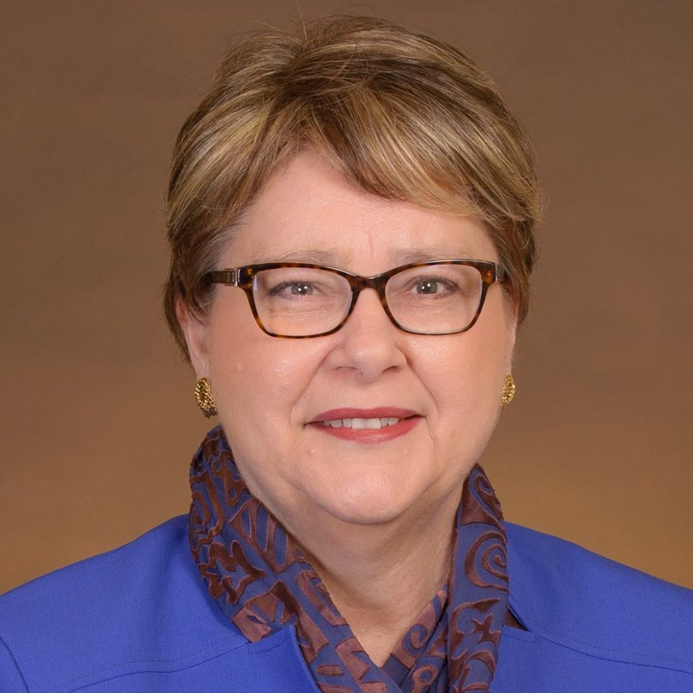
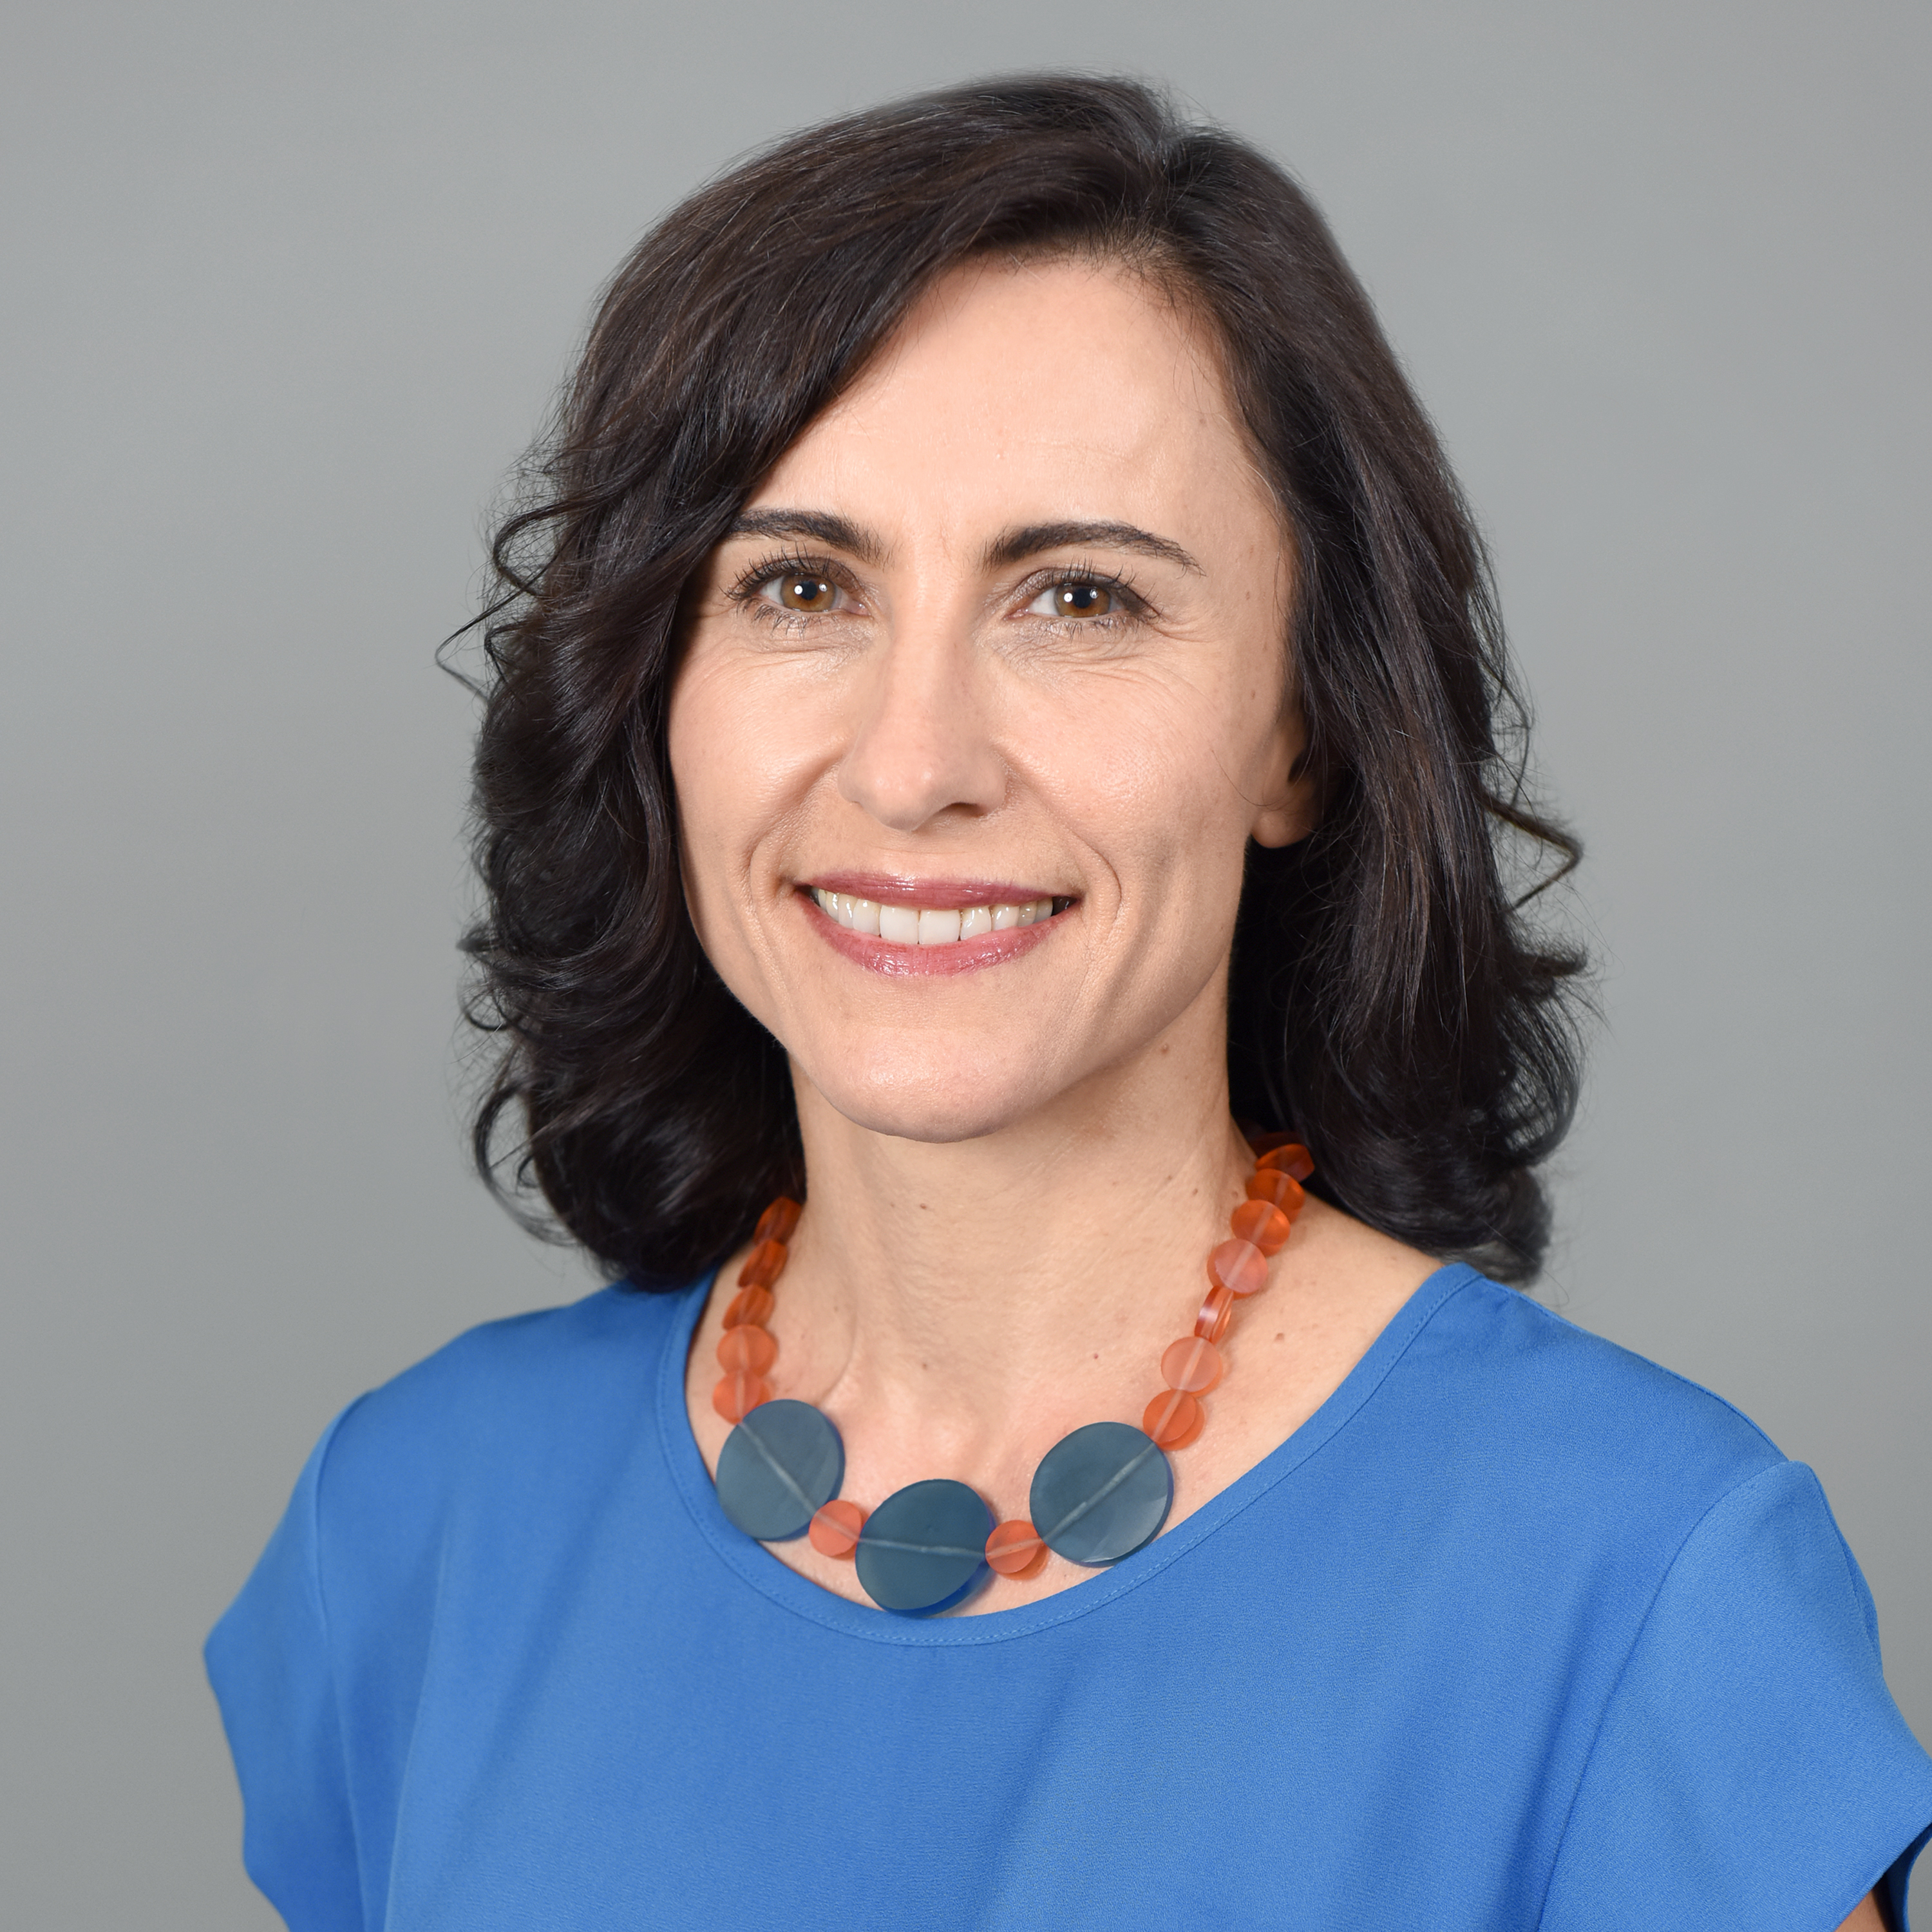
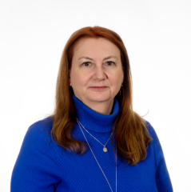
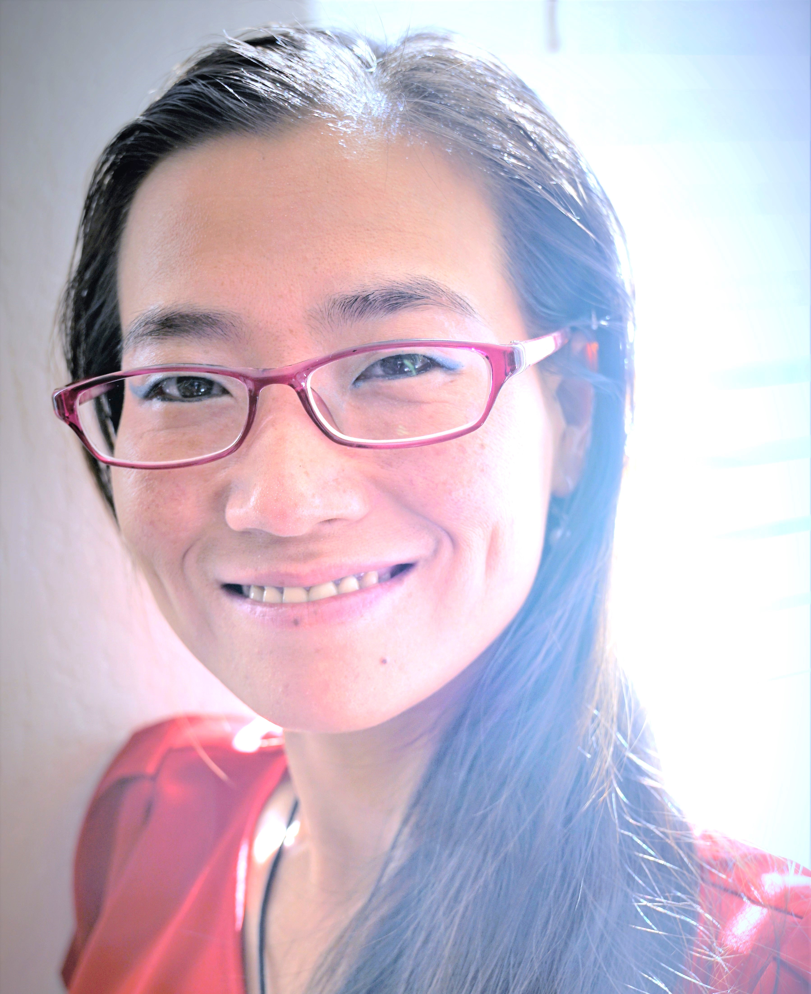
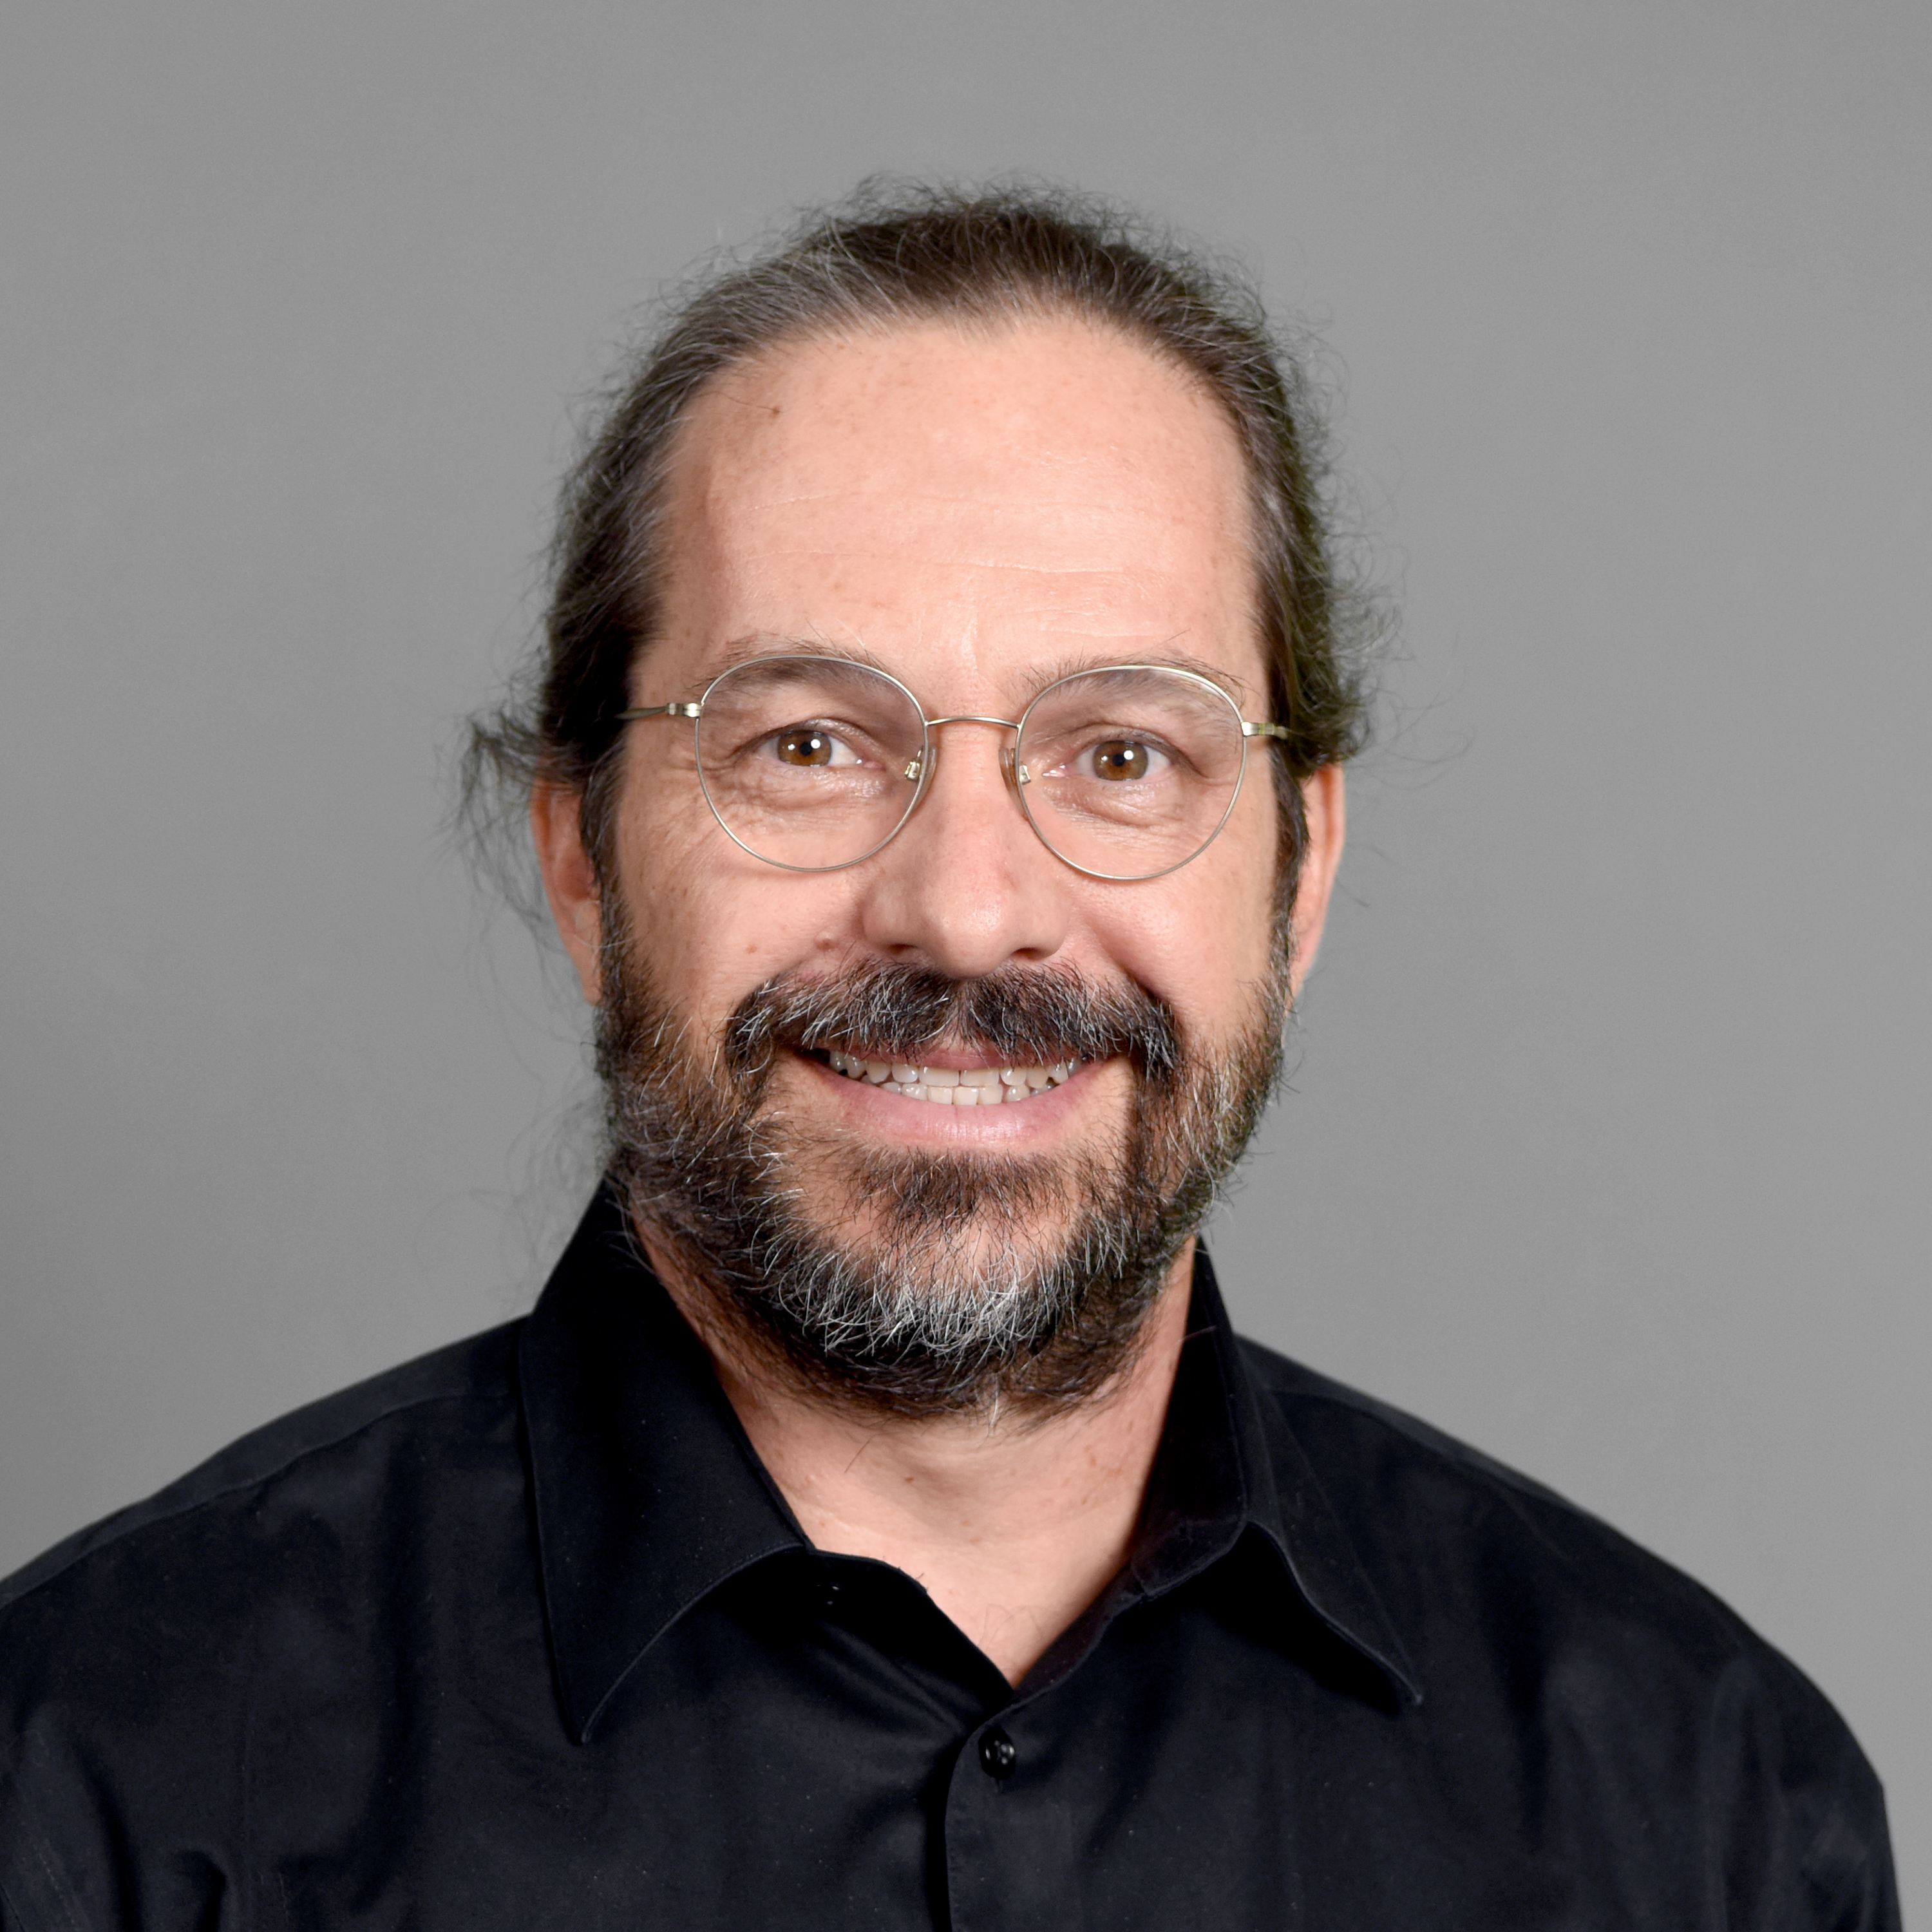
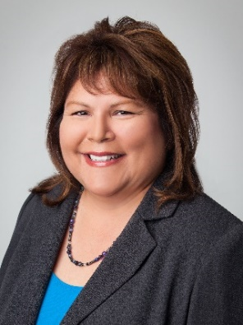
Senate presidents and secretary
Welcome
The university Senate 1 2 3 4 5 6 7
Role of senators
Senate terminology and processes 1 2 3 4 5
Reviewing new course proposals 1 2 3
FAQs
Shirley Rose University Senate President
Simin Levinson President Downtown Phoenix campus
Caroline Harrison President Tempe campus
Yun Kang President Polytechnic campus
Ken Sweat President West campus
Chris Kyselka Secretary Academic Assembly and Senate

Slide 6
University Academic Council
Welcome
The university Senate 1 2 3 4 5 6 7
Role of senators
Senate terminology and processes 1 2 3 4 5
Reviewing new course proposals 1 2 3
FAQs
The University Academic Council (UAC) is the executive board of the University Senate, and is composed of the president, president-elect and past presidents of all four campuses. The overall Senate president and chair of the UAC is elected annually from among these individuals.
The UAC meets monthly with a primary task being discussion, delegation, implementation of Senate issues and strategic planning. Click on the button below to view the current members:
https://usenate.asu.edu/about/leadership

Slide 7
Executive Committee
Welcome
The university Senate 1 2 3 4 5 6 7
Role of senators
Senate terminology and processes 1 2 3 4 5
Reviewing new course proposals 1 2 3
FAQs
The Executive Committee is composed of each individual UAC member and the chairperson of each of the Senate‘s standing committees.
The Executive Committee meets once per month with its primary responsibility of setting the agenda for the next Senate meeting.

Slide 8
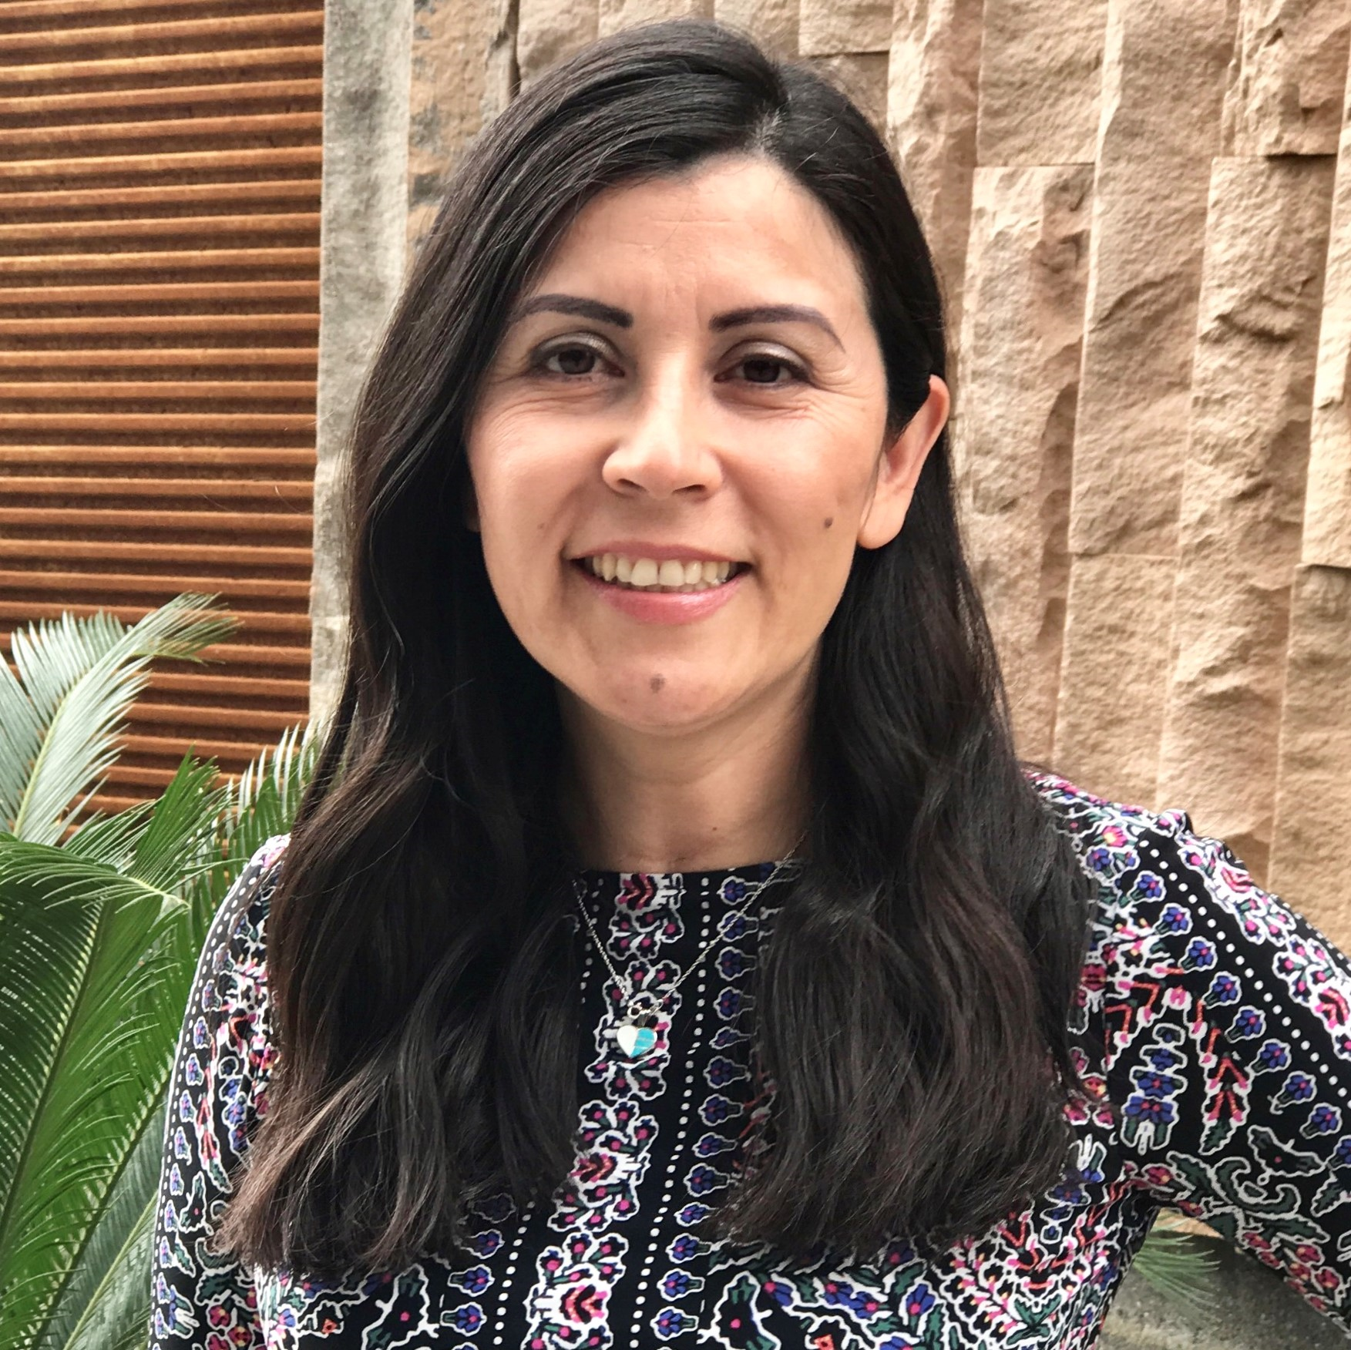
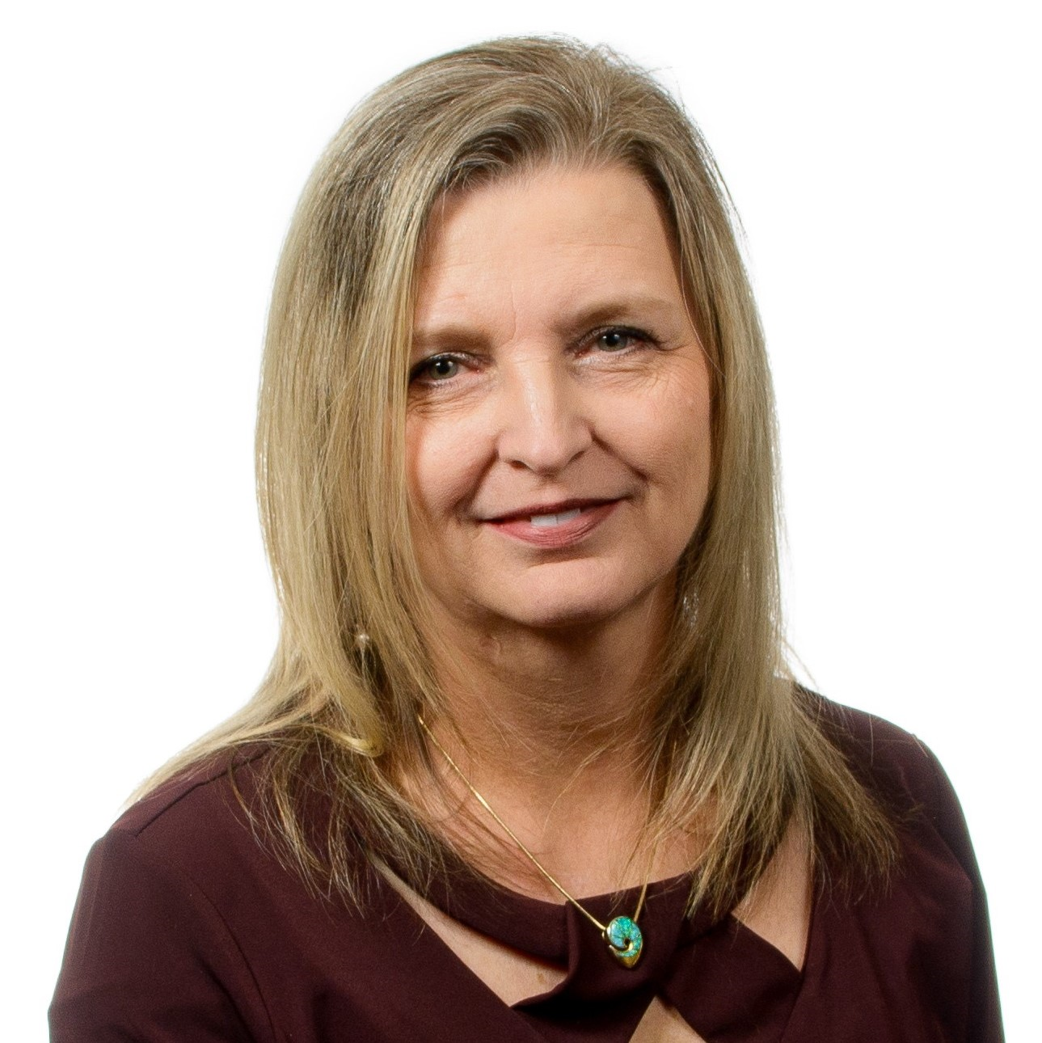
University Senate Office staff
Welcome
The university Senate 1 2 3 4 5 6 7
Role of senators
Senate terminology and processes 1 2 3 4 5
Reviewing new course proposals 1 2 3
FAQs
Maria Coca Senate Manager
Pamela Hoyle Administrative Specialist
The University Senate Office Staff is located on the Tempe campus in Interdisciplinary B, Room 361, but services Senate business on all campuses.

Slide 9
Role of senators
Welcome
The university Senate 1 2 3 4 5 6 7
Role of senators
Senate terminology and processes 1 2 3 4 5
Reviewing new course proposals 1 2 3
FAQs
Listen and talk to individuals within your academic unit. Communicate important information both from your unit to the Senate and also from the Senate back to your unit.
Attend monthly Senate meetings held on your campus, making sure to sign in at each meeting.
If selected, serve on one of the Senate standing committees. All committee assignments will be ratified by the Senate in late August.
Develop or secure an e-mail distribution list of faculty and academic professionals within your unit to facilitate communication.
Review all new course proposals that might impact your particular unit/school/college (discussed below).
Review policy motions that come through the Senate (discussed below).
Attend and promote attendance at the Academic Assembly meeting held each semester.
Encourage colleagues to visit the University Senate website to stay informed.

Slide 10
Senate terminology and processes
Welcome
The university Senate 1 2 3 4 5 6 7
Role of senators
Senate terminology and processes 1 2 3 4 5
Reviewing new course proposals 1 2 3
FAQs
Topics reviewed by the Senate are called Request for Consultations (RFC)
A request for consultation is a request made by any individual, unit, college, school, administration or organization that would like (or is required) to secure input from the faculty and/or academic professional’s perspective to aid in decision-making and/or policy development.

Slide 11
Ways to submit a Request for Consultation
Welcome
The university Senate 1 2 3 4 5 6 7
Role of senators
Senate terminology and processes 1 2 3 4 5
Reviewing new course proposals 1 2 3
FAQs
Bring the point up for discussion during the open forum of a Senate meeting.
Discuss the issue with the Senate President.
Discuss the issue with your campus President.
Discuss the issue with any UAC member.
Contact the University Senate manager.

Slide 12
Examples of Request for Consultation
Welcome
The university Senate 1 2 3 4 5 6 7
Role of senators
Senate terminology and processes 1 2 3 4 5
Reviewing new course proposals 1 2 3
FAQs
Administrative requests: search committee representation, summer UAC work, faculty governance interpretations, ACD policy change requests, RSP policy change reviews, and other faculty related policy changes.
College, School or Unit requests: curricular changes or modifications, new course proposals, policy review requests, request for ideas on how to incorporate shared governance concepts within the organization, etc.
Constituent requests: problem resolution, university-wide service resolution, etc.
University committee requests: faculty interpretations and feedback on topics, faculty representation on task forces and ad-hoc committees, consideration for new policies etc.
Student requests: faculty requests for input, joint student-faculty proposals, etc.

Slide 13
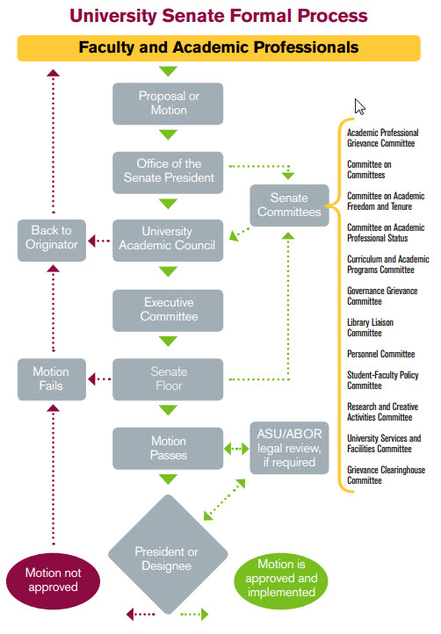
Processes for Request for Consultation: formal
Welcome
The university Senate 1 2 3 4 5 6 7
Role of senators
Senate terminology and processes 1 2 3 4 5
Reviewing new course proposals 1 2 3
FAQs
RFC are processed in two ways, formally and consultatively. This is the formal process:
Handled within one of the Senate committees, or task forces.
Results in the development of a Senate motion
Voted on by all Senators
Motion and outcomes posted on the Senate website
Motion transmitted to the President or Provost for review and/or implementation decision.

Slide 14
Processes for Request for Consultation: consultative
Welcome
The university Senate 1 2 3 4 5 6 7
Role of senators
Senate terminology and processes 1 2 3 4 5
Reviewing new course proposals 1 2 3
FAQs
This is the consultative process
Topics are handled by the Senate President, UAC, Senate office staff or one of the Senate committees by working directly with the area/person submitting the RFC.
Can sometimes develop into a formal Senate motion
Outcomes announced at Senate meetings and logged in the Senate office RFC database.
Topics are handled consultatively because they do not require a vote of the entire Senate.

Slide 15
Reviewing new course proposals
Welcome
The university Senate 1 2 3 4 5 6 7
Role of senators
Senate terminology and processes 1 2 3 4 5
Reviewing new course proposals 1 2 3
FAQs
Reviewing new course proposals is the responsibility of each individual member of the Senate. The next slide contains a video that provide an overview of the new course proposal review process and a second video that provides step-by-step instructions on how to review the courses each month.

Slide 16
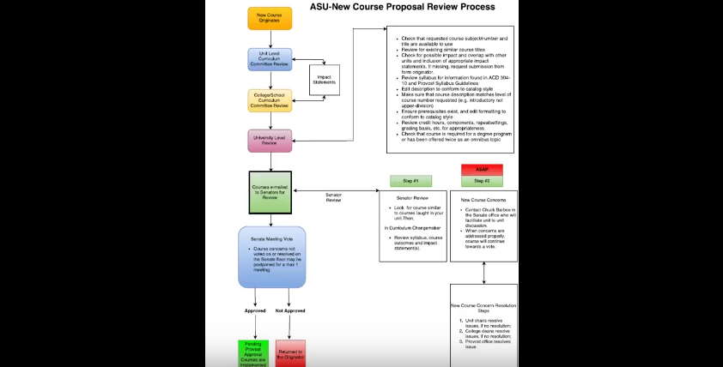
Reviewing new course proposals overview
Welcome
The university Senate 1 2 3 4 5 6 7
Role of senators
Senate terminology and processes 1 2 3 4 5
Reviewing new course proposals 1 2 3
FAQs

Slide 17
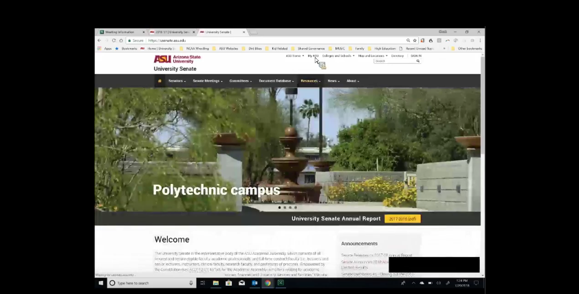
New course proposal review – step-by-step instructions
Welcome
The university Senate 1 2 3 4 5 6 7
Role of senators
Senate terminology and processes 1 2 3 4 5
Reviewing new course proposals 1 2 3
FAQs

Slide 18
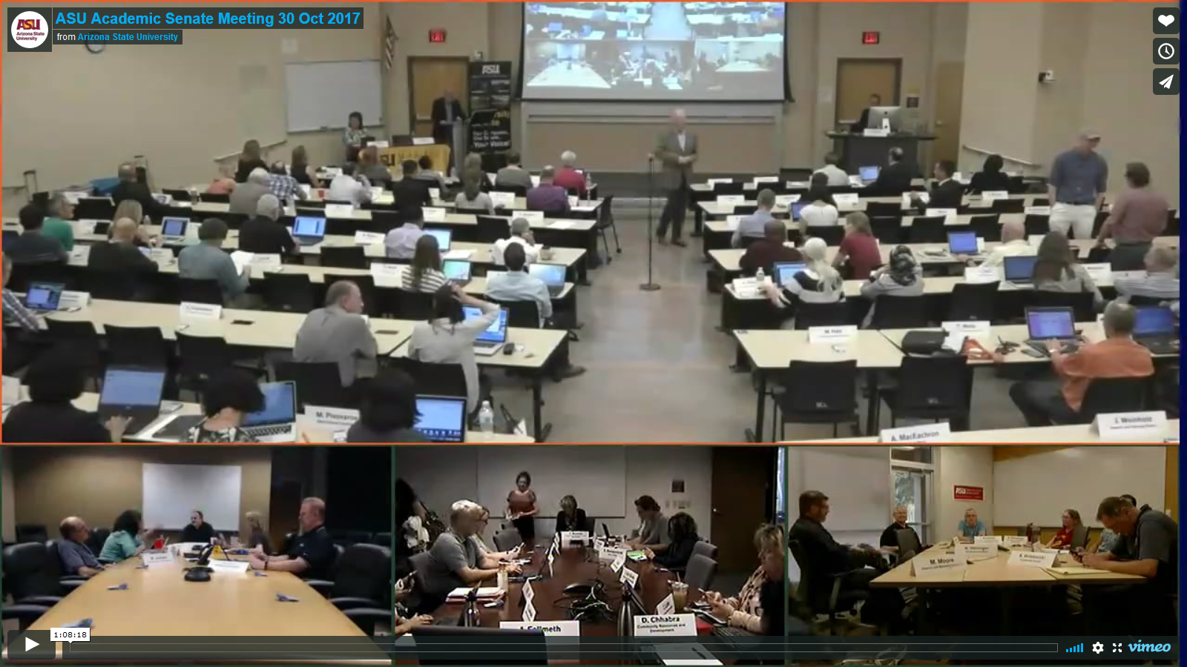
Senate meeting from 2017-18
Welcome
The university Senate 1 2 3 4 5 6 7
Role of senators
Senate terminology and processes 1 2 3 4 5
Reviewing new course proposals 1 2 3
FAQs
You may use the following link to watch a video of a recent Senate meeting. By skipping throughout the video you can find examples of Senate motion votes, new course proposal motion votes and other helpful information.

Slide 19
Frequently asked questions
Welcome
The university Senate 1 2 3 4 5 6 7
Role of senators
Senate terminology and processes 1 2 3 4 5
Reviewing new course proposals 1 2 3
FAQs
The following slides are a compilation of the most frequently asked questions when serving on the Senate.

Slide 20
FAQ 1
Welcome
The university Senate 1 2 3 4 5 6 7
Role of senators
Senate terminology and processes 1 2 3 4 5
Reviewing new course proposals 1 2 3
FAQs
When do I start, and how long is my term?
Your term begins on June 1 of the year you are elected but your first Senate meeting will not be until early the following fall semester. Your term ends on May 31, three years after your start date.
Each semester is kicked off with an Academic Assembly Reception. Invitations with exact times and locations will be sent out for this event.
You will attend your first Senate meeting on Monday, September 9, 2019

Slide 21
FAQ 2
Welcome
The university Senate 1 2 3 4 5 6 7
Role of senators
Senate terminology and processes 1 2 3 4 5
Reviewing new course proposals 1 2 3
FAQs
Where are the meetings held?
Senate meetings are video conferenced and you may attend them at any of the locations noted below. If you intend to permanently attend Senate meetings at a location other than your home campus, please notify your campus president and Pam Hoyle in the Senate Office. Parking for Senate meetings is the responsibility of each senator.
The Senate agenda is posted six days prior to the meeting and a reminder email is sent to all senators. Agendas will not be provided at meetings. Please bring a computer or print them in advance.
Click here for the 2019-20 meeting schedule.
Campus | Building | Room | Time
Downtown Phoenix | UCENT | 317 | 3 p.m.
Polytechnic | PICHO | 155 | 3 p.m.
Tempe | EDC | 117 | 3 p.m.
West | FAB | S101 | 3 p.m.

Slide 22
FAQ 3
Welcome
The university Senate 1 2 3 4 5 6 7
Role of senators
Senate terminology and processes 1 2 3 4 5
Reviewing new course proposals 1 2 3
FAQs
What if I need to miss a meeting?
Attendance at Senate meetings is critical to the success of the organization, a quorum of 50% +1 is required in order to conduct business. Three (3) unexcused absences can result in removal from the Senate.
If you need to miss a single meeting: locate a replacement and notify Pam Hoyle (pamela.hoyle@asu.edu) prior to the Senate meeting.
If you miss a meeting you must review the minutes for any important announcement or action items.
If you are going on sabbatical: request your unit to elect or assign a replacement, and then notify the Senate office.

Slide 23
FAQ 4
Welcome
The university Senate 1 2 3 4 5 6 7
Role of senators
Senate terminology and processes 1 2 3 4 5
Reviewing new course proposals 1 2 3
FAQs
Once I arrive at a Senate meeting…What do I do?
Tempe campus:
Seating chart will be provided, sit in front of the name plate provided to you and sign the attendance sheet that is passed around after the meeting begins.
Make sure you have a clicker but do not push the clicker buttons, they don’t look turned on, but they are.
Downtown Phoenix, Polytechnic and West campuses:
Open seating, make sure to sign the attendance sheet and pickup your name plate when you enter the room.
Make sure you have a clicker but do not push the clicker buttons, they don’t look turned on, but they are.

Slide 24
FAQ 5
Welcome
The university Senate 1 2 3 4 5 6 7
Role of senators
Senate terminology and processes 1 2 3 4 5
Reviewing new course proposals 1 2 3
FAQs
How do I vote?
Voting is done by using the clicker located next to your sign placard.
Do not vote until the question has been presented on the screen.
Follow the instructions on the video screen at your meeting. (Typically):
Press 1/A for Yes “in favor”
Press 2/B for No “oppose”
Press 3/C for “abstain”
Please leave the clickers in the room.
You may change your vote anytime prior to the voting question being closed…the last vote will be the only one that registers.

Slide 25
FAQ 6
Welcome
The university Senate 1 2 3 4 5 6 7
Role of senators
Senate terminology and processes 1 2 3 4 5
Reviewing new course proposals 1 2 3
FAQs
Who runs the Senate meetings?
The Senate meetings are run by the University Senate President. She/he is assisted by the campus Presidents, Parliamentarian, Senate Secretary and the Senate office staff.
Topics for discussion, and meeting agenda items are developed from Senate input, and finalized by the University Academic Council (UAC) and the Executive Committee.

Slide 26
FAQ 7
Welcome
The university Senate 1 2 3 4 5 6 7
Role of senators
Senate terminology and processes 1 2 3 4 5
Reviewing new course proposals 1 2 3
FAQs
How do I speak at a Senate meeting?
Discussion at Senate meetings is encouraged. Please state your name and unit before addressing the Senate.
The Senate adheres to Roberts Rules of Order for discussion and conducting business.
There are three typical occasions for speaking at a meeting: after the presentation of a motion, during the open forum or to ask questions of a presenter.
At the Tempe campus, approach the microphone in the center aisle, and wait to be acknowledged by the president or chair.
At the Downtown Phoenix, Polytechnic or West campuses, notify your campus president.

Slide 27
FAQ 8
Welcome
The university Senate 1 2 3 4 5 6 7
Role of senators
Senate terminology and processes 1 2 3 4 5
Reviewing new course proposals 1 2 3
FAQs
How do I get on one of the Senate Standing Committees?
The Committee on Committees will issue a preference survey to all Senators in August. This survey will ask you to indicate which committees you are most willing to serve on.
After the survey is complete the Committee on Committee evaluates preferences and develops a slate to fill all vacancies.
If you are selected for a committee, you will be notified via email.
Senators who are not placed on a committee are on standby and used as needed.
There are also task forces, and special projects that a senator might be asked to serve on as well.

Slide 28
FAQ 9
Welcome
The university Senate 1 2 3 4 5 6 7
Role of senators
Senate terminology and processes 1 2 3 4 5
Reviewing new course proposals 1 2 3
FAQs
Where do I get Senate information?
Information can be obtained from the Senate website or by contacting any of the people below:
Maria Coca Senate Manager 480-965-7940 maria.coca@asu.edu
Pam Hoyle Administrative Specialist 480-965-2222 pamela.hoyle@asu.edu
Chris Kyselka Secretary for Academic Assembly and Senate 480-727-1097 ckyselka@asu.edu

Slide 29
Welcome
The university Senate 1 2 3 4 5 6 7
Role of senators
Senate terminology and processes 1 2 3 4 5
Reviewing new course proposals 1 2 3
FAQs
If you have questions after reviewing this document, please contact your campus president or the University Senate office

