Slide 1

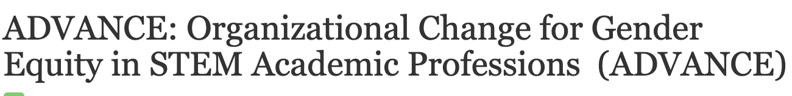


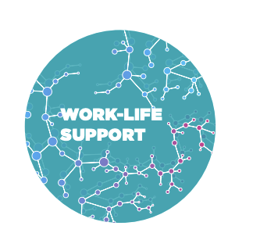


Slide 2
Three Initiatives
1
2
3
Public values;
P&T guidelines
Ensure that faculty and administrator procedures on recruiting, promotion, evaluation, and retention explicitly address how to improve equity and diversity in an interdisciplinary structure.
Digitally Enhanced Professoriate
Provide appropriate and accessible professional development and mentoring opportunities for STEM women and members of underrepresented groups across the entirety of the academic life course.
Digital Dashboard
(tracking faculty through P&T and workload)
Design, implement, and evaluate digital administrative systems to monitor equity-related processes, and empower administrators to intervene to ensure equitable opportunities and outcomes.

Slide 3
Social Science
Research Project
What is the impact of an interdisciplinary academic structure on the academic life course with a focus on equity?
A mixed-method approach to answer how intersectionality and interdisciplinarity work together to structure the academic life course at ASU and beyond.
Notes:
What is the impact of an interdisciplinary academic structure on the academic life course with a focus on equity?
A mixed-method approach to answer how intersectionality and interdisciplinarity work together to structure the academic life course at ASU and beyond.

Slide 4
Institutional Transformation Activities
Promotion to Associate Professor Guidelines
Academic Program Review (APR)
Annual Reviews for faculty, directors, deans focused on DEI
Processes for hiring including composition of search committees , bias training, rubric, and job application content (diversity statement)
Mentoring plans – especially needed for associate professors
Assessment of bias in student evaluations of teaching (Senate led)

Slide 5
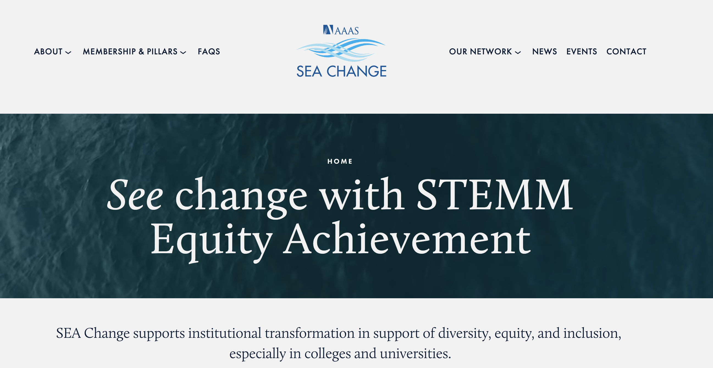
Miki Kittilson
Stefanie Pfirman
Deb Clarke
Kim Scott
Joan Brett

Slide 6

Get Involved!
Website: http://advance.asu.edu
Email: wentz@asu.edu

