Slide 1
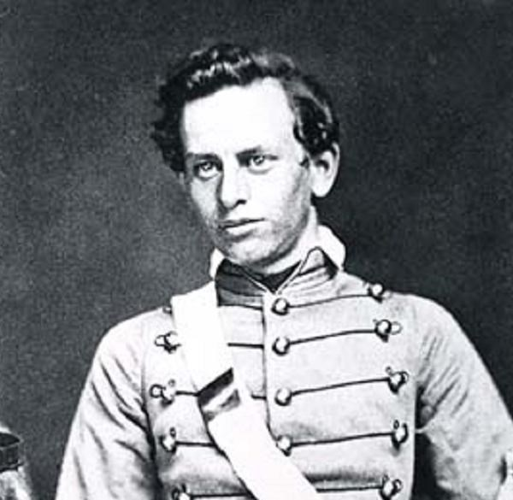
Presenter Denise Bodman Senate Meeting #2 09.02.2023
Henry Martyn Robert
Introduction to Robert’s
Rules of Order

Slide 3
Parliamentary Procedures
Consistent structure!
Ensure rights of all!
Notes:
Robert’s Rules are, simply put, one type of parliamentary procedure. There are other types of procedures and rules designed to help groups run efficiently and positively, including Marthas Rules, Atwood’s Rules, simplified rules, and various collaborative and consensus building run by trained facilitators. Effective meetings need rules and Robert’s Rules have been particularly robust and useful for bringing order to discussions, allowing all voices to be heard, and working with large groups. Small groups (12 to 25) may work well with other forms of decision making. Robert’s Rules are recognized by most organizations, including the non profit organizations, labor unions, universities, HOAs, professional organizations, and the NAACP.
What I like about Robert’s Rules is that they are pretty adaptable. They allow for change and tradition, can be used with small groups or large. They provide a consistent structure that can make meetings more efficient and effective. They ensure the rights of all people involved, allow for those taking minority positions to be heard, for free and open debate, for votes to be counted equally, and for the majority to have the right to make decisions. Don’t be mislead by thinking “the majority” always “wins” before voting. In our own senate, we saw about 3 senators completely turn around an expected majority vote simply because they very cogently presented their case and the majority sided with them.

Slide 5
