Slide 1
RFC 261: Cintana
Student Faculty Policy update – February 26
Whitney Hansen (Whitney.Hansen@asu.edu)
Student Faculty Policy Committee

Slide 2
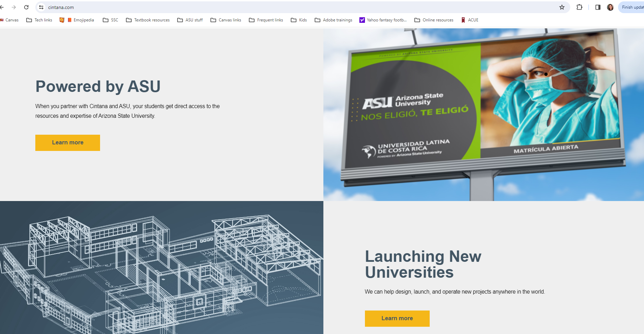
RFC 261: Cintana
Many units have received notices that their o-courses are being added to Cintana’s Content Repository (CR).
Units & faculty cannot decline to participate
Units & faculty are not compensated for the work that is submitted to the C.R.
Cintana is a for-profit company that is “powered by ASU”.
A representative from the Provost’s office said that ASU does not receive compensation for courses that are added into the CR.

Slide 3
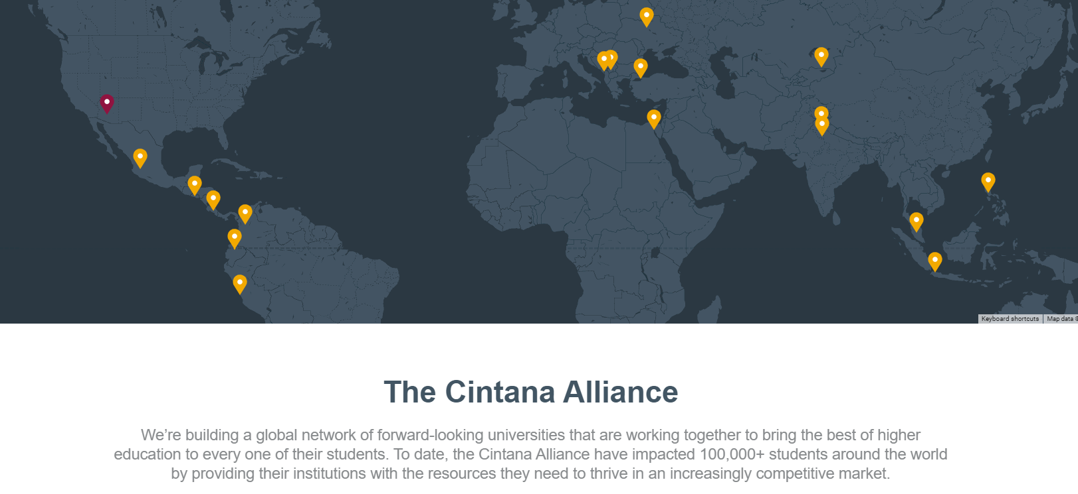
RFC 261: Cintana
Goals for RFC:
Increase transparency about the relationship between Cintana & ASU
Advocate for fair policies related to courses in the CR.
Gemma Garcia from the Provost’s office will speak about Cintana at our March Senate meeting.
If you have questions, concerns, experiences with Cintana, etc. feel free to reach out to me:
Whitney.Hansen@asu.edu

