Slide 1
Maureen McCoy MS, RD Lecturer, College of Health Solutions Faculty Advisor, Pitchfork Pantry

Slide 2
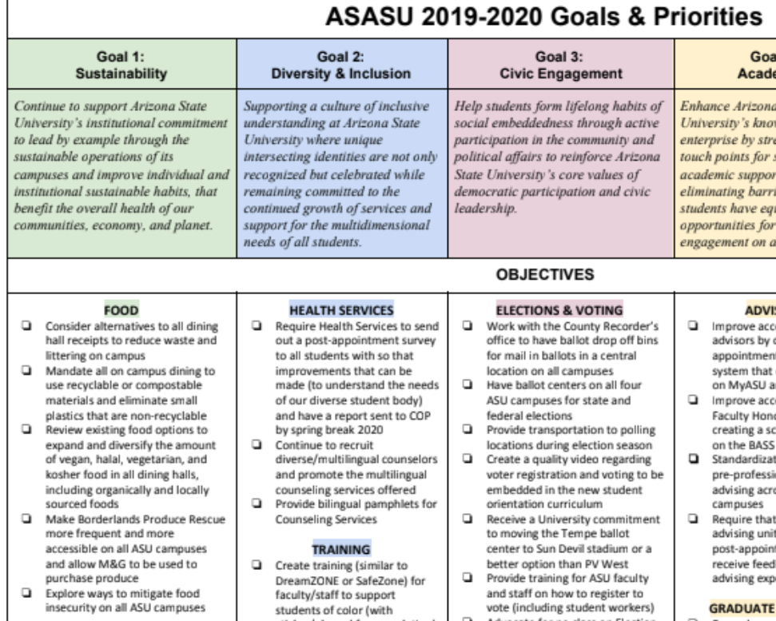
Food Insecurity
ASU Student Government has recognized food insecurity as one of the goals/priorities for 2019-2020

Slide 3
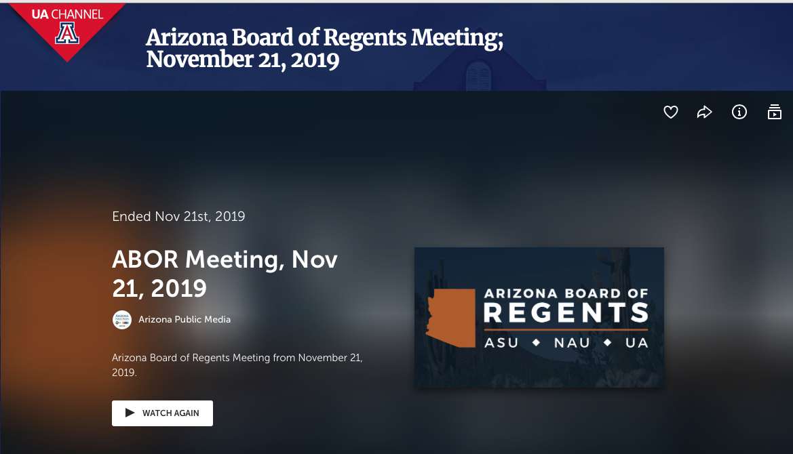
Food Insecurity

Slide 4
History
Started in 2017 after research by Dr. Meg Bruening found a 35% food insecurity rate in freshmen living in the residence halls
Locations:
Tempe: Sonora Center
Downtown: HEALab

Slide 5
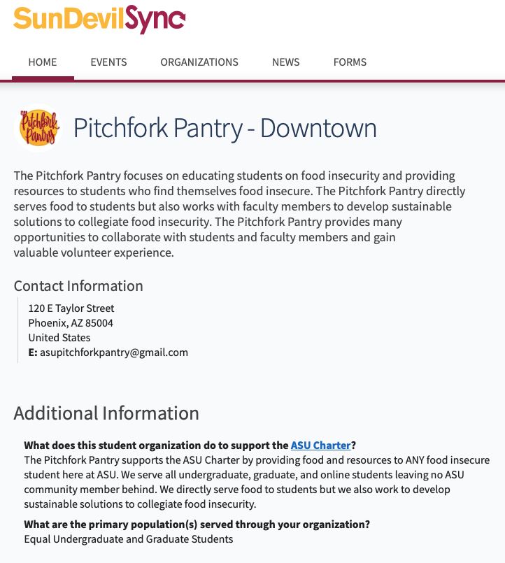
Goal

Slide 6
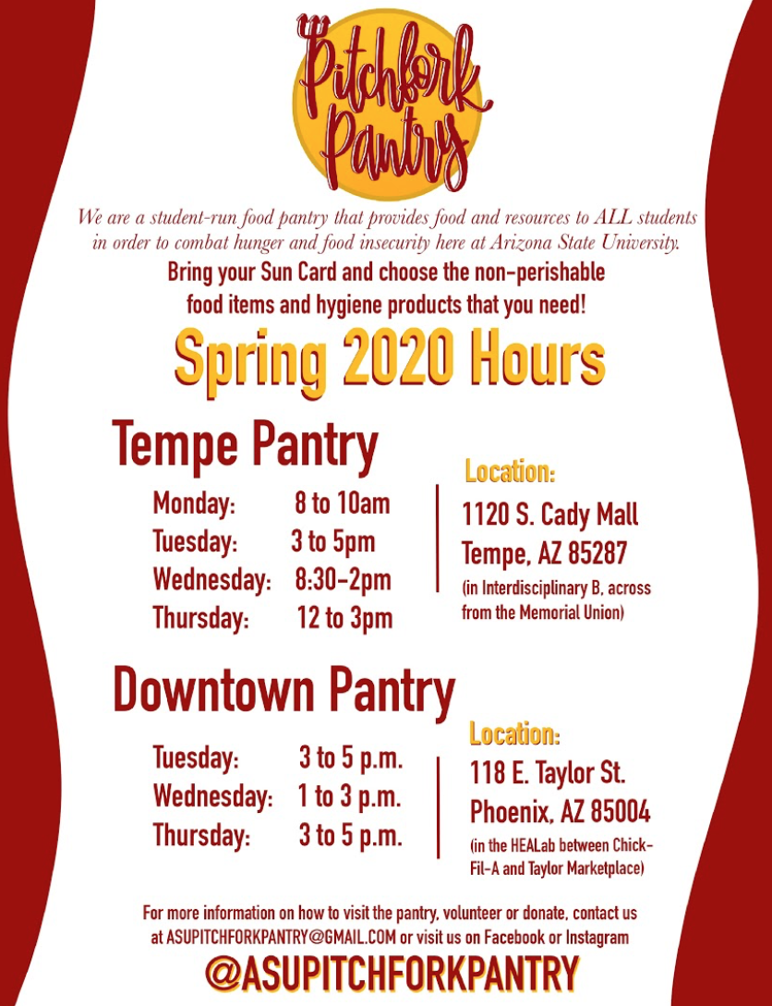
Current Locations
Tempe: Interdisciplinary B
serving 10-15 students per week
Downtown: Back of the HEALab
serving 20-25 students per week
(Edson College of Nursing and Health Innovation's Health Entrepreneurship Accelerator Lab)
East: early conversations – there is a full food bank at the House of Refuge
West: early conversations with Dean Sandrin (Vice Provost)

Slide 7
Where does the food come from?
ASU Health Inspector has currently just approved the pantry to carry non-perishable, shelf-stable food items

Slide 8
Maricopa County Food Code Restrictions
Hand Sink
Mop sink/service sink accessible within 300-feet
Volunteers have access to toilet facilities.
Appropriate lighting fixtures
NSF (National Sanitation Foundation) or commercial equivalent equipment only (fridge)
NSF 2-compartment sink
All of these would require a relationship with Aramark and written agreement

Slide 9
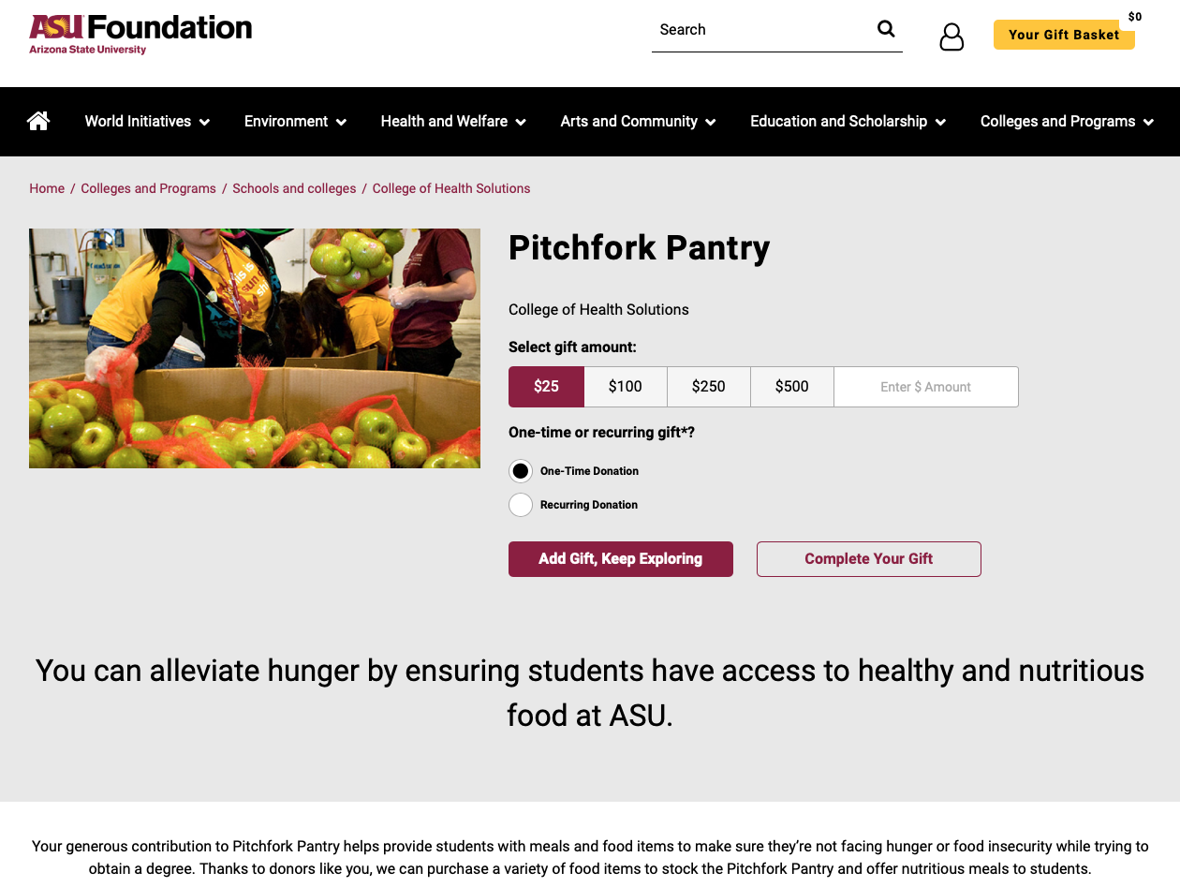
Donations
ASU Foundation has a Tax ID number that is needed by organizations like St. Mary’s in order to get an established relationship.
Currently we have around $10,000 in the account.

Slide 10
Social Media

Slide 11
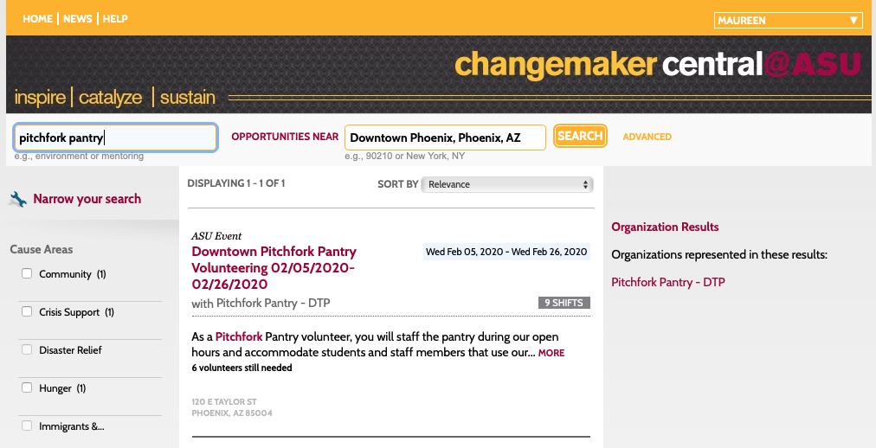
Staff/ Volunteers
2 paid student leaders – one at Tempe, one at Downtown
Volunteer opportunities listed on Volunteer Match
2 faculty advisors
Part of the 20% service requirement

Slide 12
Current Conversations
Dean of Students at Downtown and Tempe campus do not want to expand to West and Poly at this point
They see the pantry as a bandaid that is not solving the underlying issue of financial insecurity
We see ourselves as a student-run bridge to communicate with and identify students that are struggling and help them within the moment, but also point them to additional resources
Also seek to recover food that would otherwise go to waste

Slide 13
Other PAC-12 Food Pantries

Slide 14
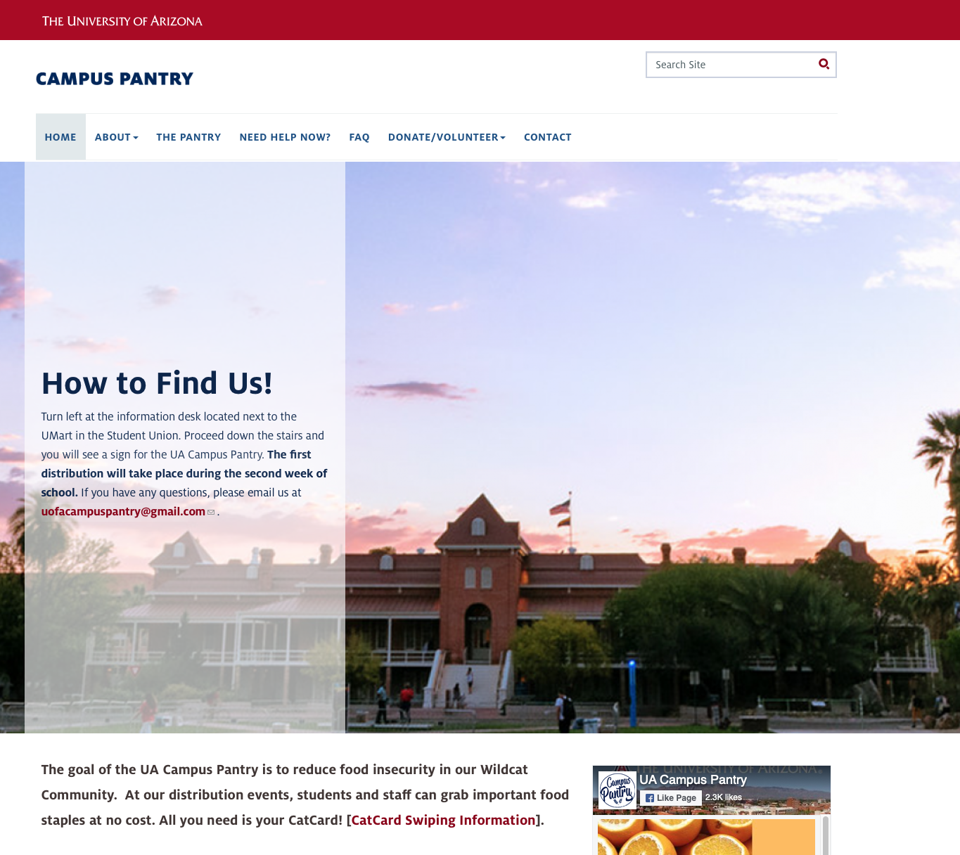
U of A – UA Campus Pantry
Website: campuspantry.Arizona.edu
Located in the Student Union.
Students swipe their “cat card” when they come in.
Relationship with food bank in Tucson, rooftop garden on their union, Swipe out Hunger, Coca Cola.
Serving hundreds of students each week.

Slide 15
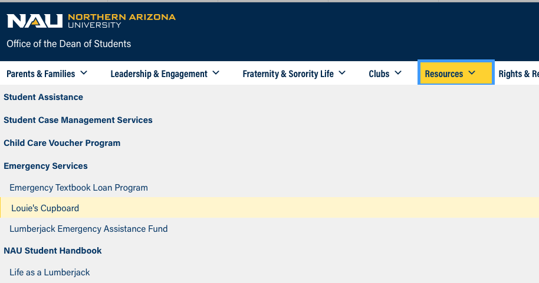
NAU – Louie’s Cupboard
Website: Located on the Dean of Students main page under “Resources”.
Located in the University Union.
Every other Friday, the students register beforehand and get nonperishable canned and boxed foods - serving around 200 students every other week.
Students developed an app that sends out a notification when there is leftover food from a catering event .

Slide 16
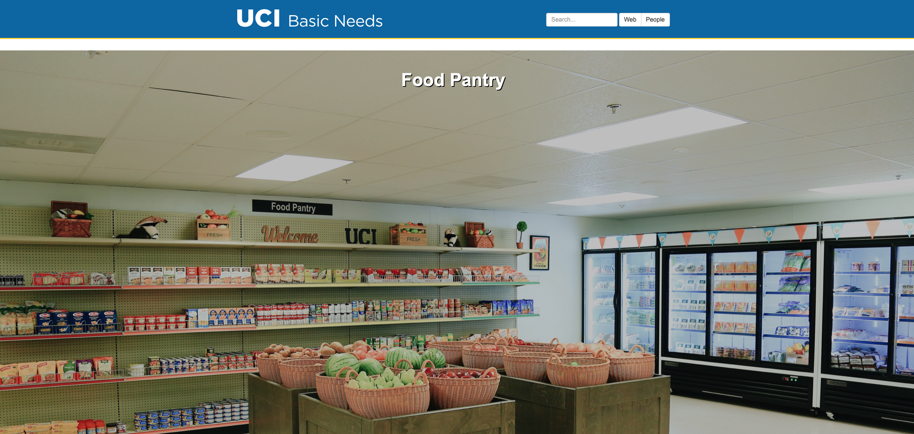
University of California, Irvine: FRESH
Website: basicneeds.uci.edu
Located in it’s own portable.
UC President Janet Napolitano approved a grand proposal that provided a one-time allocation of $75,000 for each of the 9 UC campuses to address food insecurity.
Students passed the “Food Pantry Initiative”, a student fee that allocates $3 quarterly student fees from every undergraduate.

Slide 17
University of Washington
Website: on the main Washington.edu page
Utilize a shopper and volunteer management system called “FoodBank Manager”.
Shopper and volunteer management system to communicate more effectively with shoppers and volunteers and to generate and report on more accurate data.

Slide 18
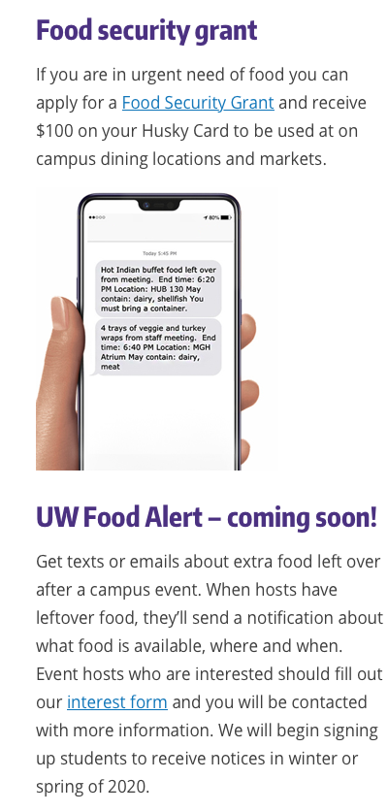
University of Washington

Slide 19
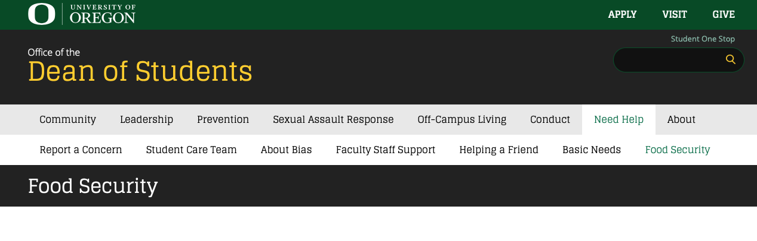
University of Oregon
Website: on the Dean of Students page
Ducks Feeding Ducks – apply online and you can get $10 added to your account to use at any campus food venue (donation component for students, employees and family members).
SNAP enrollment events held on campus each term.
Food pantry carries fresh and frozen food through a partnership with local food bank.
Ducks Leftover Textover – alerts students when there is leftover food

Slide 20
Brainstorming – Partnership Collaboratory Meeting – Feb 2020
Develop a campaign similar to “Mental Wellness” to increase awareness/acceptability of the issue
Increase awareness to staff/faculty
Leverage academic units for staffing
Internships, Americorps, Watts College, Lode Star, Class Projects
Reduce stigma
Pantry credit towards Starbucks
Messaging
Storytelling
Health Services/counseling
Food delivery
Harness food leftover from sports games
Catch incoming freshmen and inform them of resource
Consider the leftover app – students that have previously ‘liked’ the Instagram/Facebook Pitchfork Pantry page would get notifications
Build ‘students helping students’ network
Continue Swipe out Hunger conversation
Mobile food truck

Slide 21
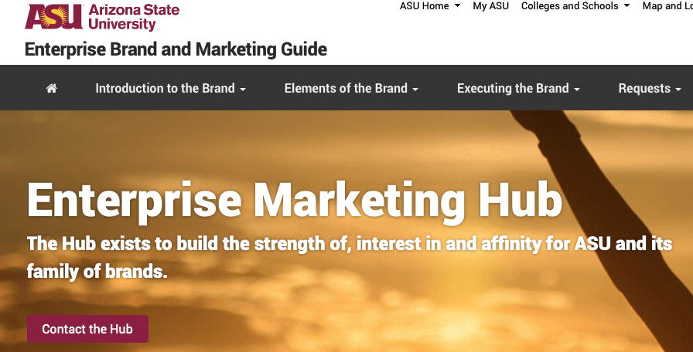
Recent Connections

Slide 22
Next Steps?
We are still interested in expanding the reach of the pantry and continue conversations with the Deans of Students
Work with marketing to expand outreach
Start to carry perishable food items/pop-up events
Work with Watts college Action Nexus
Connect students to resources

Slide 23
Thank you!
maureen.mason@asu.edu

