Slide 1
ASU Benefits Overview
Kevin Salcido
Judy Cato

Slide 2
Health & Welfare Programs
Offered through the Arizona Department of Administration (ADOA) with no ASU input
Arizona universities represent 1/3 of total pool
Studies have shown that these university employees subsidize the pool
Our preferred arrangement would be our own plan
Cost | Communication
Control | Culture

Slide 3
ASU shares major portion of expense
EPO Price Structure
 | Employee Monthly |  |  | ASU Monthly |  | # and % enrolled
Employee | $45.32 | 7% |  | $582.62 | 93% | 3,629 – 33%
Employee & Spouse | $134.83 | 10% |  | $1,197.01 | 90% | 1,382 – 13%
Employee & Child | $114.43 | 13% |  | $777.53 | 87% | 540 – 5%
Family | $250.39 | 16% |  | $1,311.41 | 84% | 2,646 – 24%
 |  |  |  |  |  | 8,197 – 75%

Slide 4
ASU shares major portion of expense
PPO Price Structure
 | Employee Monthly |  |  | ASU Monthly |  | # and % enrolled
Employee | $115.57 | 16% |  | $592.15 | 84% | 893 – 8%
Employee & Spouse | $243.60 | 19% |  | $1,252.09 | 81% | 323 – 3%
Employee & Child | $163.15 | 16% |  | $837.91 | 84% | 114 – 1%
Family | $284.38 | 16% |  | 1,460.78 | 84% | 738 – 7%
 |  |  |  |  |  | 2,068 – 19%

Slide 5
ASU shares major portion of expense
HDHP Price Structure
 | Employee Monthly |  |  | ASU Monthly |  |  | ASU HSA Monthly | # and % enrolled
Employee | $22.00 | 6% |  | $394.06 | 94% |  | $60 | 364 - 3%
Employee & Spouse | $66.00 | 7% |  | $816.72 | 93% |  | $120 | 101 - 1%
Employee & Child | $56.10 | 10% |  | $533.89 | 90% |  | $120 | 33 - 0.3%
Family | $122.10 | 12% |  | $909.94 | 88% |  | $120 | 228 - 2%
 |  |  |  |  |  |  |  | 726 - 7%

Slide 6
Retirement plans - mandatory
Arizona State Retirement System (ASRS)
Defined Benefit – Pension Plan
Employee Pays 11.94%
ASU Pays 11.94%
Optional Retirement Plan (ORP)
Defined Contribution – 401(a) Plan
Employee Pays 7%
ASU Pays 7%

Slide 8
Underutilized plans
Voluntary group plans
Auto
Life
Voluntary retirement plans
403 (b)
457 (f)
Tuition waiver

Slide 9
Total Compensation & Benefits Statement

Slide 10
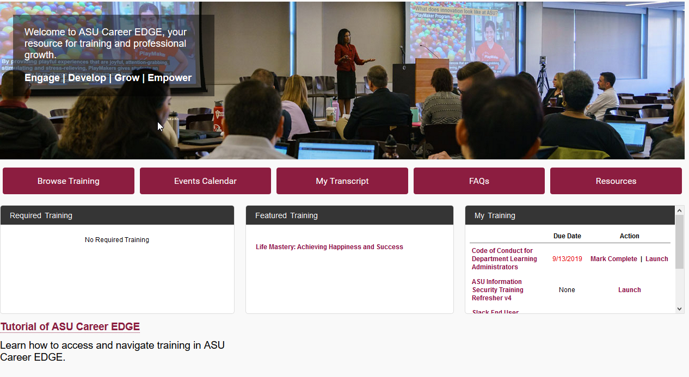

Slide 11
Thank you!
Questions?

