Slide 1
Curriculum And Academic Programs Committee (CAPC)
Annual Report 2022-23
Claudia Sadowski – Smith, Chair

Slide 2
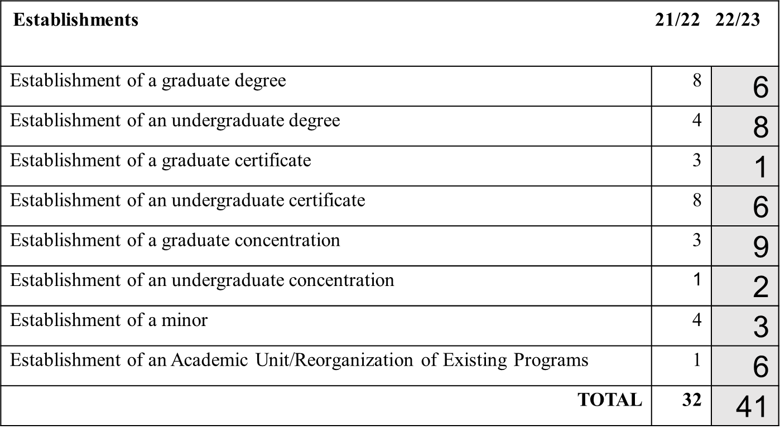
74 curricular proposals went before the Curriculum and Academic Program Committee:

Slide 3
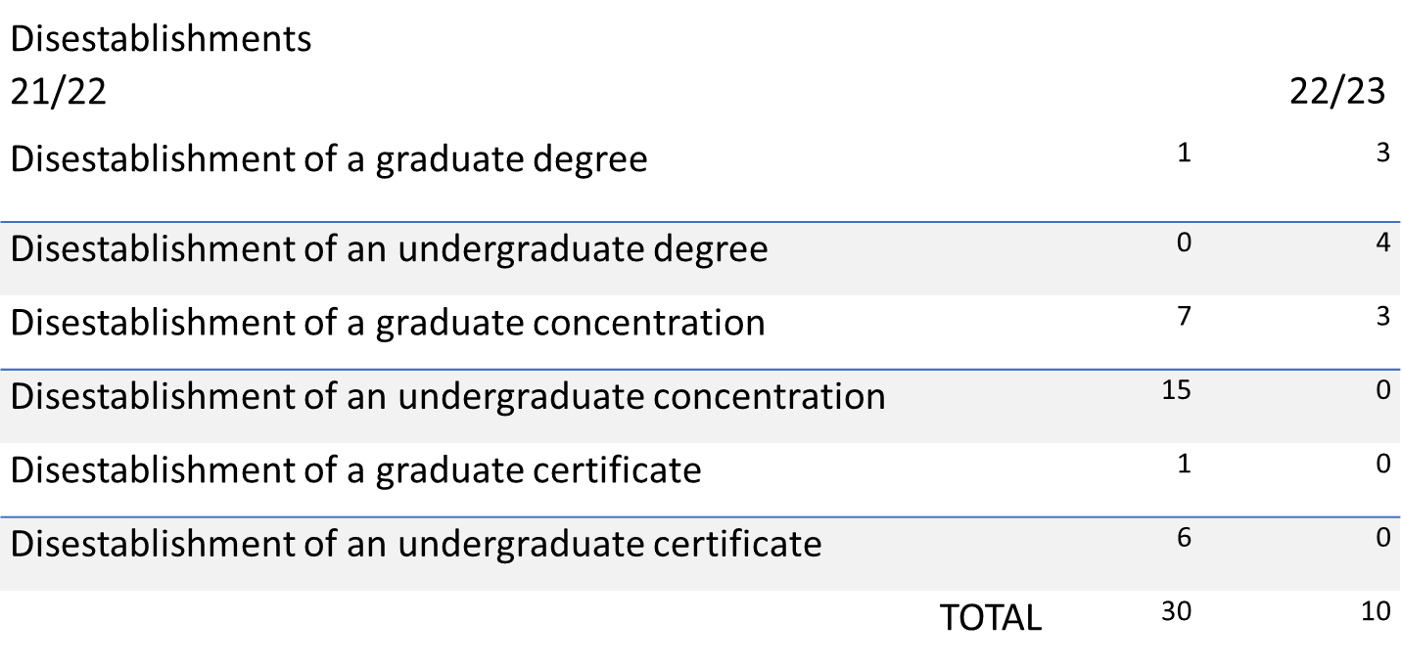
74 curricular proposals went before the Curriculum and Academic Program Committee:

Slide 4
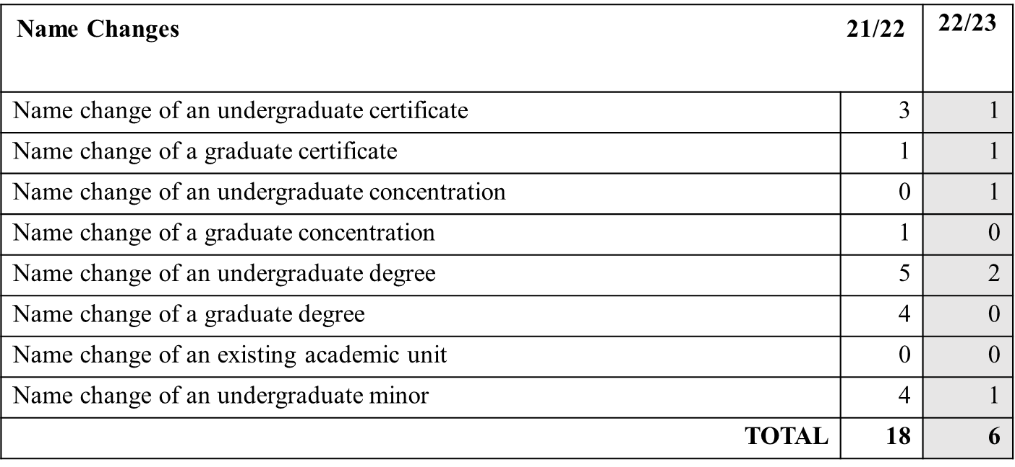
74 curricular proposals went before the Curriculum and Academic Program Committee:

Slide 5
74 curricular proposals went before the Curriculum and Academic Program Committee:

Slide 6
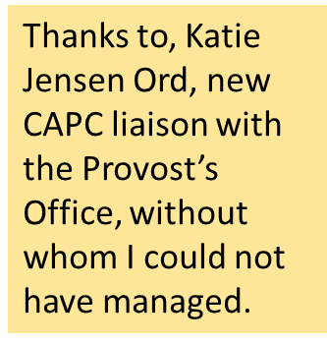
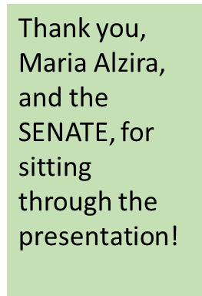
74 curricular proposals went before the Curriculum and Academic Program Committee:
Thanks to Denise Bodman, previous CAPC chair, for teaching me the ropes and for your unwavering support and advice!

