Slide 1
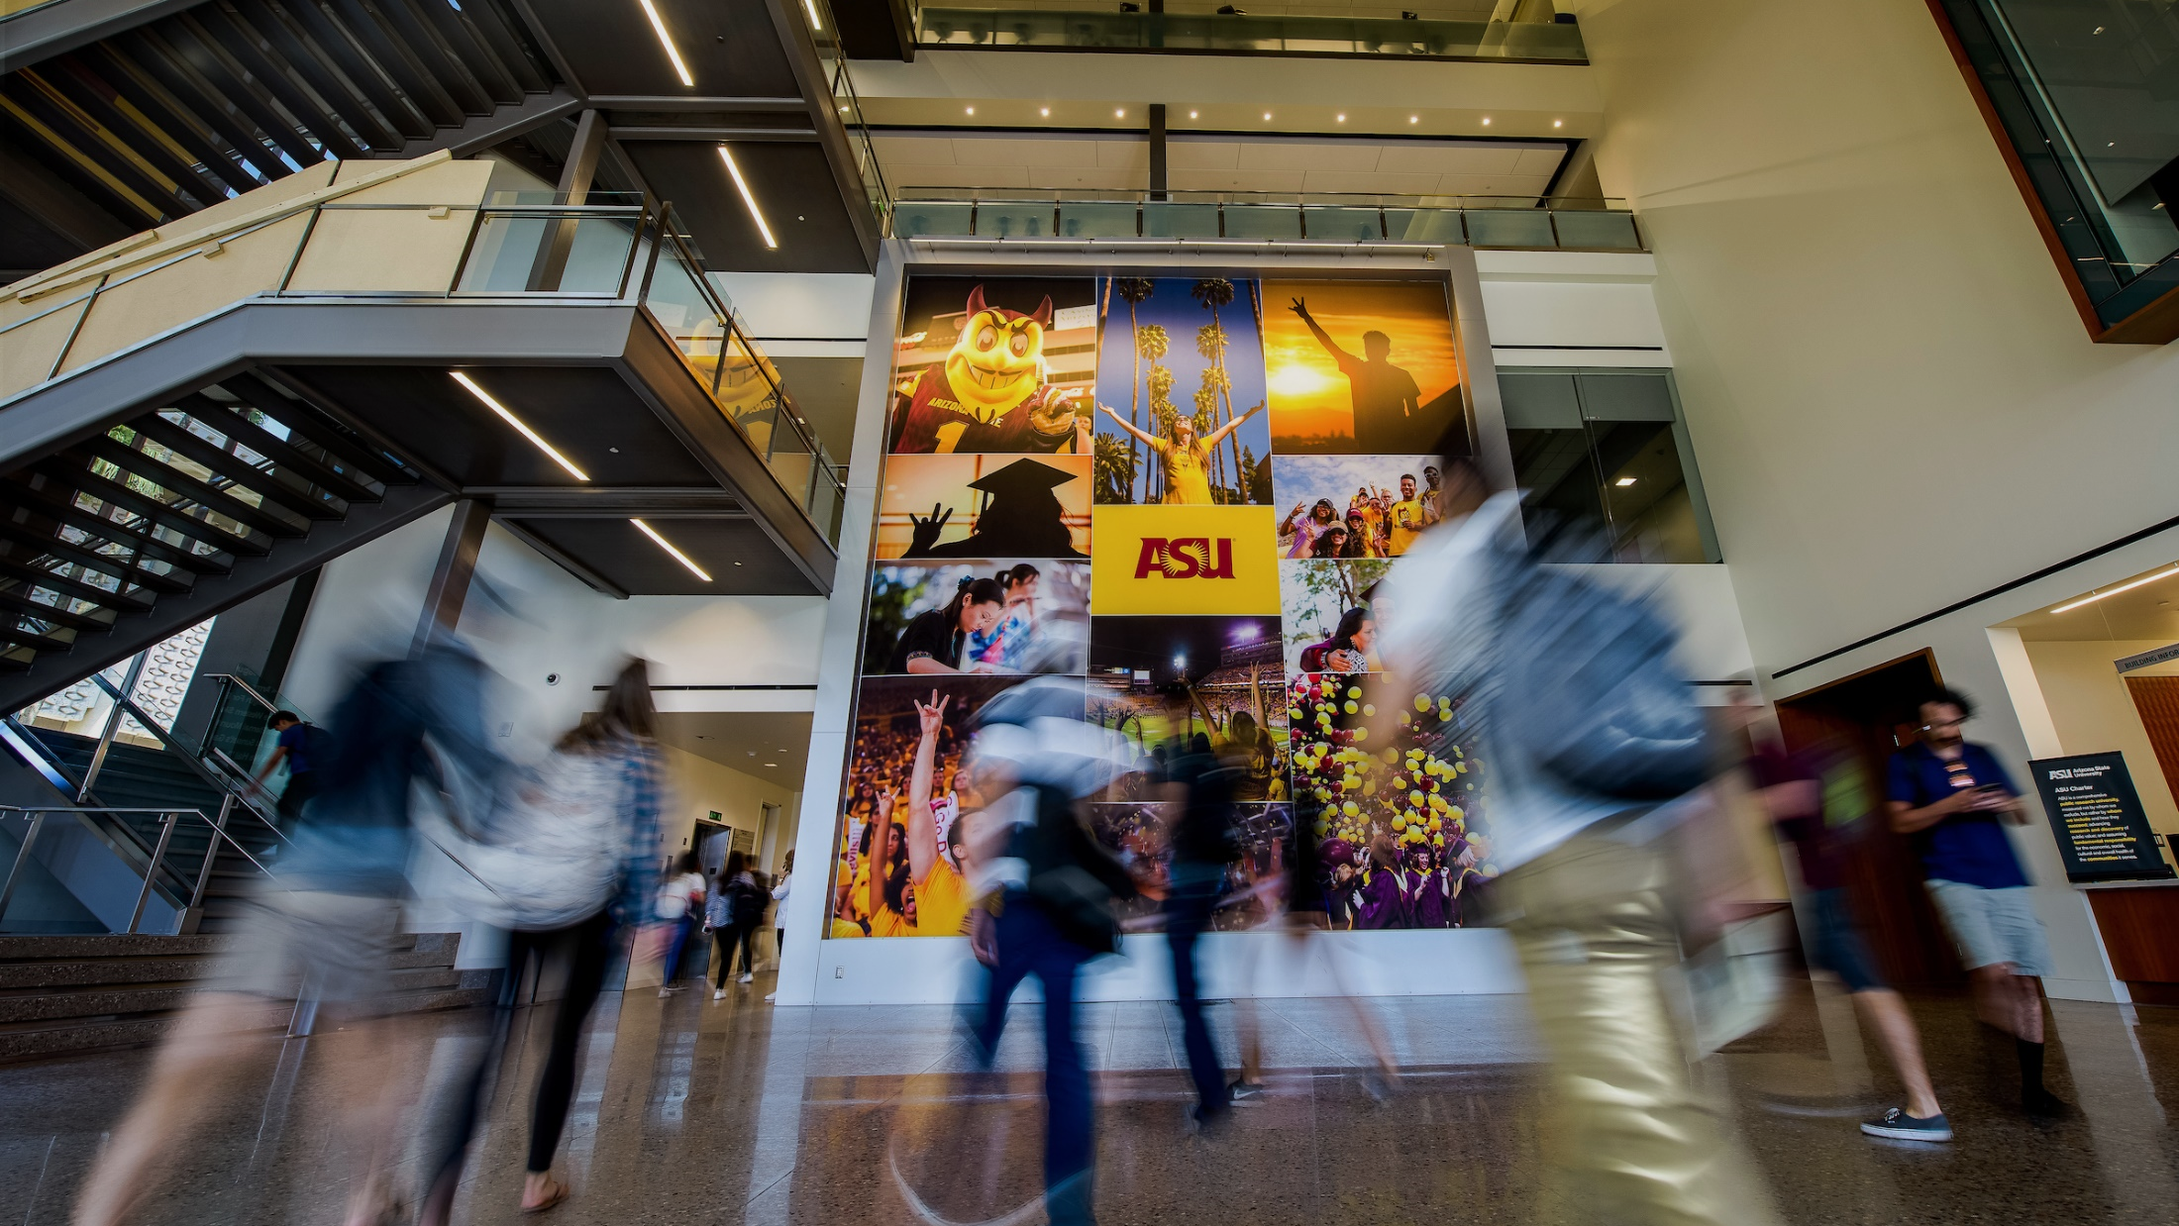
General Studies Pilot
General Studies Revision Open Forum
Discussion with the University Senate
April 6, 2020

Slide 2
ASU Charter
ASU is a comprehensive public research university, measured not by whom it excludes, but by whom it includes and how they succeed; advancing research and discovery of public value; and assuming fundamental responsibility for the economic, social, cultural and overall health of the communities it serves.

Slide 3
General education: purpose
The university’s education programs should represent the distinctiveness of the university while providing graduates with the knowledge, including concepts, skills, competencies, and intellectual habits that prepare them to take their place in our republic and the world. It should prepare graduates to pursue careers or advanced degrees, and participate fully as informed citizens in a robust constitutional democracy based in values of individual freedom, self-reliance, and equality under the law, diversity, inclusion and constructive dialog through civil discourse. As advances in technology also promote exponential increases in human knowledge, graduates need the foundational cognitive and behavioral skills necessary to adapt quickly to change. In this environment of rapidly evolving knowledge, universities should design general education and majors such that graduates’ persistence, resiliency and adaptability are realized via the whole of the curriculum.
(ABOR 2-210)

Slide 4
Task force members
Scott Barclay, School of Social and Behavioral Sciences
Tannah Broman, College of Health Solutions
Sara Brownell, School of Life Sciences
Megha Budruk, School of Community Resources and Development
Frederick Corey, Office of the Provost
Sukhwant Jhaj, Office of the Provost
Joan McGregor, School of Historical, Philosophical and Religious Studies
Darryl Morrell, The Polytechnic School
Shirley Rose, Department of English

Slide 5
Guidance and inspiration
The task force was guided and inspired by the members of the 2013 NextGenEd Working Group, including Ariel D. Anbar, Mark Lussier, Patience Akpan-Obong, Stephani Etheridge-Woodson, Richard Herrera, Helene Ossipov and Michael Stancliff.
NextGenEd: Rethinking General Education at ASU
Preliminary Report of the Provost’s General Education Working Group Arizona State University
December 2013

Slide 6
Fundamental difference between the existing model and a thematic approache
ASU’s current distribution model for general education does not make connections among areas of knowledge. In the current model, knowledge is categorized by discipline, without much attention to multidisciplinary work or application.
With the proposed design, which is based on learning organized around a theme, emphasis is on integration of learning and on developing habits of mind necessary for lifelong learning.

Slide 7
General education at ASU
General education integrates rapidly changing knowledge and perspectives across multiple disciplines through four key competencies:
inquiry
collaboration
innovation
engagement
Such competencies cultivate learning, persistence, adaptability and resiliency to address society's greatest and most pressing challenges through creative, purpose-driven problem solving. Inquiry, collaboration, innovation and engagement nurture intellectual integrity and curiosity, empathy, and the pursuit of truth, while promoting an engaged, civic-minded citizenry.

Slide 8
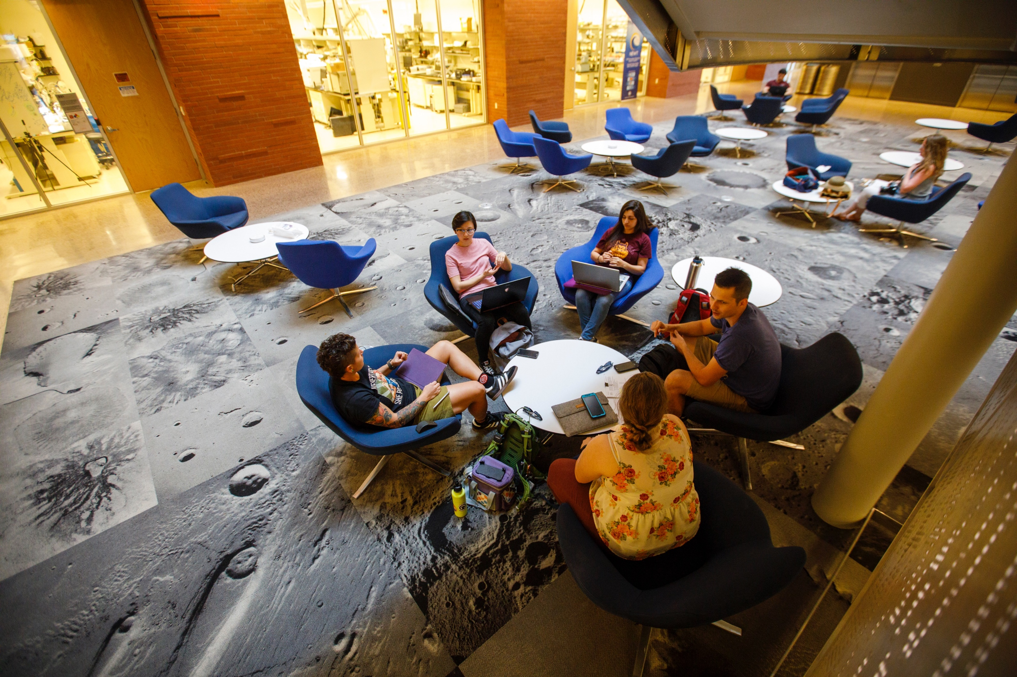
Pilot theme
Transformations

Slide 9
Parameters of the pilot program
Includes all first-year students on the West campus (an estimated 800 for Fall 2020).
Is based on the theme “Transformations.”
Incorporates courses ranging from fields as diverse as biology to political science, philosophy, English, American studies, psychology, and arts and performance.
Works for degrees ranging from English to early education, forensic science, community health and business administration.
Engenders knowledge and appreciation of American Institutions.
Incorporates knowledge of sustainability, a hallmark of ASU.
Integrates additional on-campus activities and partners including First-Year Composition, Summer Community Read, TedEx, Transformational Communities, and Barrett, The Honors College.

Slide 10
Foundations of the pilot program
The pilot is a coordinated and curated subset of ASU’s existing general studies requirements:
First-Year Composition
Core Areas
Literacy and Critical Inquiry
Mathematical Studies
Natural Sciences
Humanities, Arts and Design
Social and Behavioral Sciences
Awareness Areas
Cultural Diversity in the United States
Global Awareness
Historical Awareness

Slide 11
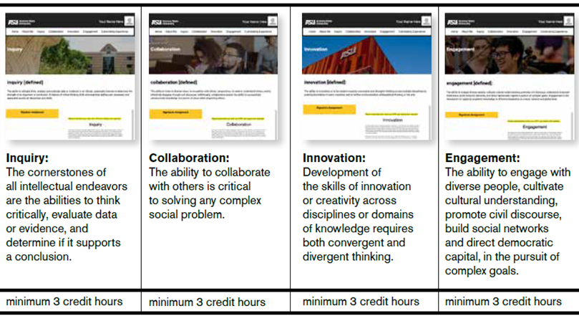
Theme-based courses
Four Competencies:
Introduction course (3 hours)
Curated content courses (minimum 12 hours)
Signature experience (3 hours)

Slide 12
Transformations: Curated courses
Frameworks 3 credits | Inquiry 3 credits | Collaboration 3 credits | Innovation 3 credits | Engagement 3 credits | Signature Experience 3 credits
Global Transformations (1 credit) Disciplinary Transformations (1 credit) Connections (1 credit) Includes Baseline Assessment | Courses in which students think critically, evaluate data, assess evidence in support of an argument, apply ethical standards, differentiate between fact and inference, and understand diverse theoretical perspectives. Samples PSY 101: Introduction to Psychology POS 314: The American Presidency HST 439: Athenian Democracy | Courses that incorporate teamwork and collaboration, group problem solving, listening to diverse points of view, empathic thinking, and effective disagreement through civil discourse and respect for others. Samples CRJ 100: Introduction to Criminal Justice IAP 222: Games and Ethics COM 263: Elements of Intercultural Communication | Courses that develop skills in innovation, creative problem solving and interdisciplinary thinking through original projects, research or creative activities that advance mission-focused goals such as inclusion, entrepreneurship or sustainability. Samples DST 101: Introduction to Disability Studies PHI 103: Principles of Sound Reasoning ENG 365: History of Film | Courses where students engage with diverse people, cultivate cultural understanding, build social networks, direct democratic capital and pursue civic engagement and civil discourse grounded in fundamental civic knowledge. Samples POS 313: The Congress HST 355: Total War and Crisis of Modernity POS/SOC 437: Women, Power and Politics | TRANSFORMATIONS Students will choose from a select list of courses and experiences that incorporate integrative material on transformations; applications of inquiry, collaboration, innovation and engagement; and an assignment with common attributes that will be used for assessment. Includes Summative Assessment

Slide 13
Assessment
A baseline assessment is conducted in the introductory course.
Uses a digital portfolio model of assessment, including artifacts from select general studies courses.
Uses standardized rubrics across disciplines.
Incorporates outcomes assessment of general studies longitudinally across the thematic program.
Uses a common rubric in the Signature Experience to conduct a summative assessment.

Slide 14
Knowledge, skills and attributes
ABOR 2-210
Sample ASU Curriculum
Knowledge
Literature, Fine Arts, Humanities
Social and Behavioral Sciences
American Institutions, including Economic Theory and U. S. History
Natural Sciences
Composition, Communication and Rhetoric
Mathematics and Quantitative Reasoning
Ethics
BA in Communication
American Literature
Introduction to Psychology
The American Presidency
Biology: The Living World
First-Year Composition
College Mathematics
Moral Dilemmas

Slide 15
Knowledge, skills and attributes
ABOR 2-210
Sample ASU Curriculum
Skills
Written and oral communication
Critical thinking
Teamwork
Intercultural competency
Information and data literacy
Ability to engage in civil discourse
Time management
BA in Communication
Rhetorical Composition and Public Speaking
Introduction to Communication Inquiry
Small Group Communication
Elements of Intercultural Communication
Social Statistics
The Congress
Embedded in all ASU courses

Slide 16
Knowledge, skills and attributes
ABOR 2-210
ASU’s General Studies Competencies
Attributes
Intellectual Integrity and Curiosity
Empathy
Pursuit of Truth
Engaged Civic-Minded Citizens
Inquiry, collaboration innovation and engagement require intellectual integrity and curiosity, the ability to think critically and evaluate data and evidence, empathy and an understanding of other’s perspectives, convergent and divergent thinking in pursuit of truth and sustainable solutions to real-world problems. In keeping with the Charter, ASU and its graduates assume fundamental responsibility for the economic, social, cultural and overall health of the communities it serves.

