Slide 1
General Studies
Transformations
New College
Patricia Friedrich, PhD
Associate Dean for Academic Programs and Faculty Affairs

Slide 2
Parameters of the program
Includes all first-year students of the West campus (an estimated 800 for Fall 2020).
Is based on the theme Transformations across disciplines.
Works for degrees as different as English, Early Education, Forensic Science, Community Health, and Business Administration.
Maintains the existing GS audit, which will continue for transfer students even when thematic GS is university-wide, but offers a
thematic alternative to all first-time, full time students.
Continues to operate through DARS since the new system is superimposed on the existing one (number and kind of GS
requirement continues to exist as is).

Slide 3
Parameters of the program Cont.
Uses a digital portfolio model of assessment, including artifacts from select GS courses.
Incorporates additional on-campus activities and partners including First-Year Composition, Summer Community Read, TedEx, Transformational Communities, and Barrett, the Honors College.
Incorporates knowledge and appreciation of American Institutions.
Incorporates knowledge of sustainability since it is one of the hallmarks of ASU.
Incorporates outcomes assessment of general studies for the first time and longitudinally across the thematic program.

Slide 4
Parameters of the program Cont.
Confers a Certificate in the Study of Transformation for those who complete the 18 credits.
To our knowledge, offers for the first time in a major US institution a thematic program to all students rather than an opt-in alternative.
Incorporates courses ranging from fields as diverse as Biology, Political Science, Philosophy, English, American Studies, Disability, Studies, and Arts and Performance just to cite a few.
Allows the students to step outside their disciplines to think like a philosopher, a scientist, an artist, etc.

Slide 5
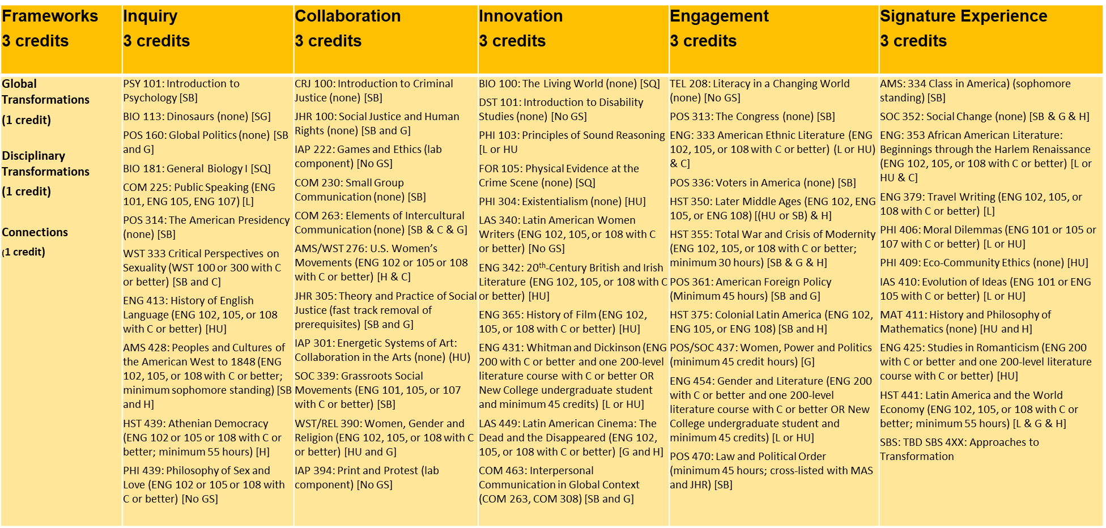
Transformations Program

