Slide 1
Provost Updates for
University Senate
Nancy Gonzales
Executive Vice President and University Provost
February 27, 2023
Copyright © 2023 Arizona Board of Regents

Slide 2
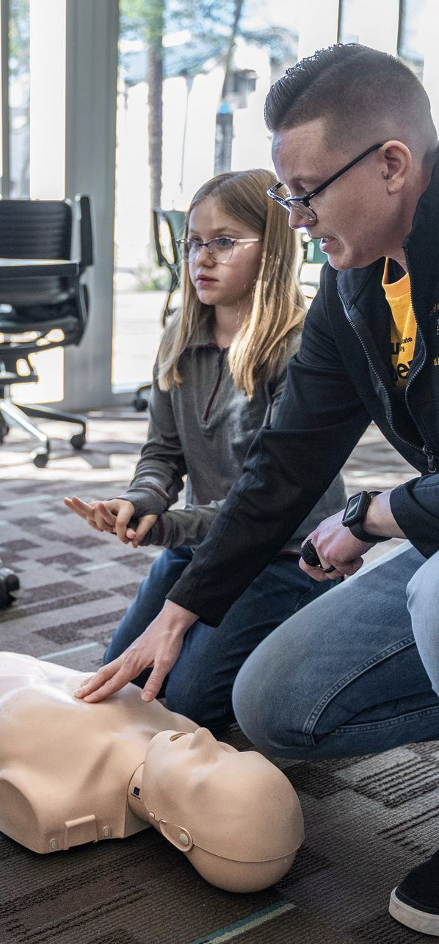
Thank you for a successful
Open Door 2023
Downtown Campus
Saturday, Jan. 28
West Campus
Saturday, Feb. 4
Polytechnic Campus
Saturday, Feb. 18
Tempe Campus
Saturday, Feb. 25
Copyright © 2023 Arizona Board of Regents

Slide 3
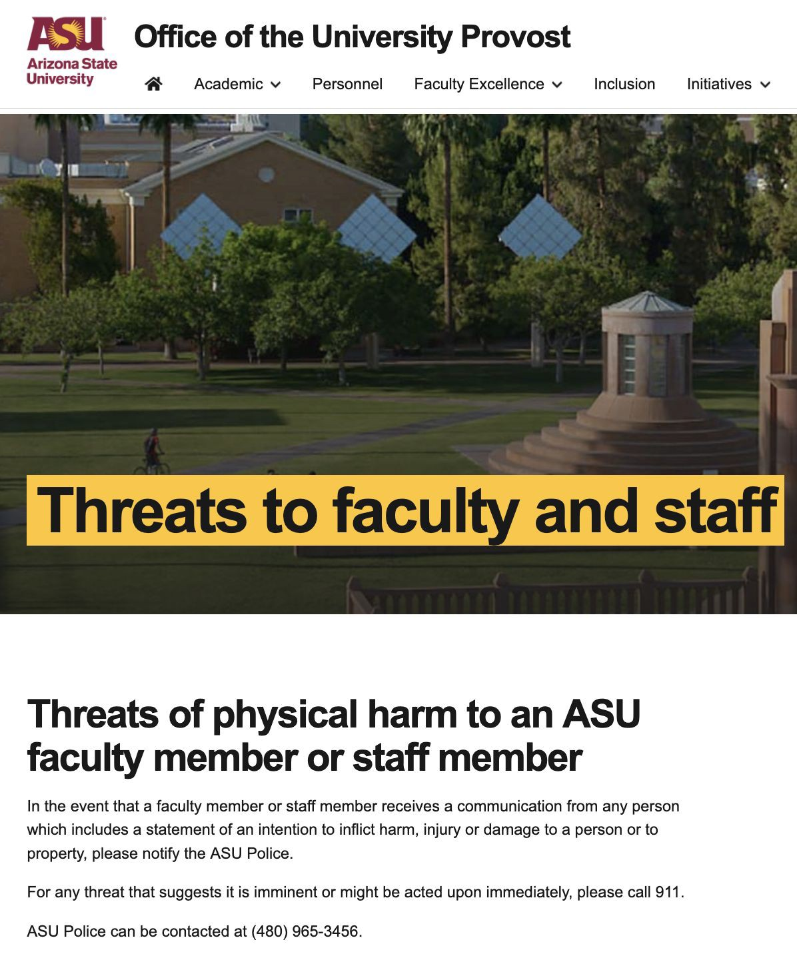
Support for faculty members who experience threatening behaviors, harassment or intimidation
Visit
https://provost.asu.edu/threats
Additional resources
https://cfo.asu.edu/behavior-response-team
Copyright © 2023 Arizona Board of Regents

Slide 4
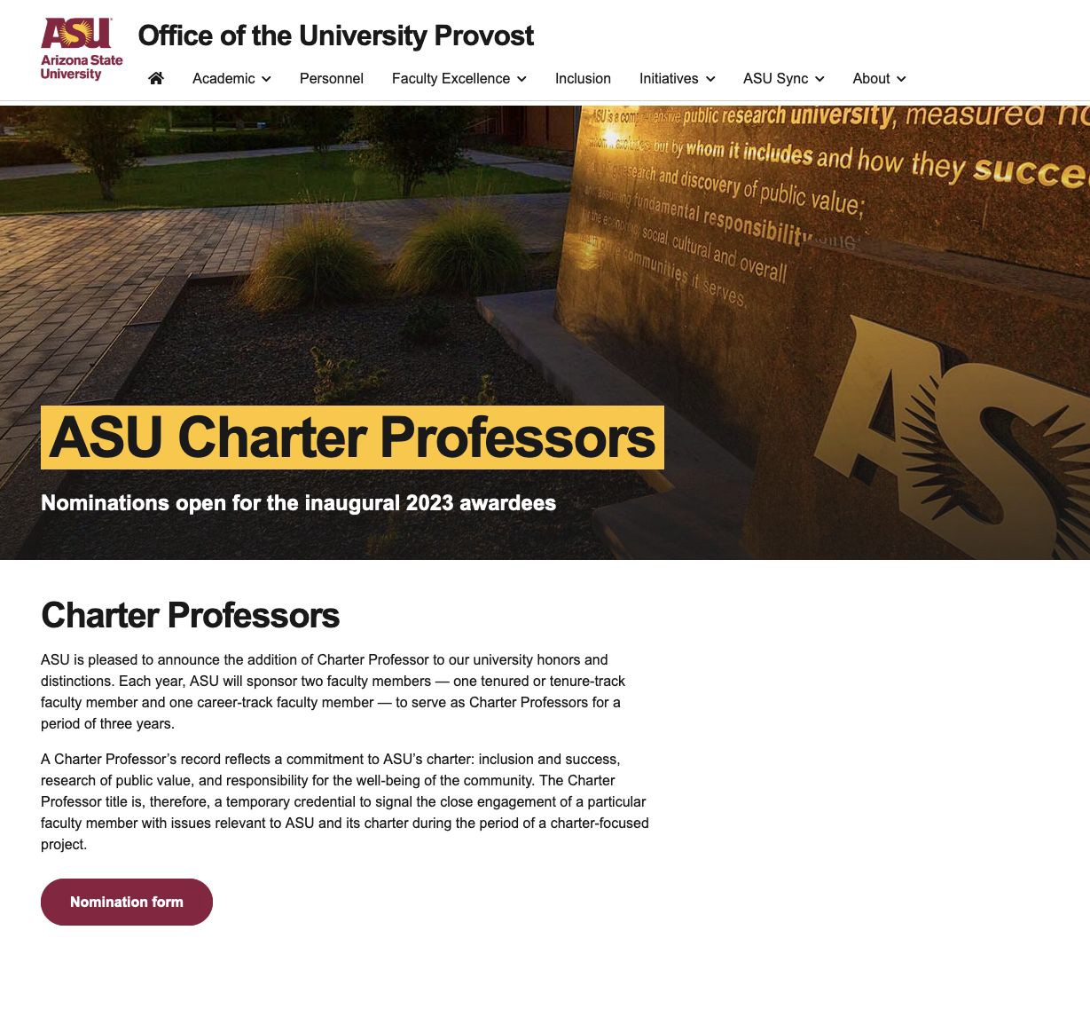
Announcing
Charter
Professors Awards
ASU is pleased to announce the addition of Charter Professor to our university honors and distinctions. Each year, ASU will sponsor two faculty members — one tenured or tenure-track faculty member and one career-track faculty member — to serve as Charter Professors for a period of three years.
A Charter Professor’s record reflects a commitment to ASU’s charter: inclusion and success, research of public value, and responsibility for the well-being of the community. The Charter Professor title is, therefore, a temporary credential to signal the close engagement of a particular faculty member with issues relevant to ASU and its charter during the period of a
charter-focused project.
Visit
https://provost.asu.edu/charter-professor
C
opyright © 2023 Arizona Board of Regents

Slide 5
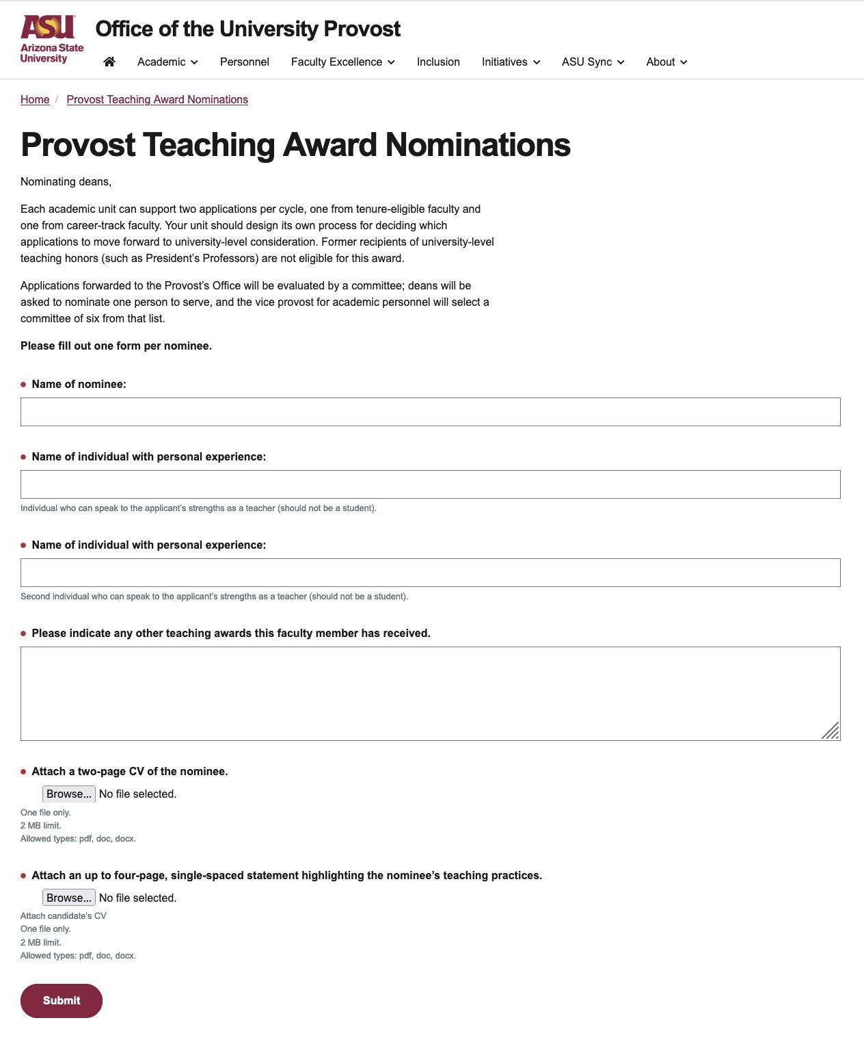
Announcing
Provost
Teaching Awards
Each academic unit can support two applications per cycle, one from tenure-eligible faculty and one from career-track faculty. Former recipients of university-level teaching honors (such as President’s Professors) are not eligible for this award.
Applications forwarded to the Provost’s Office will be evaluated by a committee; deans will be asked to nominate one person to serve, and the vice provost for academic personnel will select a committee of six from that list.
Visit
https://provost.asu.edu/provost-teaching-award-nominations
C
opyright © 2023 Arizona Board of Regents

