Slide 1
University Senate Library Liaison Committee Report Transition from Web of Science to SCOPUS
Presenter Name: Sarah Bolmarcich Location: University Senate Date: Monday, November 23, 2020
Notes:
This version is often used by the President’s office.

Slide 2
Starting January 1, 2021, ASU Libraries will no longer subscribe to Web of Science. The libraries will use SCOPUS instead.
I. Reasons for the decision
II. Preparation and resources for the transition
III. Other notes
IV. Contact information
V. Questions?

Slide 3
ASU Libraries, annual information resources budget
Library information resources budget (aggregate): $11.543 million
University contribution to partially balance inflation: $400,000
Total allocated:
$11.943 million + an annual deficit of usually several hundred thousand
Notes:
Budget information courtesy of the ASU Libraries.

Slide 4
ASU libraries, breakdown of annual information resources expenses budget
Notes:
Budget information courtesy of the ASU Libraries.

Slide 5
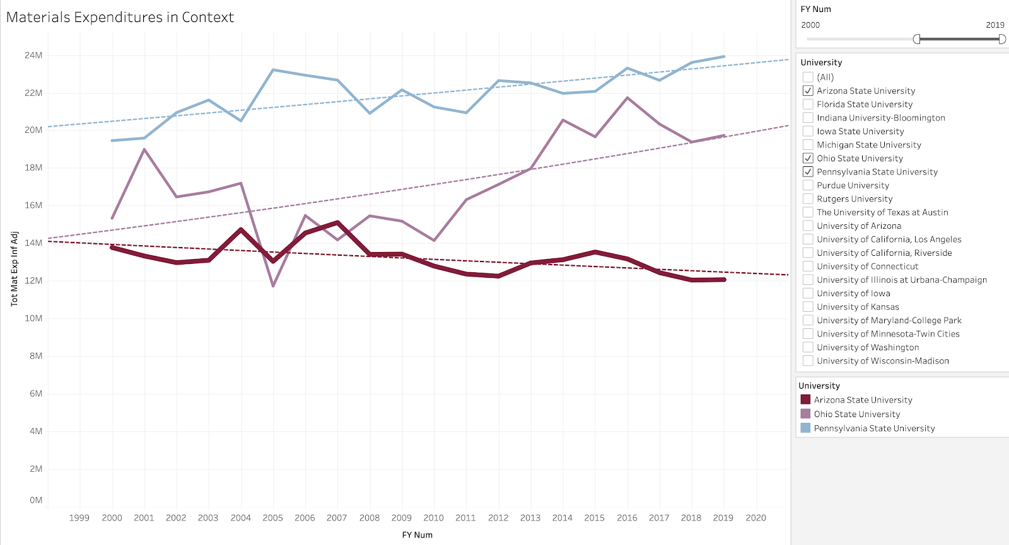
ASU vs. peer institutions, figure 1
Notes:
Figure courtesy of the ASU Libraries.

Slide 6
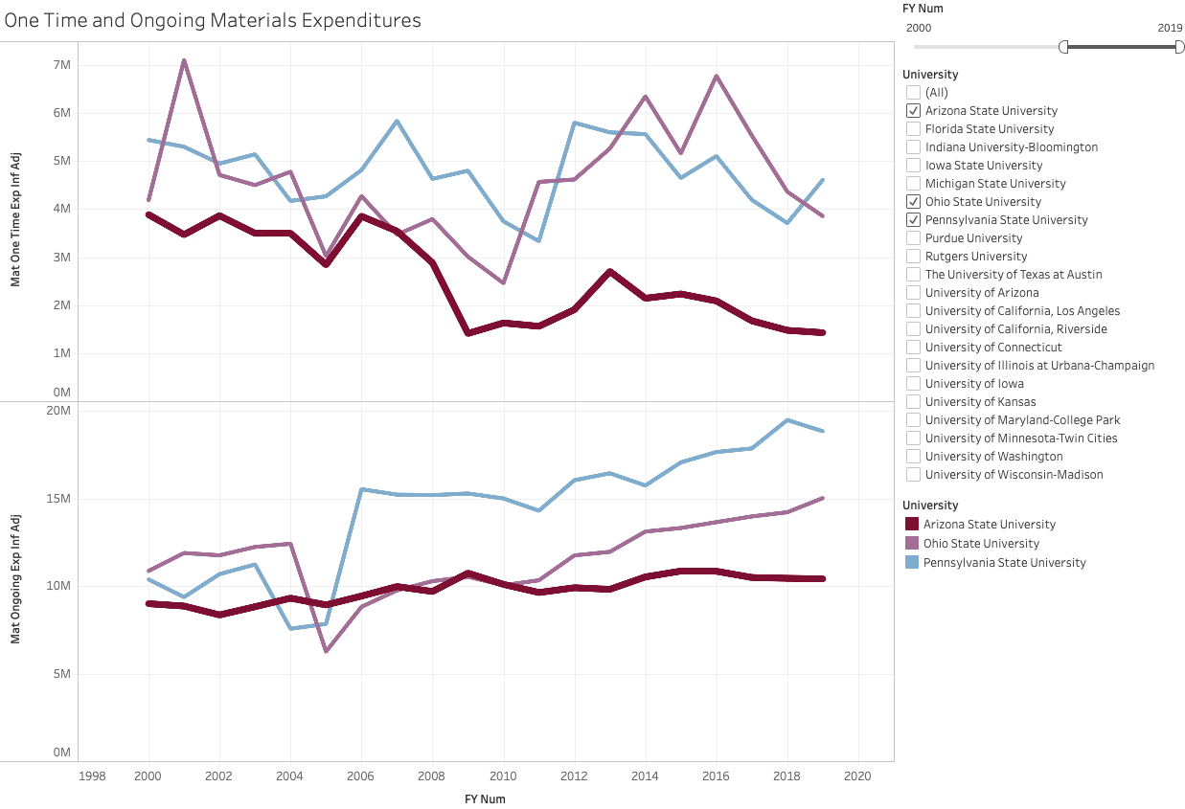
ASU vs. peer institutions, figure 2
Notes:
Figure courtesy of the ASU Libraries.

Slide 7
ASU libraries, breakdown of annual information resources expenses budget
Notes:
Budget information courtesy of the ASU Libraries.

Slide 8
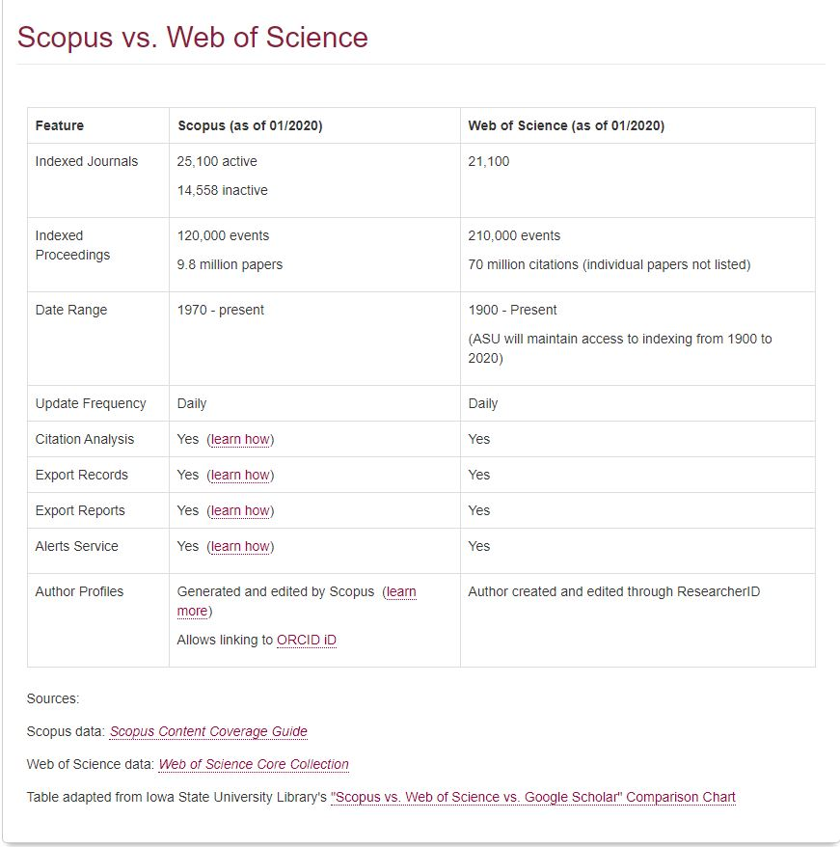
Comparison of Web of Science and SCOPUS
Source: Comparison of Scopus to Web of Science - Scopus - LibGuides at Arizona State University (asu.edu)

Slide 9
The library plan for the transition
SCOPUS… has been owned by all three Arizona state university libraries since 2015 through the Arizona Universities Library Consortium. A number of staff librarians are already very experienced with it.
The library… has created an extensive guide to SCOPUS at Home - Scopus - LibGuides at Arizona State University (asu.edu). It includes FAQs, video directions, and written instructions. Training workshops will be offered virtually and in-person.

Slide 10
Points to remember
Web of Science… will not completely vanish. The library will retain access to the citation indices from 1900-2020. Additionally, the library is losing no journal coverage. |  |  | You will retain access to… anything you created in Web of Science EndNote. Part of the transition is the migration of faculty to EndNote on the web (a free service). |  |  | The library… has a number of other subscription databases and indices that can be used to cover any gaps between SCOPUS and Web of Science (there is a 3% different in coverage). And SCOPUS is catching up. |  |  | If you use Web of Science… to populate citations or references in ASU Vita, you will need to complete that process by December 30, 2020.

Slide 11
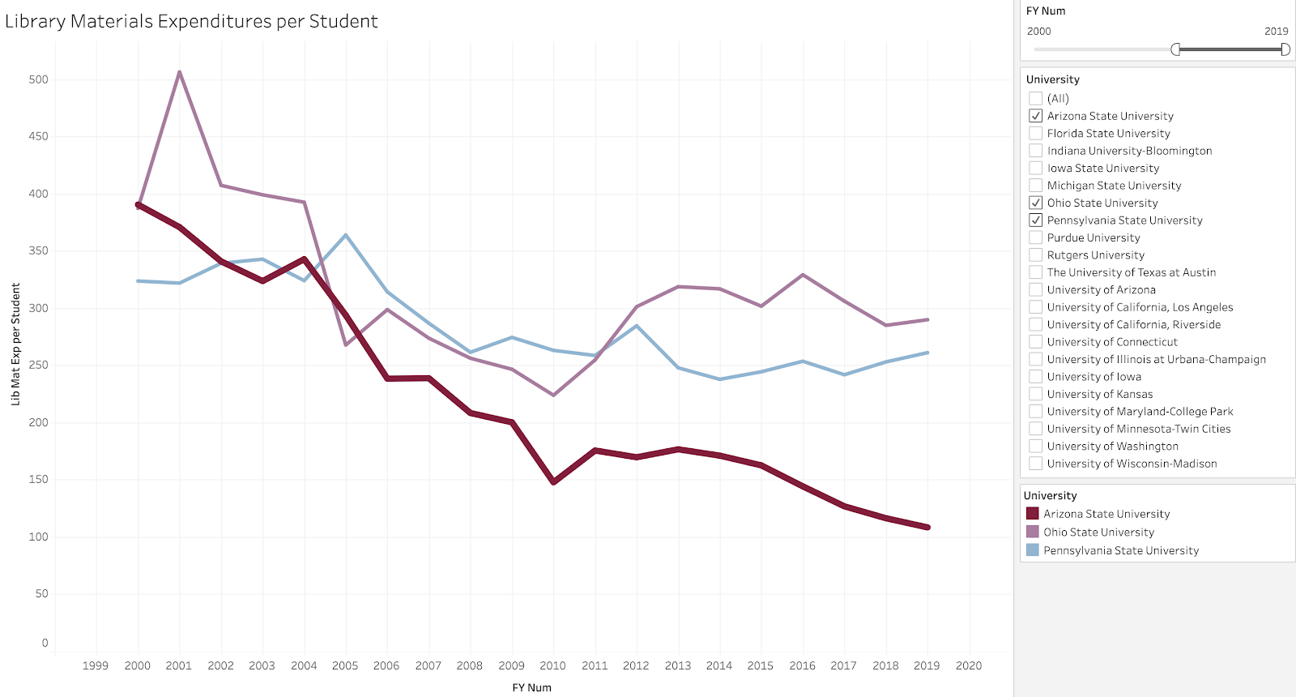
In conclusion…
Notes:
Figure courtesy of the ASU Libraries.

Slide 12
Contact information
For specific questions about transitions from Web of Science to SCOPUS, John Kromer, Head of the library STEM division, John.Kromer@asu.edu OR Eric Prosser, Engineering and Entrepreneurship Librarian, Eric.Prosser@asu.edu
For general questions on the transition and other collections questions, Debra Riley-Huff,Associate University Librarian on Engagement Learning and Services, Debra.Riley-Huff@asu.edu
For general library issues to be directed to the Library Liaison Committee, Sarah Bolmarcich (SILC), Chair, LLC, Sarah.Bolmarcich@asu.edu

