Slide 1
University Senate Update From Knowledge Enterprise
University Senate, 2/27/2023
Sally C. Morton, Knowledge Enterprise
scmorton@asu.edu
New Economy Initiative: stc@asu.edu

Slide 2
ASU Structure
EdPlus@ASU
ASU Public
Enterprise
Office Units
ASU Enterprise Partners
ASU Enterprise Technology
ASU Enterprise Brand Strategy and Management
ASU Preparatory Academy
2

Slide 3
1. What is Knowledge Enterprise?
Knowledge Enterprise, previously “OKED” then “KED,” has members and offices at all ASU campuses.
Knowledge Enterprise is the engine that drives ASU research. We are responsible for the research and economic development ecosystem of the University.
We provide dedicated service to the entire university to enable faculty, students and community researchers to be successful.
Notes:
Knowledge Enterprise helps fulfill the commitments outlined in the charter by creating a mindset that enables problem-solving, serving the university community and driving forward research and innovation.

Slide 4
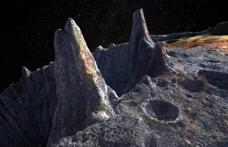
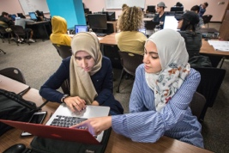
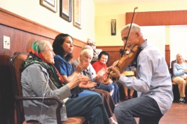
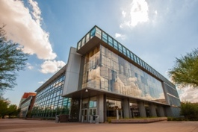
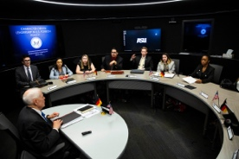
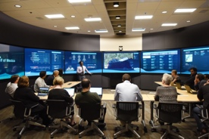
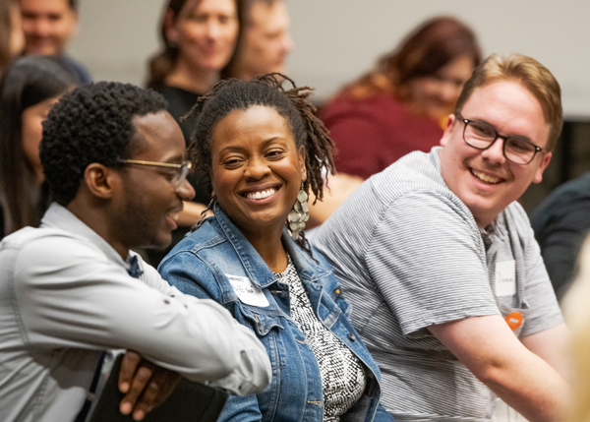
Institutes & Initiatives Supported By Knowledge Enterprise
NewSpace Initiative
Interplanetary Initiative
Julie Ann Wrigley Global Futures Laboratory
Institute for Social Science Research
Institute for Humanities Research
Jim Bell, Director
Lindy Elkins-Tanton, Vice President
H. Russell Bernard, Director
Peter Schlosser, Vice President & Vice Provost
Ron Broglio, Director
Biodesign Institute
Global Security Initiative
The McCain Institute
Decision Theater
J. Orin Edson Entrepreneurship + Innovation Institute
Joshua LaBaer, Executive Director
Nadya Bliss,
Executive Director
Evelyn Farkas, Executive Director
Jon Miller, Director
Linda Ricchiuti,
Executive Director
Notes:
Thriving People. Thriving Planet. Thriving Society. It’s an ambitious goal. It also covers a lot of ground – which you can see reflected in the depth and breadth of the institutes and initiatives, and areas of expertise that make up KE – from sustainability on Earth to exploration in space to nurturing everything from human health to entrepreneurship and innovation to human rights.

Slide 5
Knowledge Enterprise Research Support
Research Compliance and Integrity, Finance, and Strategy (OSPRA)
Core facilities and animal care
High-performance research computing(Sol) including the Quantum Collaborative
Research Development
Corporate Engagement and Strategic Partnerships
Economic Development
International Development
Chief Science and Technology Officer
Key collaborators in Enterprise Partners: ASU Research Enterprise (ASURE) and Skysong Innovations
Notes:
One component of Knowledge Enterprise is providing dedicated service to the entire university to enable researchers to be successful. This support system helps fulfill our directive to drive research forward. We support the university’s research ecosystem through everything from the facilities used, to advanced computing and infrastructure like compliance, finance and strategy.

Slide 6
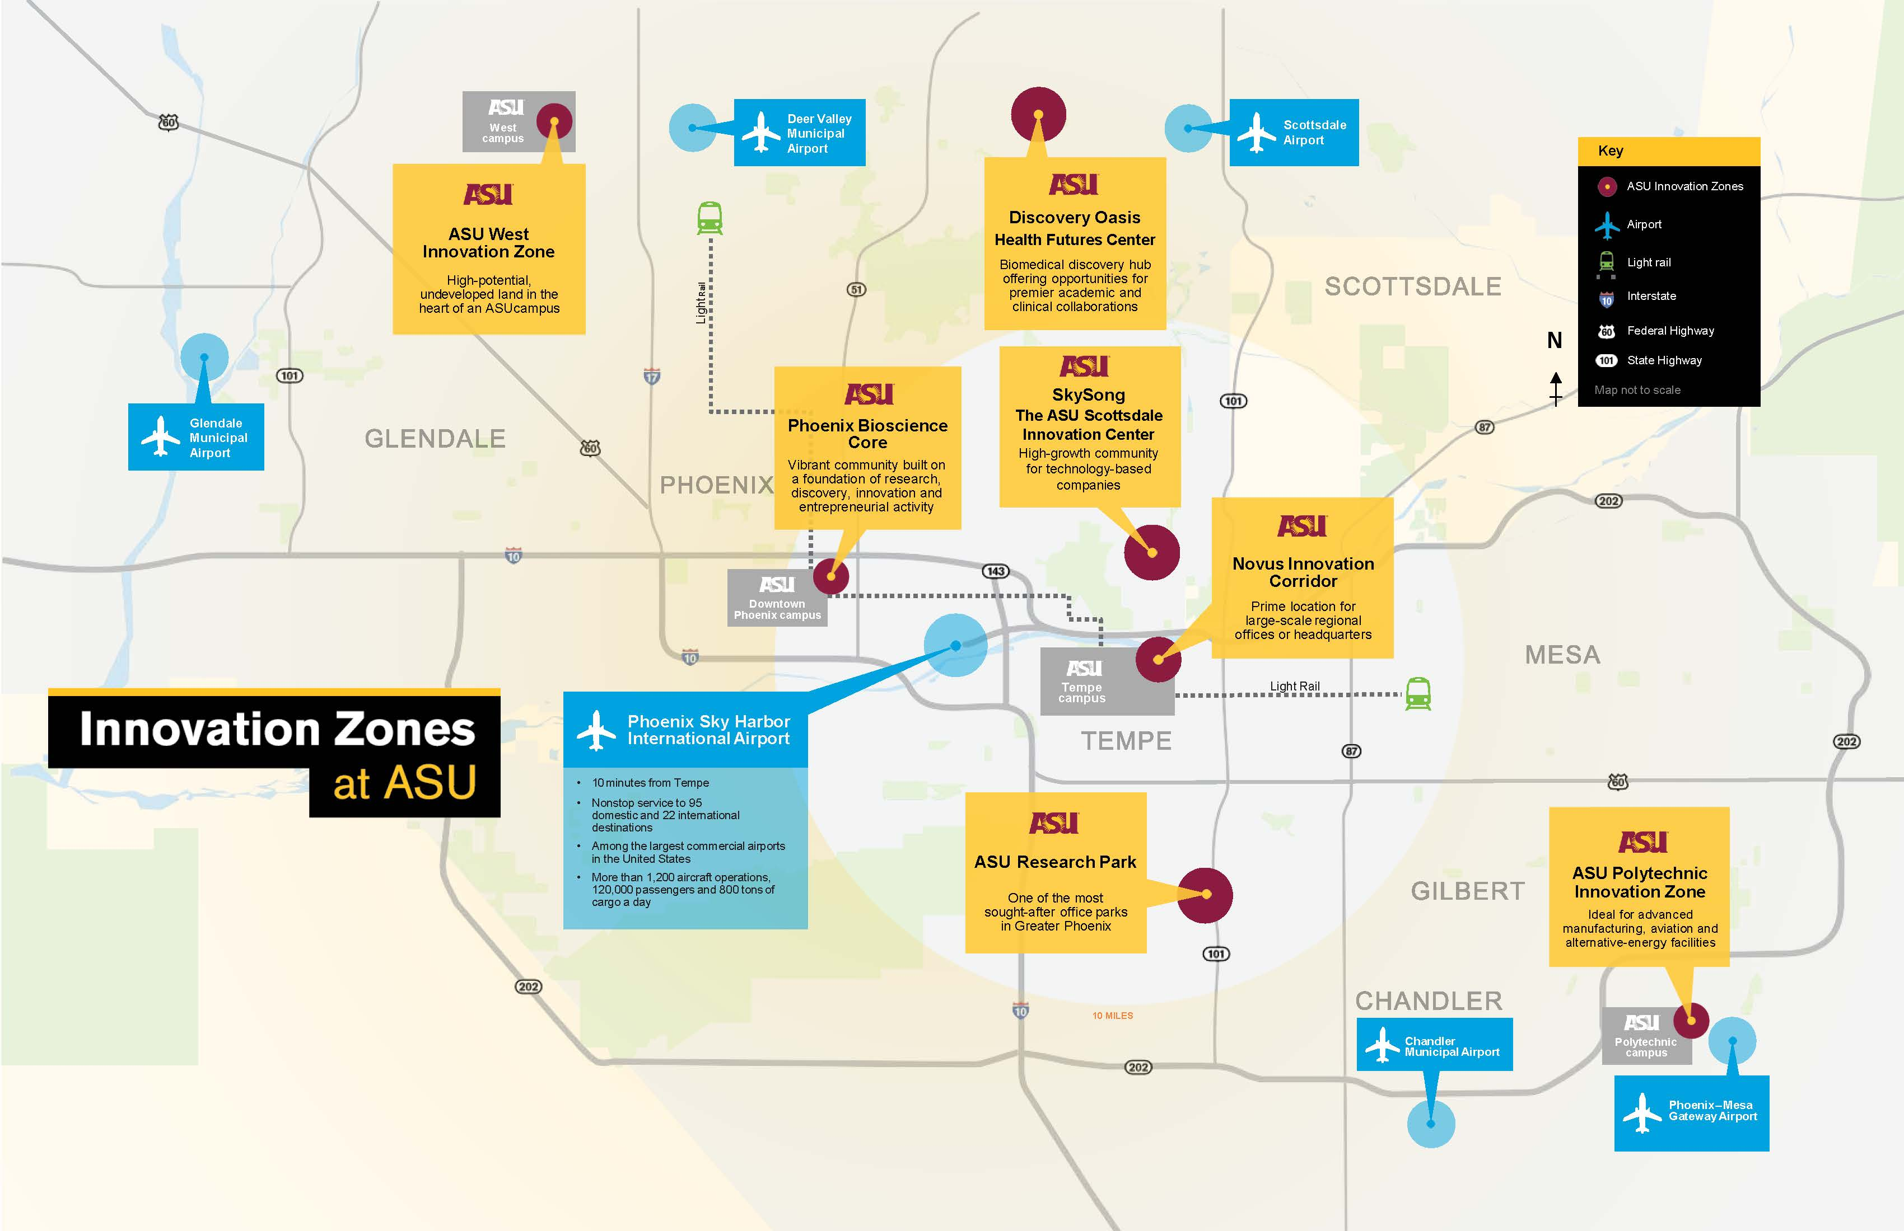
ASU research engagement spans the Valley

Slide 7
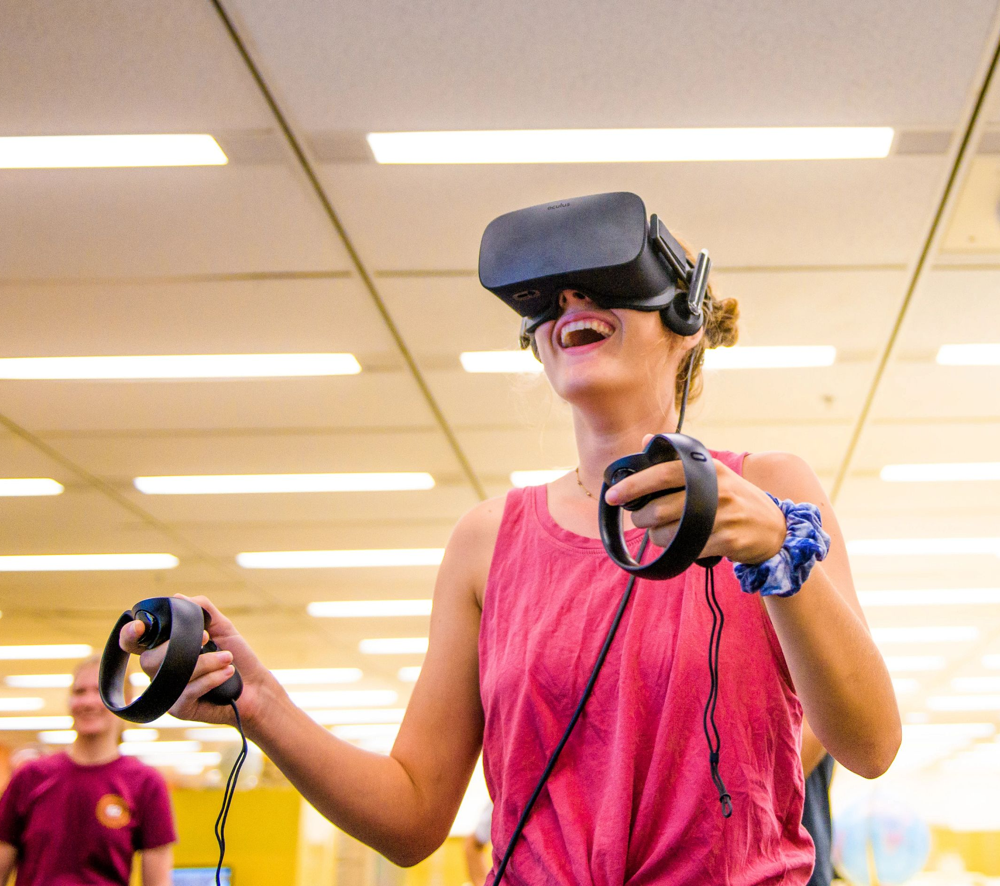
2. What is the New Economy Initiative (NEI)?
Advanced manufacturing + materials
Augmented intelligence
Automation/robotics
Big data
Biosciences + personalized medicine
Cybersecurity
Digital media
Virtual/augmented reality
Notes:
TYPES OF INDUSTRIES
Working in these industries will require advanced training and education
These industries rely on talent, research, and innovation — and will locate themselves and grow in places that support their needs

Slide 8
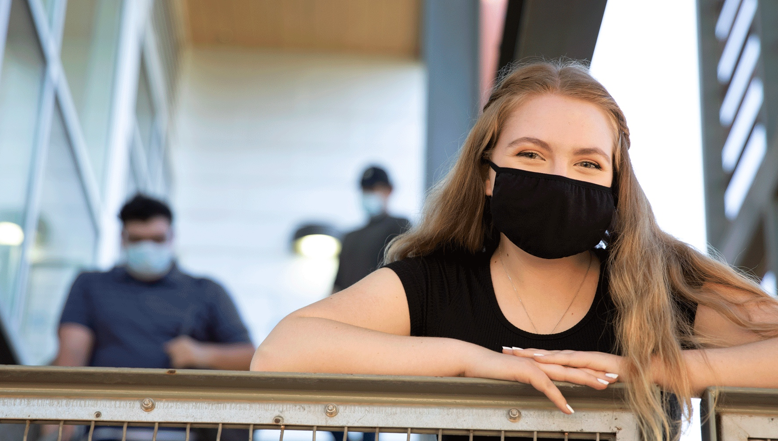
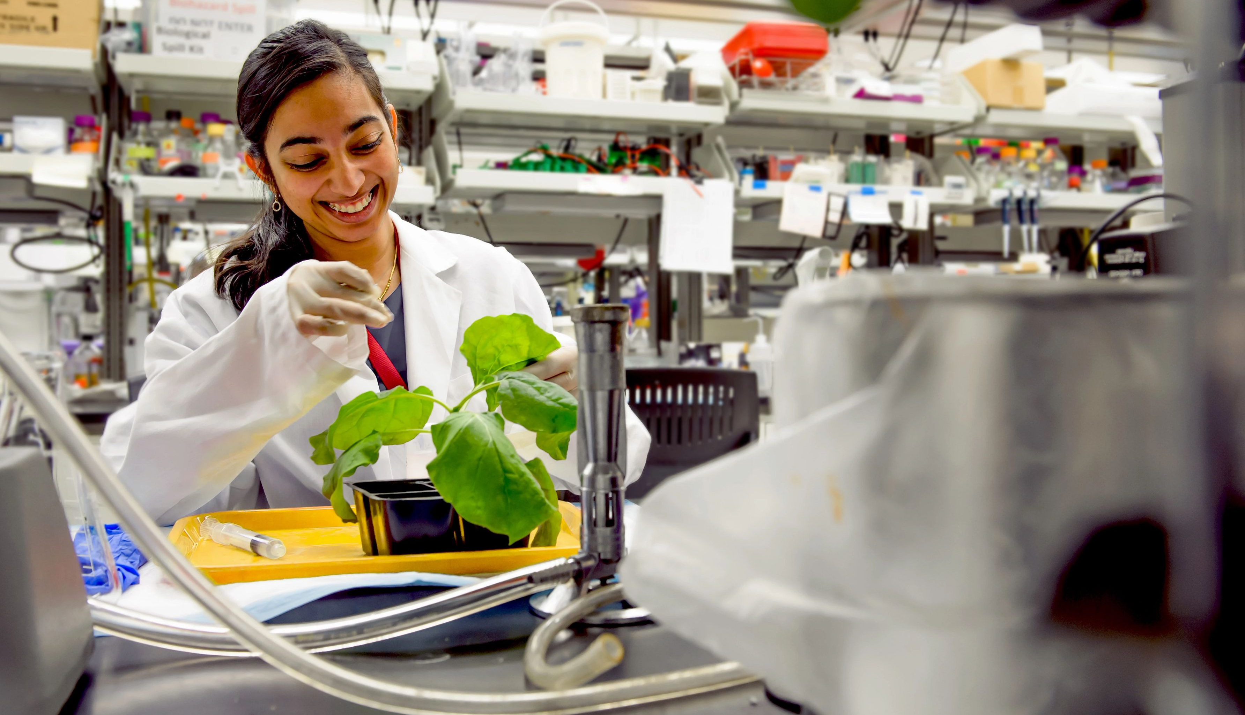
ASU New Economy Initiative Assignment from the State
Science and Technology Centers
Catalyze industry-relevant research, development and manufacturing
Workforce development
New graduates, re-training and upskilling for existing workforce
Support of New Economy enterprises
Partner with industry,
enhance entrepreneurship, and attract new businesses to AZ
Notes:
Respective to the New Economy, ASU plays three roles:
ASU is the engine for technology research and training across multiple fields that are directly relevant to industries of the future.
ASU partners directly with those industries, as well as a wide variety of local, national, and global stakeholders to create value for Arizona.
ASU leverages investments from the state of Arizona and the federal government create a strong return on investment through job creation and economic growth.

Slide 9
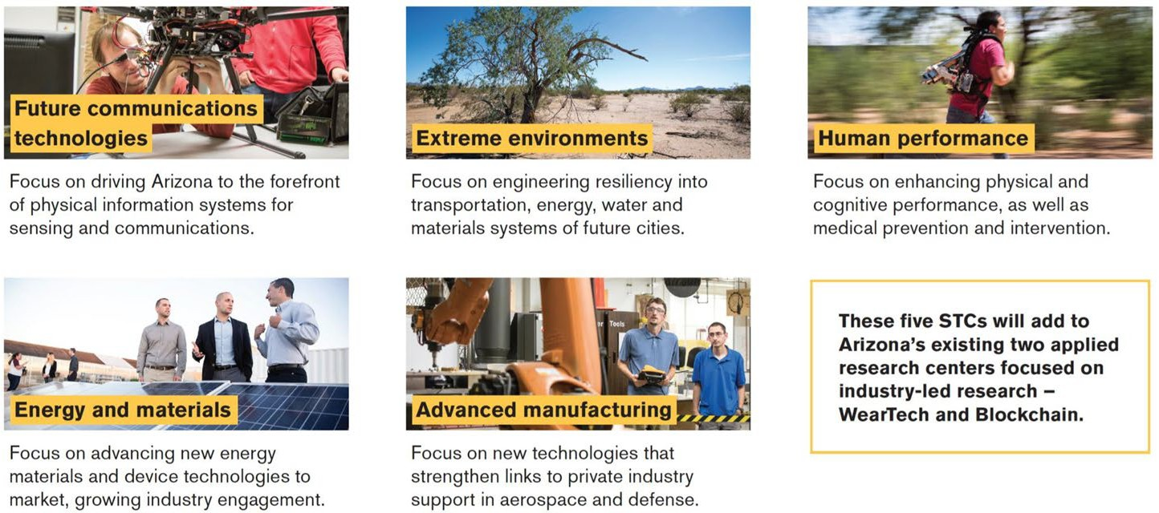
Science and Technology Centers (STCs) Are the Organizing Hubs
Kicked off in 2022
Learning Engineering and Sustainability starting now
Kicked off in 2021

Slide 10
What an STC
is
What an STC
does
Consortium of researchers, entrepreneurs, subject matter experts and technologists in industry
Advanced training and development tools and methodologies that are developed at scale
Research, development, and prototyping facilities with state-of-the-art equipment
Embodied expertise focused on engineering, technology, and commercialization
Convergence of stakeholders to develop a growing and highly skilled workforce to support research & innovation, economic development and state competitiveness
Engages industry to develop a technology roadmap and identify opportunities
Solicits and co-funds (with industry) proposals
in response to identified opportunities
Invests in and conducts research and development to understand and solve problems
Builds capacity by training the present and future workforce with relevant curricula at scale
Transfers learning to practice through entrepreneurship and industry partnerships
Translates projects to industry to make products and systems that employ areas of strength for the region and ASU

Slide 11
What an STC supports
Research and student training
Industry-Academia Proposers Day
Research projects (co-funded by industry)
Impact engineering fellowships
Workforce training program
Enabling equipment
Equipment in ASU Core facilities that enables capabilities key to the STC
Faculty Involvement
Faculty self-associate with an STC by either participating in a Proposers Day or submitting a successful proposal with an industry partner
Next Proposers Day: March 22, 2023
Contact stc@asu.edu

Slide 12
ASU NEI Accomplishments
Launched 7 Science & Technology Centers
Attracted corporate partnerships
Increased co-funded projects
Created Industry Council
Grew Fulton Schools of Engineering
Launched CareerCatalyst
Enhanced research facilities
Solidified Arizona and ASU as microelectronics leader
Notes:
Launched 5 STCs
What are STCs? They are the intellectual hubs of the ASU NEI efforts – the organizing principle of our approach. They are proactive responses to emerging high-tech opportunities.
Advanced Materials, Processes, and Energy Devices: Batteries, Power Electronics and Photovoltaics
Manufacturing, Automation and Data Engineering: Process science and engineering, Robotics and automation, and Data analytics, Cyber and AI
Human Performance: Devices, Assessment and Performance Multipliers
Extreme Environments: Water, Heat and Air
Advanced Communications Technologies: Awareness for Autonomous Vehicles, Flexible Modems, Communications for Augmented Reality and Future RF Systems
New Corporate Partnership & R&D Project Examples –
2022 - STC affiliated industry partners grew to 40 with $3.6M in expenditure
2021 – 29 industry partners with $2.9M in expenditures
Co-funded projects: Round 1 – 2 STCs - 11 projects awarded - $485K industry investment
Ex. Working with 2DSemiconductors wafer-scale manufacturing of incredibly thin semiconductors
Ex. Working with Leap Photovoltaics on low cost manufacturing for solar cells
Industry Council – Working with Industry leaders in the semiconductor space to understand unique needs and partnership opportunities given the microelectronics focus in the state.
FSE Growth –
2022 – Enrollments = 30,296 Graduates = 5,123
2021 – Enrollments = 26,999 Graduates = 5,122
2020 – Enrollments = 24,994 Graduates = 4,687
Career Catalyst via Learning Enterprise Launched upskilling/reskilling programs:
Grow with Google Sustainability Analyst
Professional Skills for Everyone
Grow research facilities –
$15M in equipment for MTW
Equipment Highlights:
ICP Etch @ 300mm ($2.9M)
Maskless Lithography Tools & Instruments ($2.2M)
Atomic Layer Deposition Tools & Instruments ($845K)
Microelectronics leader
People. Education. Facilities.
Macrotechnology Works (MTW)
MTW serves as a gateway for boosting development of technology, enhancing collaboration, reducing barriers to research and development, complementing the use of other technologies and facilities, recruiting talented researchers, employees and leaders through leading edge, world-class equipment and laboratories. The facility positions ASU to capitalize on its strength and respond nimbly to opportunities – such as NNeRD and Chips Act.

Slide 13
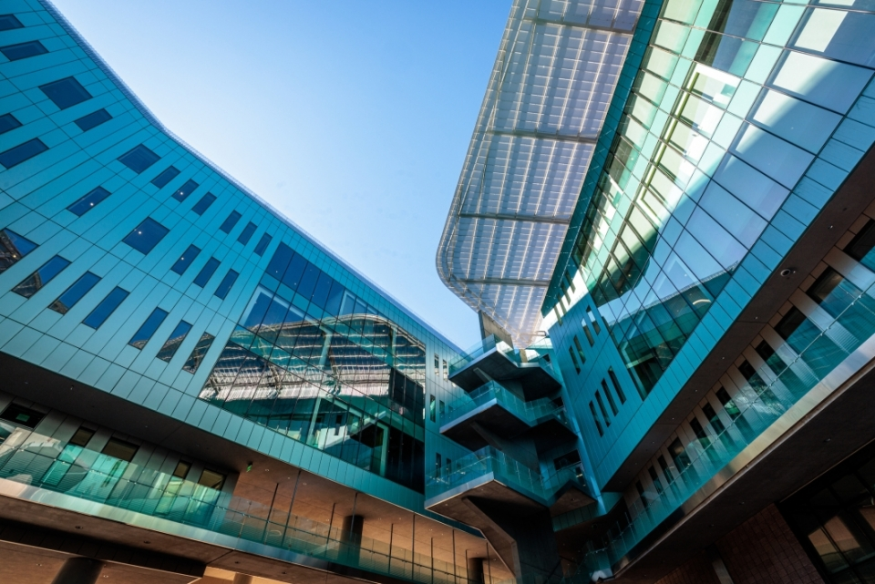
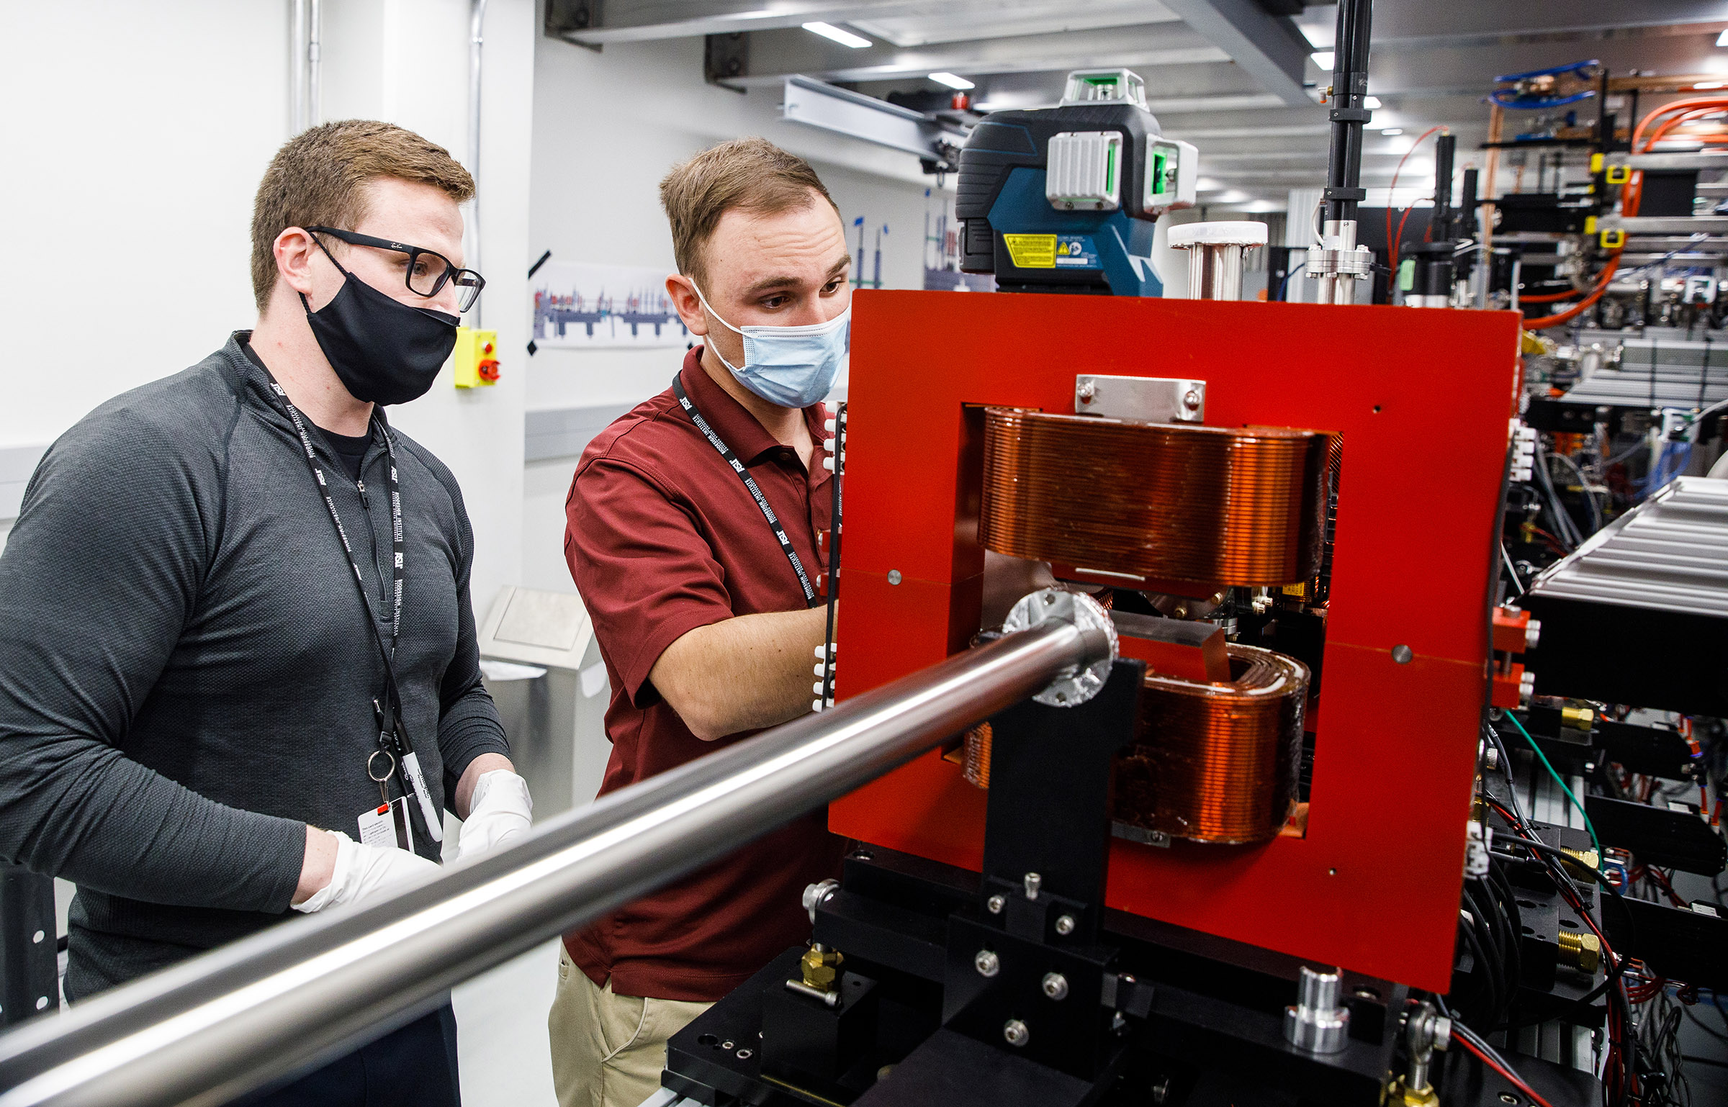
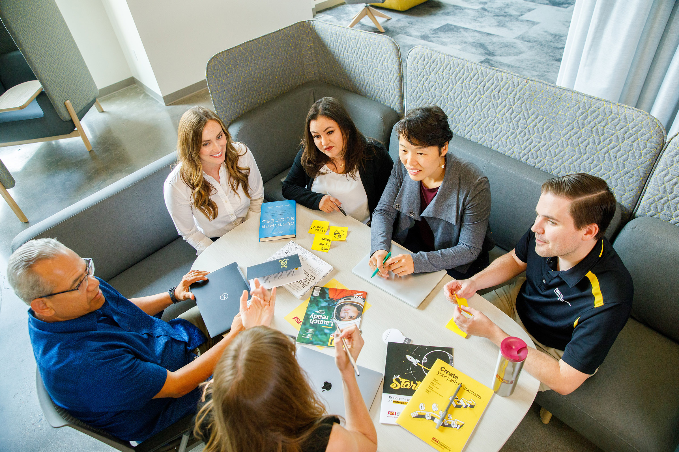
The ASU NEI Future
Ability to nimbly respond to new opportunities
Growing partnerships and excitement among industry community
Efficient and effective Science and Technology Center Model
Notes:
Why AZ cares?
We have a model that is working extremely well and generating excitement.
Companies are partnering
Suppliers are relocating
Seeing excitement from industry partnerships and involvement.
First Proposer’s Day – Feb 2022 – 2 STCS participating
XX attendees
YY unique companies
Proposer’s Day – October 2022 – 3 STCs participating
140 attendees
50+ unique companies represented
Jobs are being created
As ABOR’s own economic analysis revealed we anticipate 48,000 added by Year 10 and 158,000 jobs by Year 20
Over 20 years this creates $78.3B in labor income over 20 years through created jobs with an added economic output of $177.8B
We will work to prepare the state’s workforce - college students and workforce
When we began the NEI we started by working on clear opportunities - microelectronics push in the valley
Joined three other relevant areas aligned with ASU strengths. (Added STCs)
Since then ASU added two STCs that rose to forefront as essential.
Will embrace new ideas as they emerge.

Slide 14
3. What is ASU Doing Now?
3. What is ASU Doing Now?
Notes:
Knowledge Enterprise helps fulfill the commitments outlined in the charter by creating a mindset that enables problem-solving, serving the university community and driving forward research and innovation.

Slide 15
University Senate Update From Knowledge Enterprise
Thank You
University Senate, 2/27/2023
Sally C. Morton, Knowledge Enterprise
scmorton@asu.edu
New Economy Initiative: stc@asu.edu

