Slide 1
University Senate: October 30th meeting
A
month in review
at the
nation’s most innovative
university
Nancy Gonzales
Executive Vice President and University Provost
October 30, 2023

Slide 2
ASU’s statement of
support
and
leadership role as a founding member

Slide 3
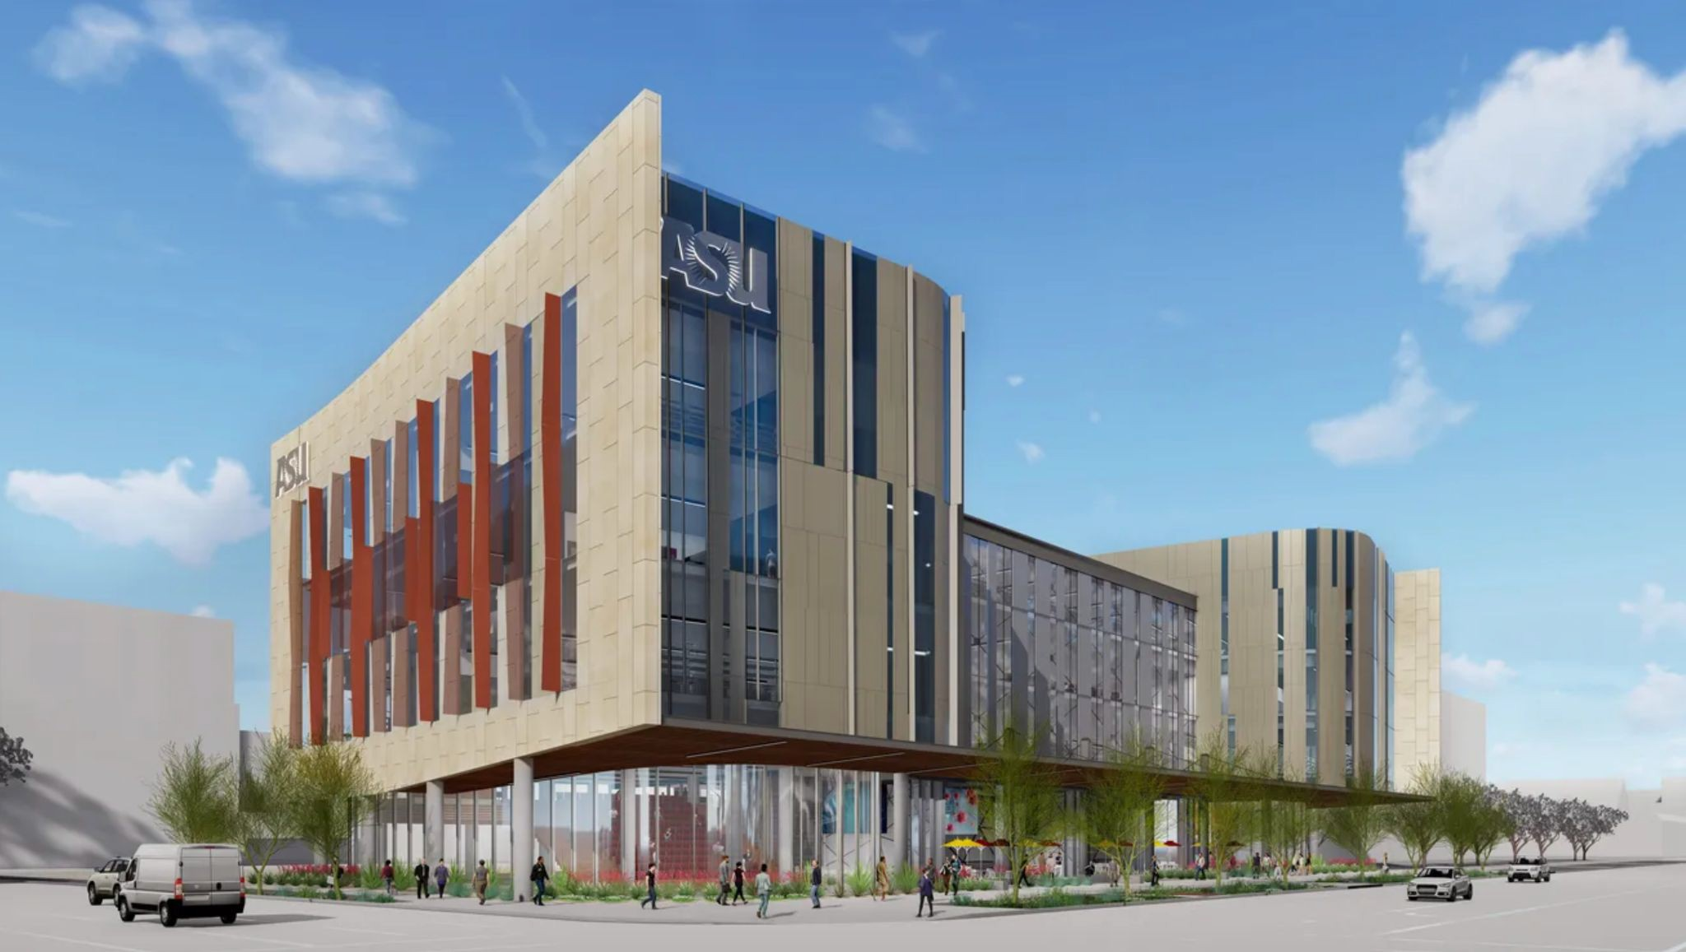
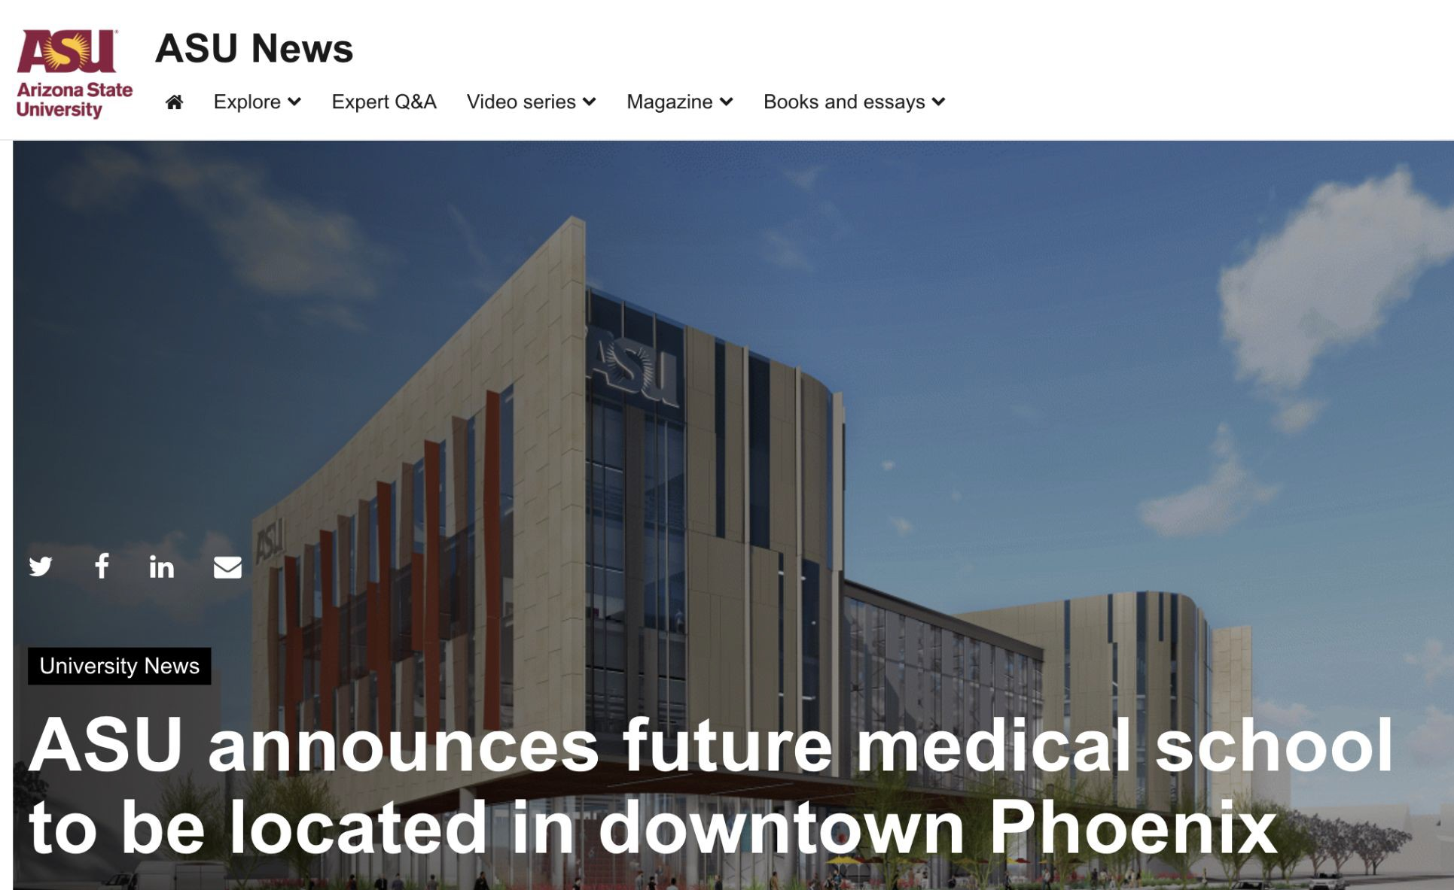
On Oct. 19, ASU
announced
downtown
Phoenix as the future
home of our medical
school.
ASU Health is a “learning health ecosystem” created by the university to accelerate and focus its health-related efforts to tackle the state’s urgent health care needs, now and into the future.
ASU is launching a medical school, creating two other new schools, expanding its alliance with Mayo Clinic, launching a state health observatory and more. The charge is to address significant and growing health care needs and help improve health outcomes across Arizona.

Slide 4
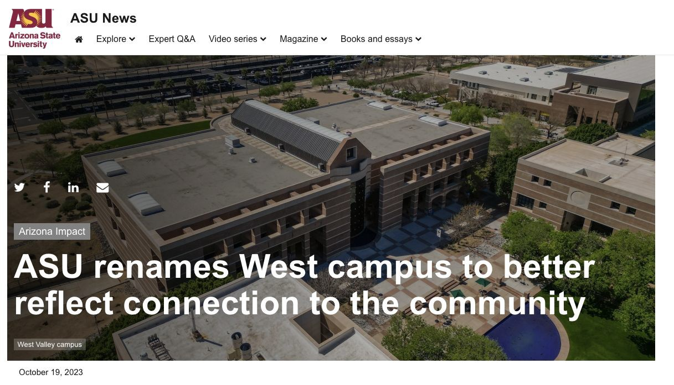
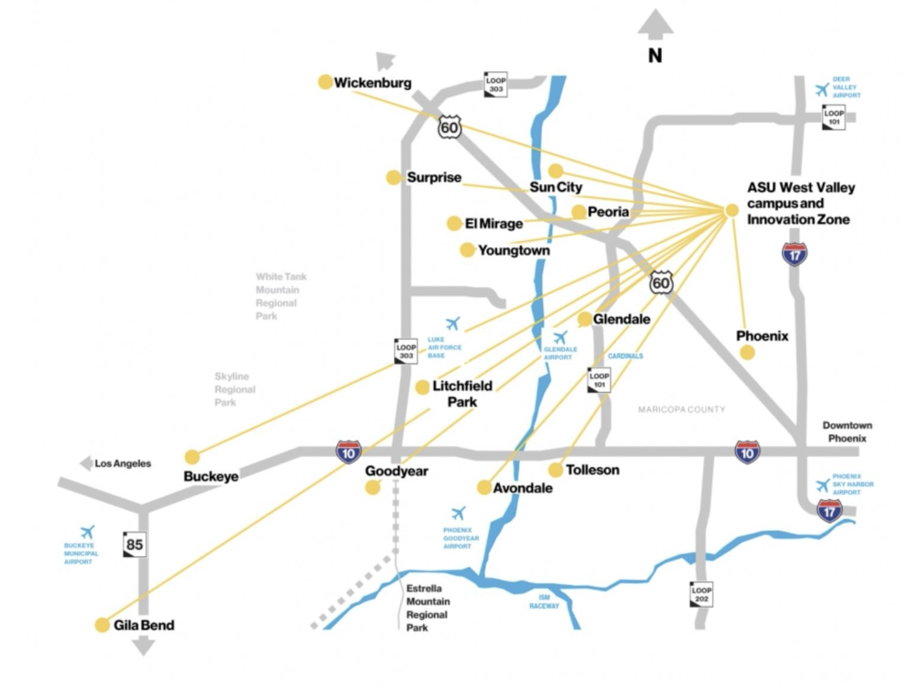
Later that day …
On Oct. 19, ASU
unveiled the new
campus name,
ASU
West Valley
at
WESTMARC Best of the West event to better reflect connection and service to the wider community.

Slide 5
Congratulations
to the
ASU team led by Professor Lindy Elkins-Tanton for the
successful launch
of Psyche
on Oct. 13 at
NASA’s Kennedy Space Center.

Slide 6
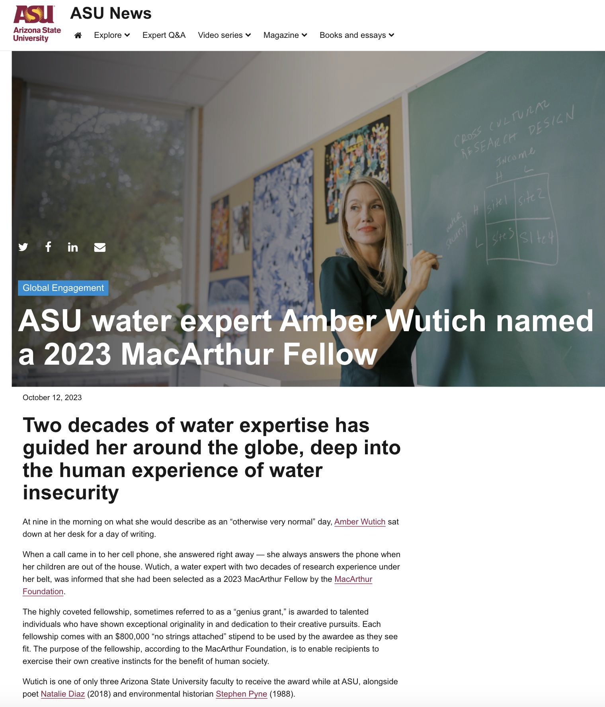
On Oct, 12. ASU’s
newest
MacArthur
Fellow
was
announced.
Congratulations
Amber Wutich!

Slide 7
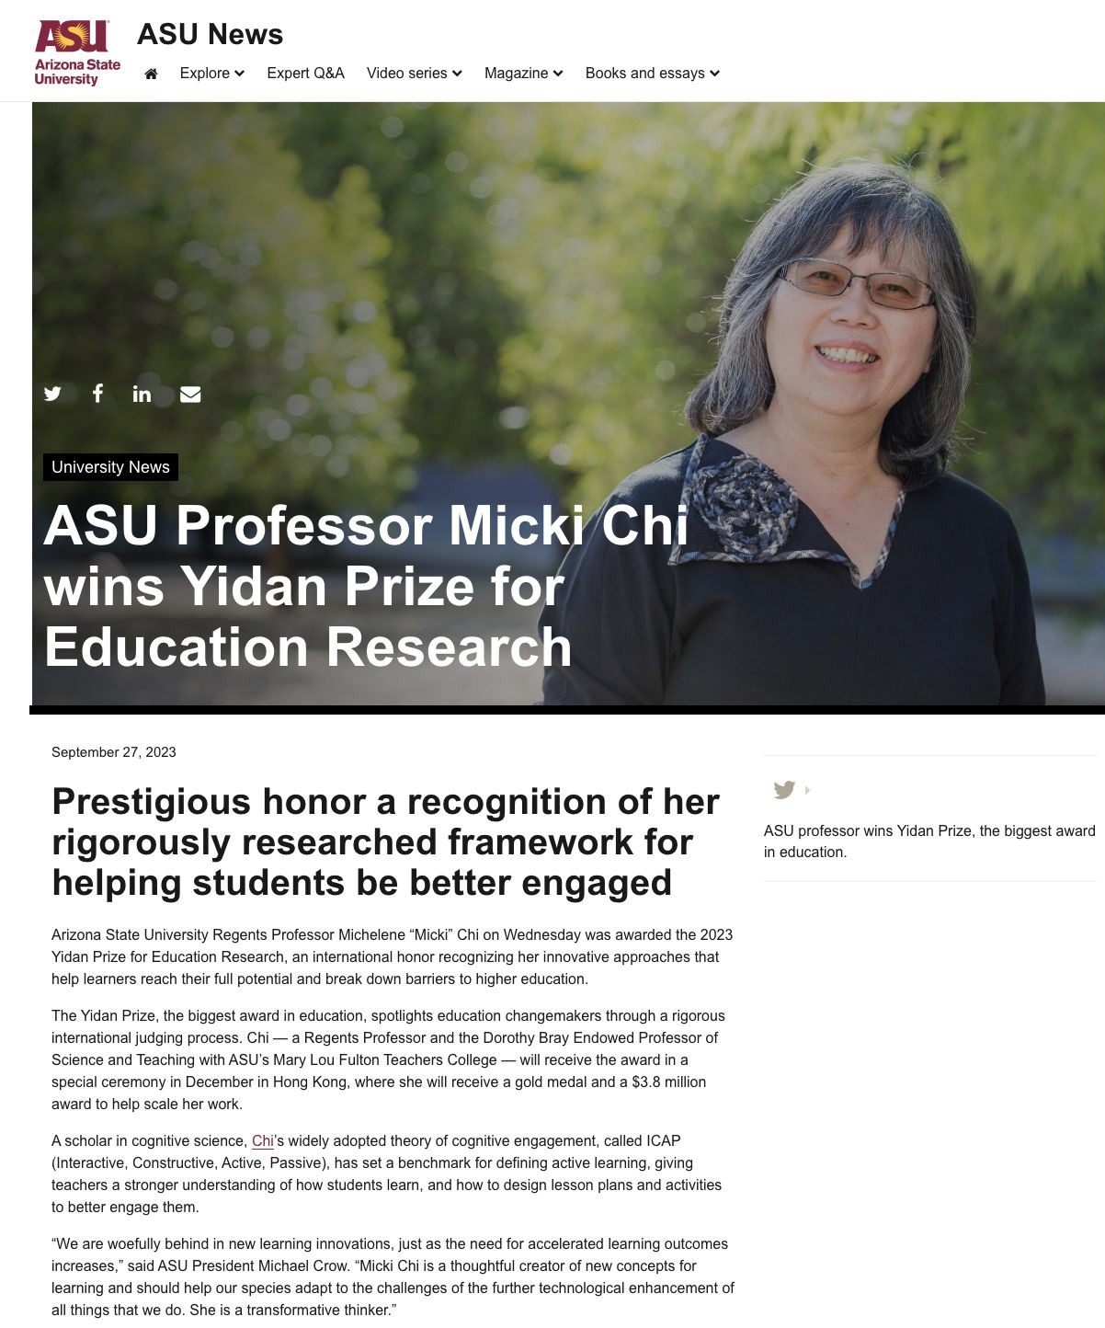
On Sept. 27, Micki Chi won the
Yidan Prize.
Congratulations
Micki Chi!

Slide 8
Earlier today!
ASU announced as
2023 Fulbright HSI Leader
This initiative is part of the U.S. State Department’s long-standing commitment to continue to build diversity and inclusion within the Fulbright Program and all the Bureau’s international exchange programs. ECA established this designation in 2021 to acknowledge the strong partnerships between the Fulbright Program and HSIs, and to encourage all HSIs to increase their Fulbright engagement on campus. Having strong HSI participation in the U.S. government’s flagship international exchange program is critical to fully representing the diversity of the United States through the Program.

Slide 9
Looking ahead
ASU launched a comprehensive website on Artificial Intelligence.
Please visit
ai.asu.edu
and
take a look. I encourage faculty to be involved in shaping how ASU activates AI in our teaching and research.

Slide 10
University Senate: October 30th meeting
Thank you
Nancy Gonzales
Executive Vice President and University Provost
October 2, 2023

Slide 11
An update on the
ASU General Studies proposal
Deck here
https://docs.google.com/presentation/d/1X8rrraZ-BQyIYHAiUacvKY0JQwyXh-c48i9xZuokQNE/edit#slide=id.g25cc556d345_0_6

