Slide 1
Committee on Committee Updates
2024-2025
Elisa Bienenstock

Slide 2
Committee on Committee Updates
Elections for the following positions will occur in Spring 2025:
Campus Presidents
(https://usenate.asu.edu/about/leadership)
Committee on Academic Freedom and Tenure (CAFT)
ABOR Policy 6-201 and ASU policy ACD 509–02
https://usenate.asu.edu/committees/caft
Governance Grievance Committee (GGC)
ACD 509–02
https://usenate.asu.edu/committees/ggc
Academic Professional Grievance Committee (APGC)
ACD 509–03
https://usenate.asu.edu/committees/apgc
Each is a 3-year term.
The goal is to recruit 2 excellent nominees for each position.

Slide 3
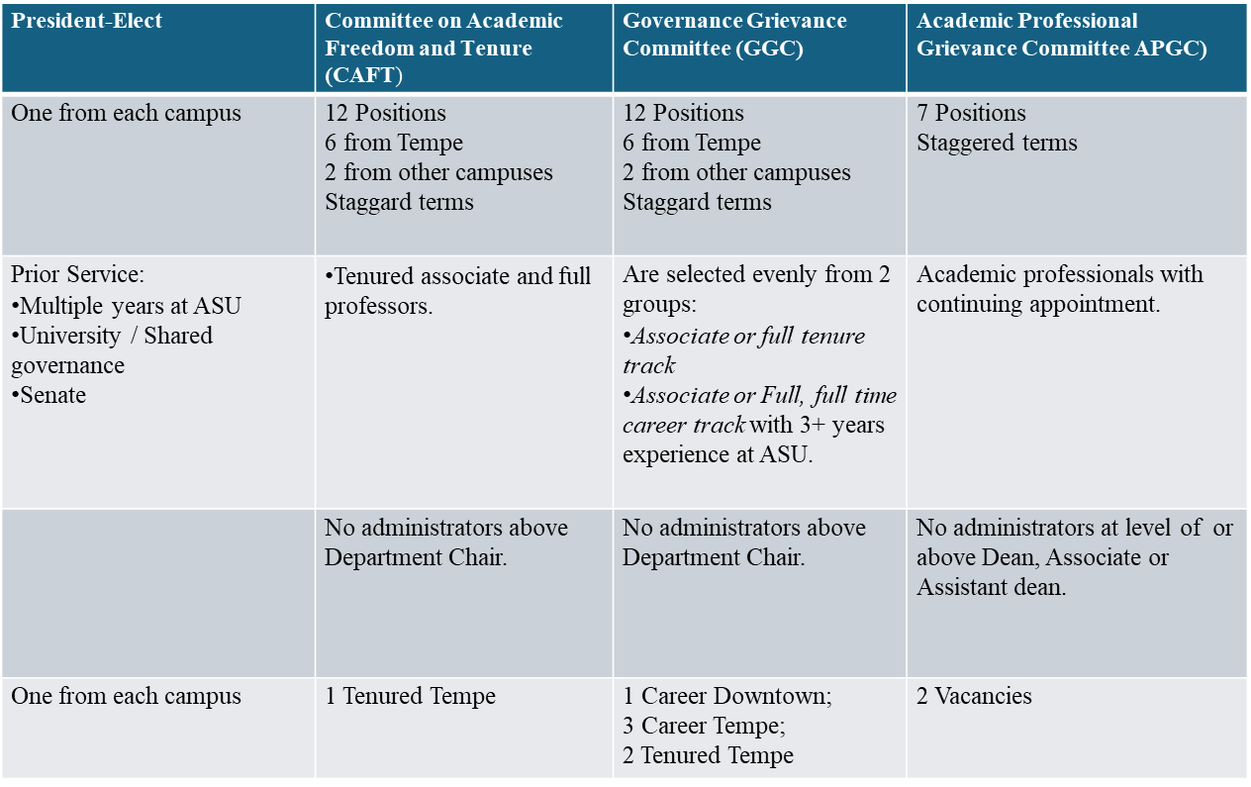
Eligibility / Need (+1 candidate per position)

Slide 4
Benefits of University Service
Experience in Shared Governance
University service provides an inside view to ASU’s governance structures and priorities.
Professional Growth
University level service factors into consideration for promotion from Associate to Full and beyond for tenure and career track faculty.
Networking
Committees provide not only opportunities to meet colleagues from varied backgrounds, disciplines and campuses but also provides direct access to University leadership.
Skills
Committee work enhances leadership, communication, collaboration, and problem-solving skills.
Influence and Impact
University Committees contribute directly to the decision-making processes and shared governance and help shape policies or initiatives that affect students and faculty.
Community
Committee work fosters a sense of belonging and teamwork, as members work towards common goals.
Visibility
Active committee members can gain recognition which can lead to further opportunities.

