Slide 1
University Services and Facilities Committee
USFC report @ Senate meeting #3 11/4/24
Bruno Welfert

Slide 2
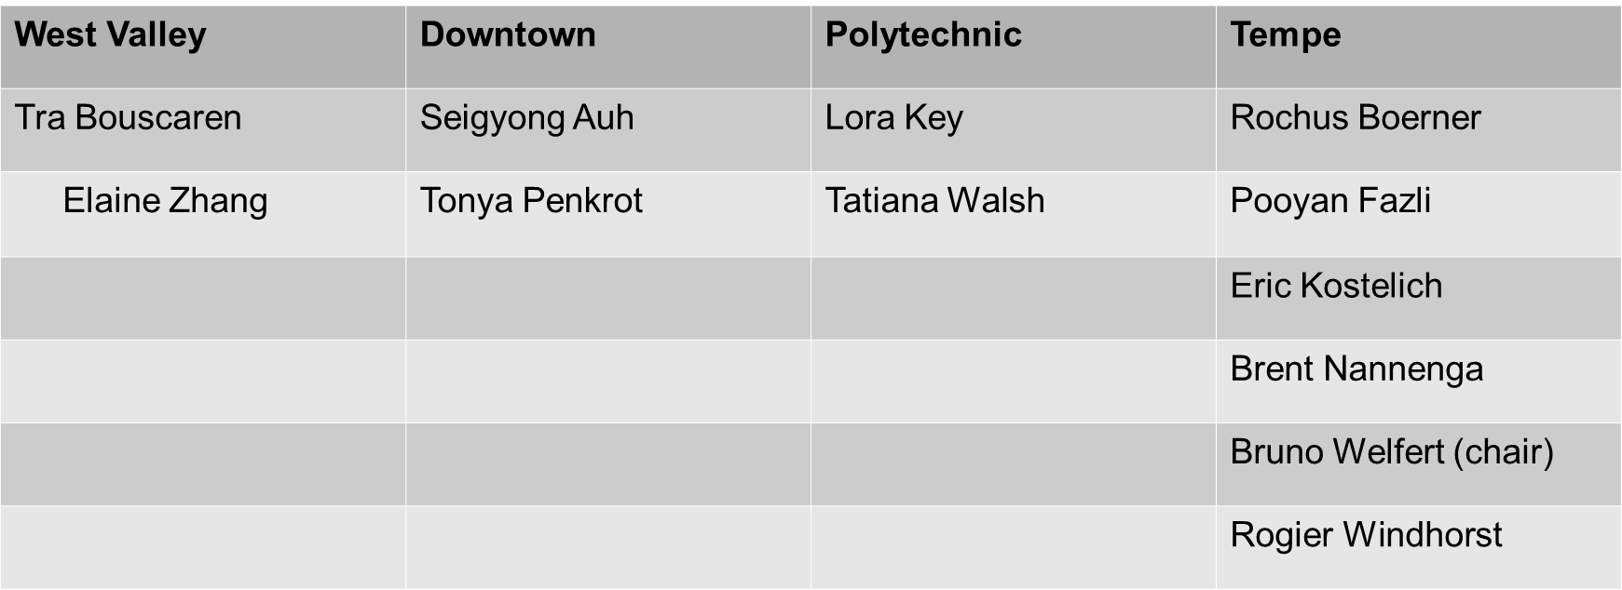

Slide 3
Open RFC’s (Requests For Consultation)
RFC 205 Building maintenance (1/2020)
A balance should exist between maintenance/upgrade of existing structures and building new ones
Various contacts with VP & CFO M. Olsen calling for more transparent communication with faculty, staff and students; an online tool for providing feedback was discussed.
AY2024-25: handicapped access to bathrooms (Goldwater, heavy doors), barrier in exterior staircases (Goldwater, to prevent falls)
RFC 243 Fragrance sensitivity (11/2022)
Fragrances in cleaning and personal case products create health issues in 1/3 population, 1/10 severe.
Possible need of somewhat comprehensive survey
RFC 248 Classroom scheduling (3/2023)
Why can’t classrooms be scheduled M/W?
Vice Provost A. Jones + Math scheduler: M/W after 1:30pm permitted, otherwise M/W/F schedule must be used.

Slide 4
RFC 249 ADA Compliance for the graduation/convocation stage (9/2023)
Issues with floor and stage wheelchair access at Desert Financial Arena.
Walk-through 12/2023 by Committee members, escorts used at graduations 12/2023 and 5/2024, expected for 12/2024 as well
ADA/§504 Coordinator P. Fisher: architect hired to evaluate accessibility compliance options (short term) and complete arena remodel (long term)
RFC 256 Concur Travel (8/2023)
Make Concur more user friendly.
Met 10/1/2024 with President E. Kawam and ASU executives who oversee travel to discuss ideas and recommendations.
RFC 257 Routine use of dangerous disinfectants (9/2023)
An update on non-toxic cleaning solutions has been requested from the Program Manager.
No response yet from facman@asu.edu

Slide 5
RFC 262 Campus Transportation (1/2024)
Shuttles between ASU campuses not always on time, affects class attendance (Polytechnic campus).
R. Peterson/JC Porter (Commuter Services): timetable already optimized.
On-going issues: RFC re-opened, re-contact CS: can alternate, busy/less-busy stops be identified?
RFC 13 Electric Vehicle X-parking @ASU campuses (9/2024)
Electric vehicle charging at Poly parking lots not free for multi-campus pass holders?
N. Ezell (PTS): depends on color of pass (Red/Green at lots 5,16,48, Orange at lot 49 anytime; free for all after 4pm). More info at https://cfo.asu.edu/ev-charging
RFC 17 Paths shading scheduling (10/2024)
Need for more shading over pathways on ASU campuses, especially during hot summer months.

