Slide 1
Fiscal Year 2025 Financial Overview
ASU University Senate
December 2024
1

Slide 2
Agenda
ASU Public Enterprise Overview
Revenue Model and Incentives
Net Position and Liquidity
2

Slide 3
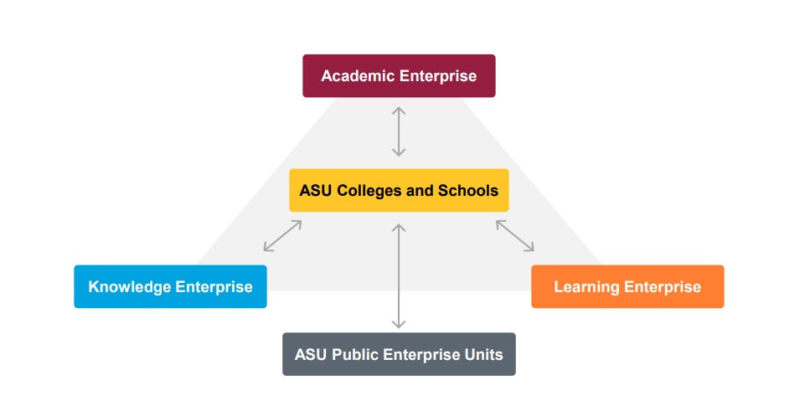
ASU Public Enterprise
Organizational design enables the ASU Charter:
Three entities shape ASU’s advancement - Academic Enterprise, Knowledge Enterprise and Learning Enterprise
ASU Public Enterprise encompasses ASU itself as well as key affiliated entities established to advance the Charter
Leverages the ability to draw on resources, capital and expertise beyond traditional boundaries
Sun Devil Athletics
Note: Discrete component units include ASU Enterprise Partners, Arizona Capital Facilities Finance Corporation (ACFFC), ASU Alumni Association, ASU Research Park, Inc., ASU Preparatory Academy and Sun Angel Foundation.
3

Slide 4
ASU Public Enterprise Revenues by Source
($ in Millions)
Component Units
Other Revenues
TRIF
Auxiliary Enterprises
Gifts and Contributions
Grants and Contracts
Financial Aid Grants
Tuition and Fees
Federal Recovery Funds
Public Investment
2003
2004
2005
2006
2007
2008
2009
2010
2011
2012
2013
2014
2015
2016
2017
2018
2019
2020
2021
2022
2023
2024
4

Slide 5
University Public Investment
Year-Over-Year Change FY 2024 Actuals to FY 2025 Estimate ($ in Millions)
Direct Appropriations | -$2.6 | -0.6%
ABOR Transfers | -$16.3 | -41.2%
Total Public Investment | -$18.9 | -4.2%
Note: Reflects university, rather than enterprise figures. Direct Appropriations include Appropriated General Funds, Research Infrastructure, Capital Infrastructure and Arizona Financial Aid Trust. ABOR Transfers include Arizona Teachers Academy and Arizona Promise, and exclude state aid for ASU Preparatory Academy. FY 2025 Budget and figures reflect the Governor’s Recommendation for statewide adjustments (e.g., Health Insurance Trust Fund premium increase, risk rate, retirement rate).
20

Slide 6
FY 2025 University Budget ($ in millions)
5

Slide 7
ASU Student Headcount Enrollment
International
Online
Campus
Nonresident
Online
Campus
Resident
Online
Campus
Note: Above figures represent annual headcount figures as presented in State of the ASU Enterprise Presentation February 2024.
6
Notes:
Updated

Slide 8
ASU Student FTE Enrollment
FTE enrollment from Fall 2015 to Fall 2024 reflects a compound annual growth rate of 4.9 percent
Non-resident undergraduates comprise 41.0 percent of Fall 2024 FTE enrollment, compared to 32.8 percent in Fall 2015
Graduate students have grown from 17.0 percent of FTE enrollment in Fall 2015 to 19.4 percent in Fall 2024
8.7%
25.0%
33.7%
Note: FTE enrollments reflect Fall census and include campus immersion and digital immersion students.
7

Slide 9
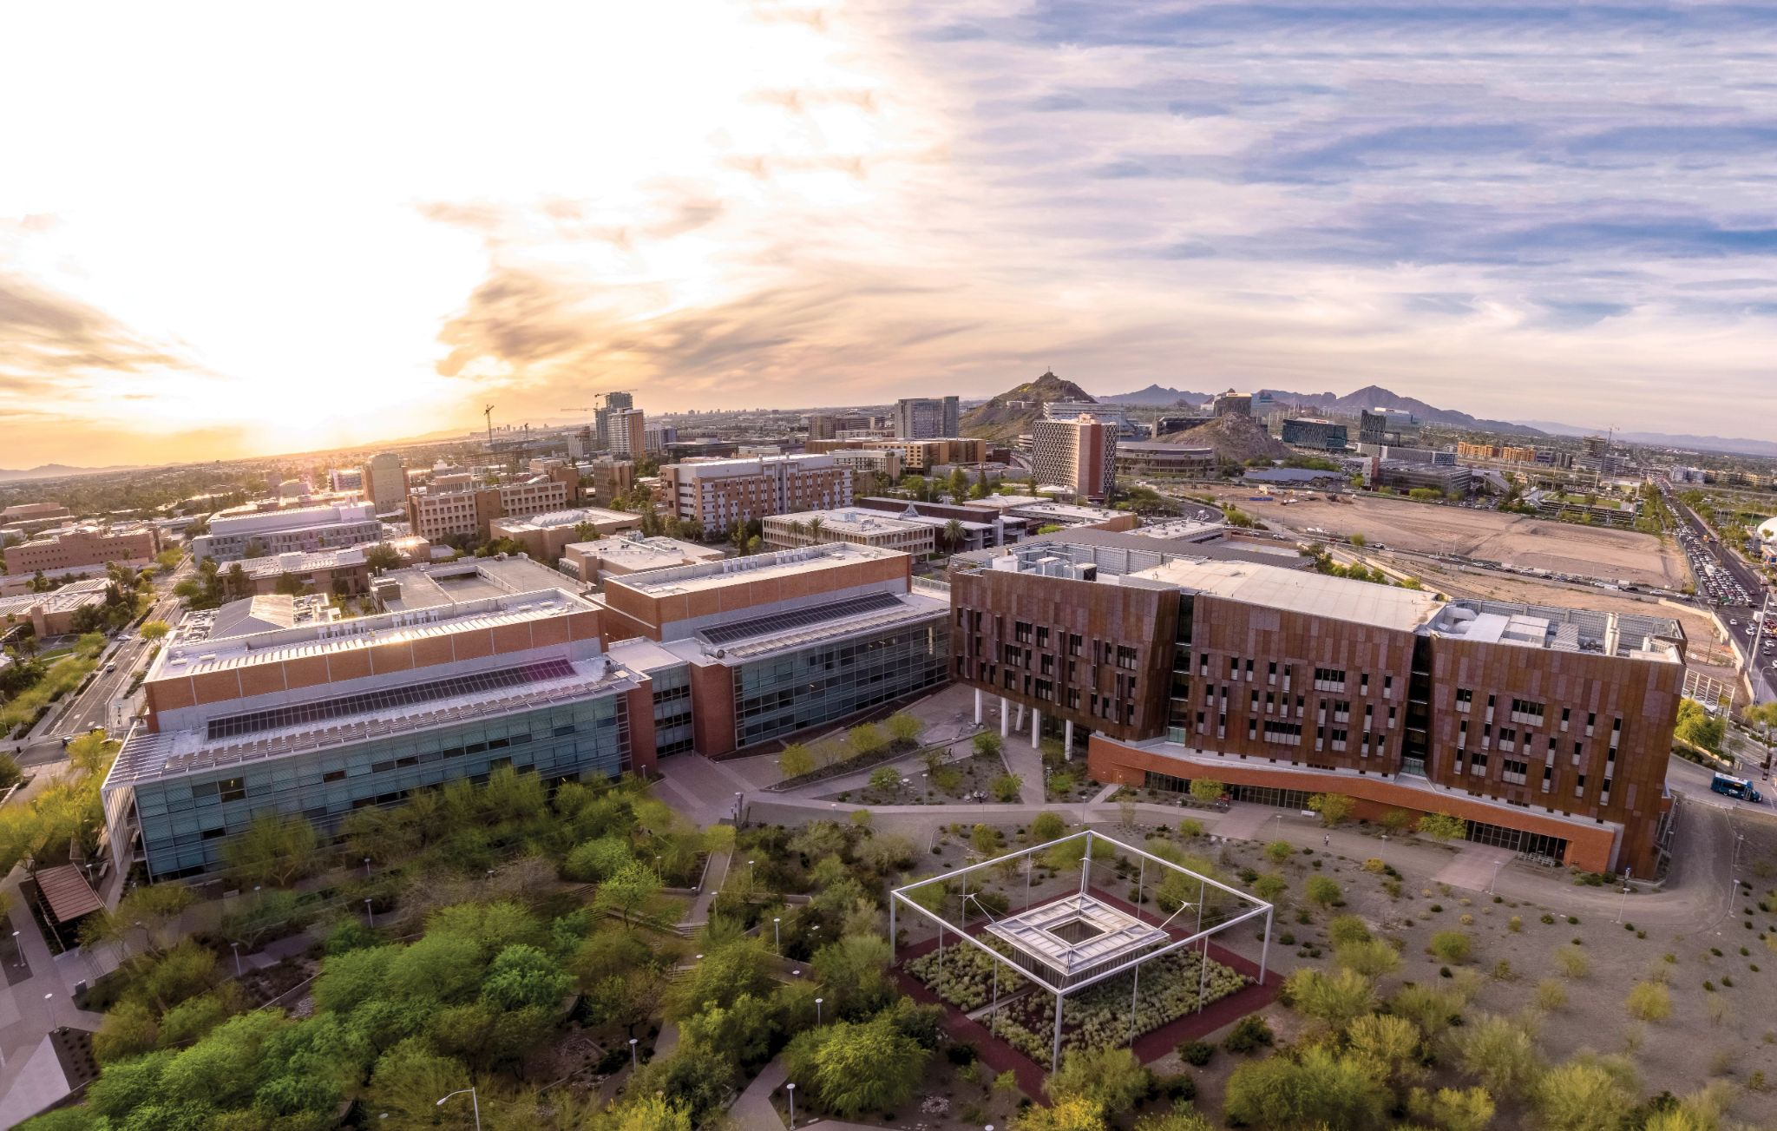
Tuition and Mandatory Fees
Tuition Setting Process:
Beginning with academic year 2024-25, the Arizona Board of Regents approved maximum percentage growth rates for resident base tuition, mandatory fees, and housing and dining plans
On April 20, 2023, ABOR approved ASU’s proposed maximum percentage growth ranges for academic years 2024-25 through 2028-29
On December 15, 2023, ASU announced rates for academic year 2024-25
On September 23, 2024, ASU announced Spring 2025 Tuition Surcharge of $350 due to lower Public Investment
ASU’s Commitment:
Since February 2012, ASU has upheld its commitment to Arizona residents by limiting annual tuition increases to 3 percent or less
ASU’s approved maximum growth rates for academic years 2024-25 through 2028-29 reaffirm this commitment to Arizona residents
AZ Tuition and Fees CAGR FY 2013-2025
ASU | 1.9%
UArizona | 2.8%
NAU | 2.9%
HEPI | 3.2%
8

Slide 10
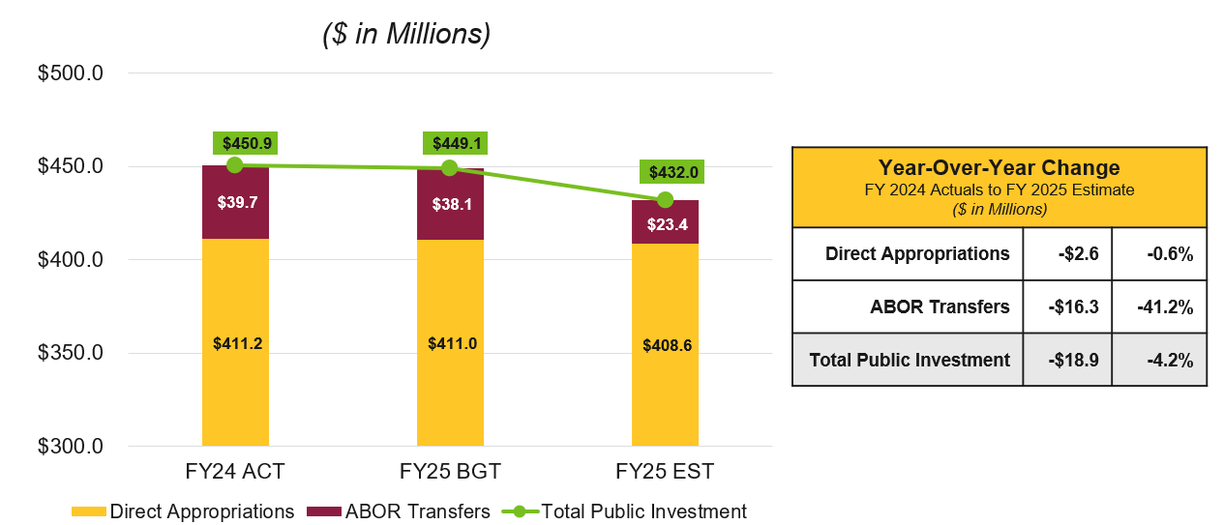
Enterprise Operating Revenues by Source
($ in Millions)
University Public Investment
Note: Public Investment includes Appropriated General Funds, Research Infrastructure, Capital Infrastructure, AZ Financial Aid Trust, AZ Teachers Academy and AZ Promise. Gross Tuition and Fees reflect Scholarship Allowance as an expense rather than contra-revenue. Grants and Contracts includes Sponsored Research, Financial Aid Grants and one-time COVID-19 Relief Funding. All Other Revenues includes TRIF, Net Auxiliary, Net Investment and Other Revenues.
9

Slide 11
Diverse Revenue Model
ASU will continue to aggressively pursue new revenues as a means of contributing to core investments, including quality education and financial aid for Arizona students. These revenues will reflect:
Continued growth
Enrollment at Phoenix metropolitan campuses
Core enrollment in digital immersion programs
New enrollment channels
International students from Cintana-affiliated institutions
New corporate partners through InStride
Expanded presence at ASU California Center
New pathways
Increase in Learning Enterprise learners
New ASU Prep opportunities
10

Slide 12
Entrepreneurial Incentives for Colleges and Schools
Designed and implemented a revenue incentive model with clear controls that promote entrepreneurship at the unit level
All deans and their directors operate with an entrepreneurial mindset, leading revenue generation for their colleges and schools
The enterprise encourages growth through clear and robust incentives:
◦ Enrollment funding
◦ Allocation of academic fees
◦ Distribution of facilities and administrative (F&A) cost recovery funds.
Maintain overall central administration oversight and support
The Provost, CFO and University Planner regularly review unit finances.
Continue to build capacity for enterprise-level initiatives
Revenues are managed centrally with regular unit discussions about investments needed for growth
Financial modeling and planning.
11
Notes:
Verify with Christian ? Add picture?

Slide 13
FY 2022 University Expenses by Classification
Auxiliary Enterprises
Public Service
Research
Institutional Support
Scholarships & Fellowships
Student Services
Academic Support
Instruction
ASU
Source: Integrated Postsecondary Education Data System – FY 2022
Student-focused expenses include Instruction, Academic Support, Student Services and Scholarships and fellows.
12

Slide 14
University Financial Update
14

Slide 15
University Monthly Days Cash on Hand
ASU’s FY 2022-25 monthly days cash on hand are influenced by one-time COVID-19 Relief revenue
For FY 2025, the estimated impact of the enacted legislative budget is a decrease of 2-3 days of cash on hand
Note: Reflects university, rather than enterprise figures. The ABOR target range is 75 to 125 percent of Moody’s published median among public college and universities. For FY 2024, ASU is within the prescribed range of 143-239 days, based on the current median.
21
Notes:
Estimate of Monthly days cash on hand excluding HEERF
FY 2021 (June 30, 2021) - 148 days
FY 2022 Projected (June 30, 2022) - 137 days

Slide 16
Questions?
15

Slide 17
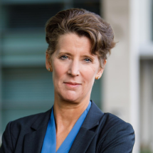
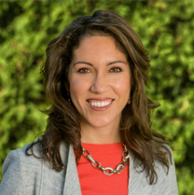
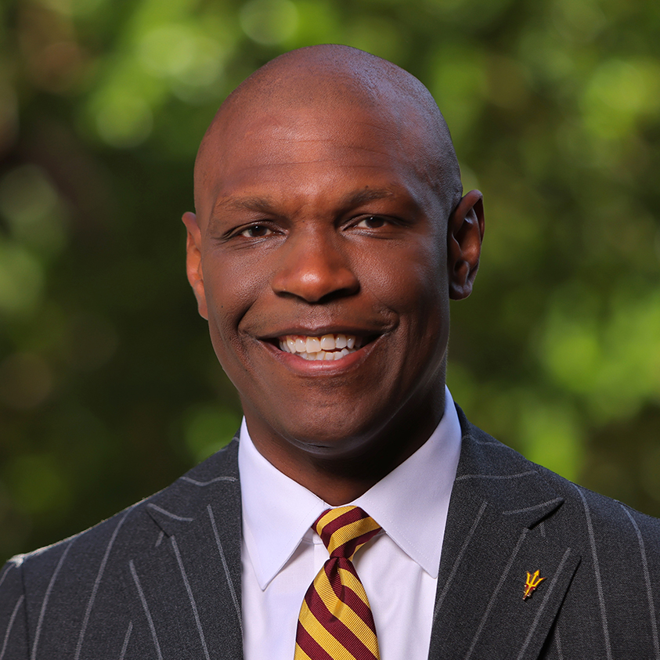
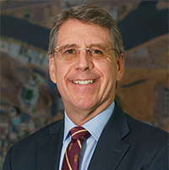
Working Group Matrix
Michael Crow
Nancy Gonzales
Sally Morton
Maria Anguiano
President, ASU Chief Executive Officer, ASU Public Enterprise
Executive Vice President and University Provost, Academic Enterprise
Executive Vice President, Knowledge Enterprise
Executive Vice President, Learning Enterprise
Chris Howard
Morgan Olsen
Sherine Gabriel
Jim O’Brien
Executive Vice President and Chief Operating Officer
Executive Vice President, Treasurer and Chief Financial Officer
Executive Vice President, ASU Health
Senior Vice President, University Affairs Chief of Staff, Office of the President
16

Slide 18
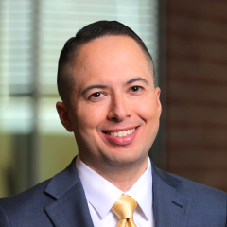
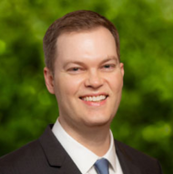
Working Group Finance
Michael Crow
Nancy Gonzales
Sally Morton
Maria Anguiano
President, ASU CEO, ASU Public Enterprise
Executive Vice President and University Provost, Academic Enterprise
Executive Vice President, Knowledge Enterprise
Executive Vice President, Learning Enterprise
• • • •
Former Executive Vice Provost, Columbia University Director, Workiva, Inc Chair, In-Q-Tel, Inc. Former Director, Engineering Animation, Inc.
• • •
Former Dean of Science, Virginia Tech Former Vice President, Statistics and Epidemiology, RTI International in North Carolina’s Research Triangle Park Former Endowed Chair in Statistics, RAND Corporation
• • •
Former CFO, Minerva Project Former CFO, UC Riverside Former Advisor to the President and Chief of Staff to the CFO, University of California Office of the President
• •
Former Dean of Natural Sciences, ASU Former Director, REACH Institute, ASU
Chris Howard
Morgan Olsen
Jim O’Brien
Rich Stanley
Executive Vice President and COO
Executive Vice President, Treasurer and CFO
Senior Vice President, University Affairs Chief of Staff, Office of the President
Senior Vice President and University Planner
•
Former President, Robert Morris University and Hampden-Sydney College
•
•
Former CFO, Purdue University and Southern Methodist University Past President, National Association of College and University Business Officers
•
Former Executive Vice Provost, New York University
• •
Former Corporate Attorney at three publicly traded companies Former Attorney, Dickinson, Throckmorton, Parker, Mannheimer & Raife
Christian Osmeña
Matthew Smith
Vice President, Enterprise Planning
Vice President, Budget Planning and Management
• •
Former CFO, California Community Colleges Former Budget Advisor, California Department of Finance
• •
Former Assistant Vice President for Budget, Planning and Analysis, Brown University Former Director, Strategy and Operations, Huron Consulting Group
17
Notes:
Nancy, Sally, and Jim

Slide 19
Enterprise Operating Expenses by Use
($ in Millions)
Financial aid expense includes federally-funded (e.g., Pell Grant) and institutionally-funded programs
Higher compensation driven by living wage adjustments, merit-based salary increases, fringe benefit cost increases, and substantial sponsored research growth
Note: Compensation include Salaries and Wages, Benefits and Pension Liability/OPEB. Financial Aid includes Scholarships and Fellowships, Scholarship Allowance and HEERF/CRF - Student Grants. Interest and Depreciation includes Interest on Indebtedness and Depreciation.
18

Slide 20
ASU Public Enterprise Financials
Year-Over-Year Change FY 2024 Budget to FY 2025 Estimate
Revenue | 2.5%
Expense | 1.8%
Note: Revenue and expense figures have been modified to reflect Scholarship Allowance as an expense rather than contra-revenue. Discrete component units include ASU Enterprise Partners, Arizona Capital Facilities Finance Corporation (ACFFC), ASU Alumni Association, ASU Research Park, ASU Preparatory Academy and Sun Angel Foundation.
19

Slide 21
ASU Public Enterprise Net Position
($ in Millions)
Net position is the financial position at the end of the fiscal year accounting for all assets, deferred outflows, liabilities and deferred inflows.
Pension and OPEB
Unrestricted
Restricted
Capital Assets
ASU Component Units
13

