Slide 1

Career-Track Faculty
Patricia Friedrich, Vice Provost of Academic Personnel
Colleen Cordes, Assistant Vice Provost for Career-Track Faculty
Presentation to ASU Senate, March 3, 2025

Slide 2
ASU Charter & CTF
Career track faculty (CTF) play a pivotal role in ASU’s ability to live out our charter:
Teaching faculty and instructors play critical roles in ensuring all students at ASU have access to high-quality, accessible, and innovative educational experiences, supporting their success throughout their time at ASU
Clinical faculty bridge education and practice application, providing direct services to the community and supervising students in applied settings, helping to enhance the health of the community
Research faculty work to advance research and discovery of public
Professors of practice bring industry and professional experience to the university, uniquely preparing students to meet emerging workforce needs
Work of CTF necessarily complements that of tenure/tenure-track colleagues in supporting ASU’s mission
Notes:
Really critical to note is that in addition to the different ways CTF support the mission of the charter, the essential functions of CTF can vary within and between faculty type and between units. Take, for instance, clinical faculty. In some units, clinical faculty are out in the community, overseeing student internships, in others, they may be primarily bringing a professional lens to didactic teaching in the classroom, while in others they are engaged in hands-on patient care.
Similarly, teaching faculty can be involved in a range of activities, from teaching and mentoring to academic program administration. Research faculty are often primarily funded on day-to-day can also be found in the classroom or engaging in student mentoring on research projects.
There is no one singular experience for career track faculty; in addition to initiatives at the university level, it’s the UNIT LEVEL that often drives the day-to-day experience of CTF

Slide 3
Career Track Faculty By the Numbers

Slide 4
Career Track Faculty
Ranks by Track
Instructor (n = 549) | Teaching (n = 722) | Clinical (n = 498) | Research (n = 189) | Practice (n = 195)
Principal Instructor | Teaching Professor (n = 131) | Clinical Professor (n = 96) | Research Professor (n = 52) | Professor of Practice** (n = 195)
Senior Instructor | Associate Teaching Professor (n = 200) | Clinical Associate Professor (n = 136) | Research Associate Professor (n = 43)
Instructor (n = 549) | Assistant Teaching Professor (n = 391) | Clinical Assistant Professor (n = 266) | Research Assistant Professor (n = 94)
**while ACD lists ranks, in practice, we only hire at the highest rank due to the nature of the position
Data as of 2/13/2025. Source: Workday
Notes:
What does the term “career-track faculty” encompass? While conversations often focus on the important work of Teaching and Instructor faculty (who comprise approximately 60% of CTF), it’s critical to note that CTF also includes clinical faculty, research faculty, and professors of practice throughout the university.

Slide 5
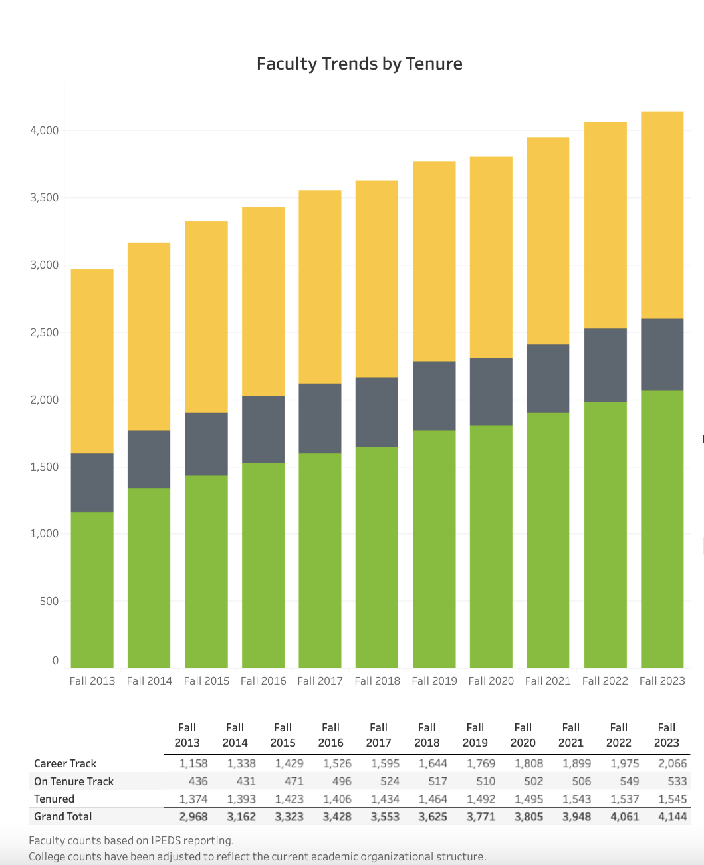
Growth F2013 – F2023
*39% of faculty in 2013
*49.9% of faculty in 2023
Net gain of 908 CTF faculty
Tenured
Tenure-Track
Career-Track
Source: facts.asu.edu
Notes:
ASU’s access mission has necessarily resulted in expansion of career track faculty across ASU in the recent years. If we look at official university data from 2013 -2023, across all of ASU, there was a net gain over 900 CTF (across tracks/rank). This has resulted in almost half of all benefits-eligible faculty at ASU being career track faculty.

Slide 6
Building a Career at ASU

Slide 7
**Note: Data is based on time of initial hire at ASU. May not reflect time since hire into current role
Data pulled 2/14/25. Source: Workday

Slide 8
Recent Initiatives (2022-present)
Reclassification to Career Track Faculty
Expansion of Multi-Year (MY) contracts
Establishment of University-wide Career Track “Welcome” event
Establishment of University-wide awards for which CT are eligible
Launch of Career Track Faculty promotion workshops
Establishment of Instructor promotion pathways
Review of Unit/College bylaws to support CTF engagement in shared governance
Support of CTF in leadership at unit-levels
  Approximately 40% of units have a specific career faculty assistant/associate dean focused on advancement of CTF
Support for Career Faculty Association launch and related programming
Creation of the role of Assistant Vice Provost for CTF to further support faculty

Slide 9
CTF Promotion Cases Submitted to Provost’s Office
Source: Provost’s Office Internal Data

Slide 10
Anticipated Personnel
Actions
2024-2025 cases under review for
2025-2026 implementation
Teaching Track:
54 assistant teaching professors → associate teaching professor
35 associate teaching professors → teaching professor**
Clinical Track:
25 clinical assistant professors → clinical associate professor
16 clinical associate professors → clinical professor**
Research Track:
3 research assistant professors → research associate professor
3 research associate professors → research professors
Instructor Track:
44 instructors → senior instructor
**if successful, promotion to teaching professor
and clinical professor include initiation of a MY contract
Source: Provost’s Office Internal Data

Slide 11
Multi-Year and Rolling Multi-Year Contracts
2025 data is a projection
Source: Institutional Analysis
Notes:
ABOR sets cap on MY contracts as percent of tenure/tenure-track faculty
In 2022, Provost Gonzales advocated for the cap to go from 15% to 30%
There are currently 282 MY or RMY contracts; if all promotions successful it will increase to 322 for fall 2025
Given 2160 TT faculty, 322 would bring us to 14.9%; given acceleration in promotions reviewed by Provost’s Office each year, we anticipate exceeding the previously set 15% cap in 2026.

Slide 12
Questions?

