Slide 1
University Senate
Nancy Gonzales Executive Vice President and University Provost March 3, 2025

Slide 2
The ASU Charter drives all we do
ASU is a comprehensive public research university, measured not by whom it excludes, but by whom it includes and how they succeed; advancing research and discovery of public value; and assuming fundamental responsibility for the economic, social, cultural and overall health of the communities it serves.
2

Slide 3
Demonstrate leadership in enabling academic
excellence and accessibility at scale
Maintain the fundamental principle of accessibility to all students qualified to study at a research university.
Maintain university accessibility to match Arizona’s socioeconomic diversity, with undifferentiated outcomes for success.
Ensure that more than 90% of students continue studies beyond their first year.
Enhance university graduation rate to greater than 85% and more than 40,000 graduates annually.
Continuously enhance quality while maintaining affordability.
Overcome geographic and financial barriers to education by enrolling 170,000 online degree-seeking students.
Continuously increase measured student development and learning outcomes.
Engage learners of all socioeconomic, geographic and demographic backgrounds.
3
Notes:
White text box

Slide 4
ASU enrollment reaches
Maintain the fundamental principle of accessibility to all students qualified to study at a research university
highest ever levels
Total enrollment (FY03 to FY24, estimate for FY25)
ABOR metric
International
Online
Campus
Nonresident
Online
Campus
Resident
Online
Campus
FY04
FY07
FY08
FY09
FY10
FY11
FY12
FY13
FY14
FY15
FY16
FY17
FY18
FY19
FY21
FY22
FY23
FY24
FY03
FY05
FY25
FY06
FY20
4
Notes:
Updated

Slide 5
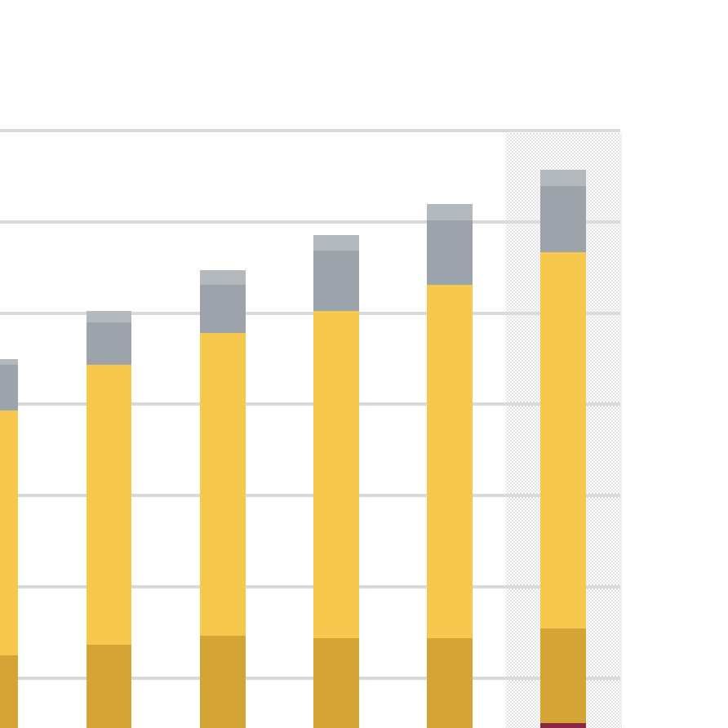
ASU enrollment reaches
Maintain the fundamental principle of accessibility to all students qualified to study at a research university
highest ever levels
Total enrollment (FY03 to FY24, estimate for FY25)
ABOR metric
FY21 to FY25
International
+30,938
191,398
Online
Campus
160,460
Nonresident
Online
Campus
Resident
Online
Campus
FY04
FY07
FY08
FY09
FY10
FY11
FY12
FY13
FY14
FY15
FY16
FY17
FY18
FY19
FY21
FY22
FY23
FY24
FY03
FY05
FY25
FY06
FY20
5
Notes:
Updated

Slide 6
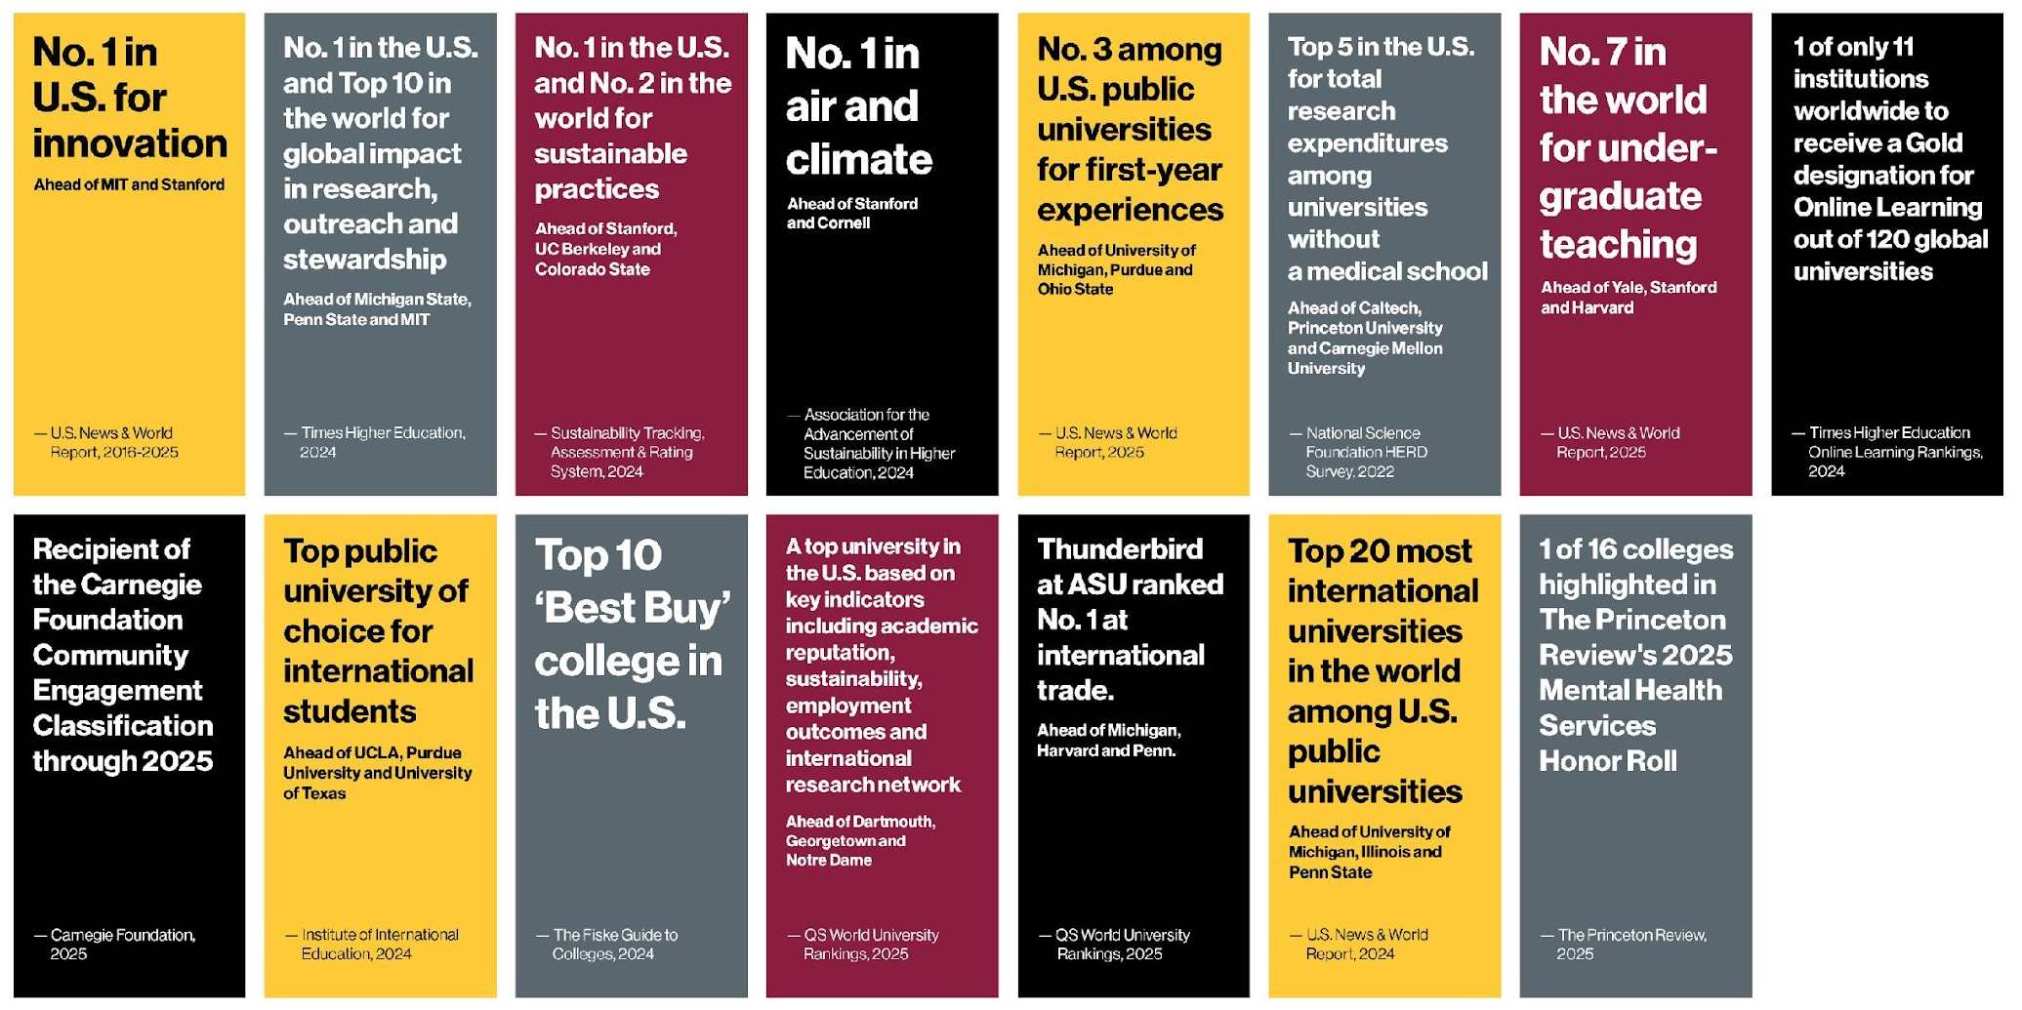
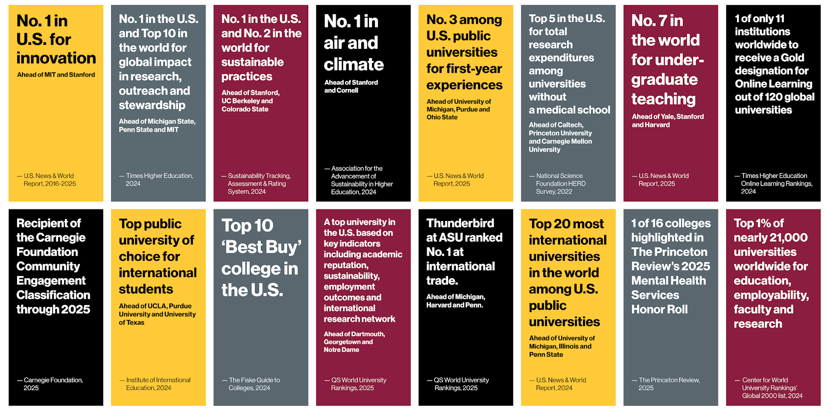
ASU excellence earns recognition
6

Slide 7
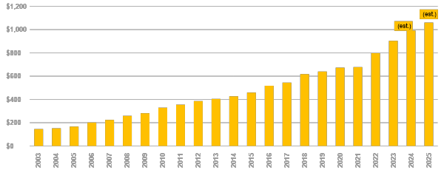
Engage learners of all socioeconomic, geographic and demographic backgrounds
ASU is approaching $1 billion
Enhance research competitiveness to more than $1.5 billion in annual research expenditures
Launch the prototype medical center for the planet
in research expenditures
NSF HERD expenditures (dollars in millions, actuals for FY03 to FY23, estimates for FY24 and FY25)
ABOR metric
Goal
$1.5 billion
Research priorities:
Advanced technology
Health
National security
Space
Sustainability
FY04
FY07
FY08
FY09
FY10
FY11
FY12
FY13
FY14
FY15
FY16
FY17
FY18
FY19
FY21
FY22
FY23
FY24
FY03
FY05
FY25
FY06
FY20
7
Notes:
Research priorities?

Slide 8
ASU successfully competes
Enhance research competitiveness to more than $1.5 billion in annual research expenditures
for major awards
Total anticipated awards
DOD Irregular
Europa Clipper
Warfare Center
$23M
$24M
Arizona State University students and faculty built an infrared camera, E-THEMIS, for NASA’s Europa Clipper mission. The camera will help investigate Jupiter’s moon, Europa, for potential conditions for life.
Arizona State University has been chosen to partner with the U.S. Department of Defense on research examining global trends in irregular warfare, with a focus on analyzing tactics, forecasting shifts and evaluating effectiveness.
Diversifying semiconductor
Direct Air Capture Hub
supply chains
$11M
$14M
The Southwest Regional DAC Hub develops direct technology to remove carbon dioxide from the atmosphere, where it can be either stored long-term or used in industrial processes.
This multiregional initiative, led by the State Department and ASU’s Schools of Engineering and Business supply chain faculty, aims to foster investment, build workforce skills and boost economic growth.
8
Notes:
IWC: $24M total funding
Updated description: Arizona State University has been chosen to partner with the U.S. Department of Defense to advance research on global trends in irregular warfare. Leading a national consortium, ASU will support the DOD’s Irregular Warfare Center in analyzing evolving tactics, forecasting shifts, and evaluating their effectiveness. The initiative aims to build a network of experts to develop innovative solutions for irregular warfare.
Advanced Research Projects Agency for Health (ARPA-H): · BAA – Broad Agency Announcement: PI Ruoyu (Fish) Wang, RxCRS: Reliable and eXplainable Cyber Reasoning System for Digital Health Security: $10M+ total funding
GSI’s Center for Cybersecurity and Trusted Foundations (CTF) has secured a $10M+ award from ARPA-H to transition its DARPA-funded Assured Micropatching project (2020, $6M) beyond the Department of Defense. This large-scale initiative aims to enhance digital health security and improve health outcomes for broader populations by adapting innovations originally developed for the warfighter. Building on ASU’s proven track record with DARPA, this award positions the university to establish a strong partnership with ARPA-H.
DAC Hub: $11M+ in total funding
Description: Funded by DOE, the Southwest Regional Direct Air Capture Hub develops direct air capture technology to remove CO₂ from the atmosphere at any location, where it can be either stored long term or used in industrial processes, such as beverage bottling, cement production, greenhouses, and synthetic fuel production.Solar and wind energy in the area supply power to direct air capture infrastructure.

Slide 9
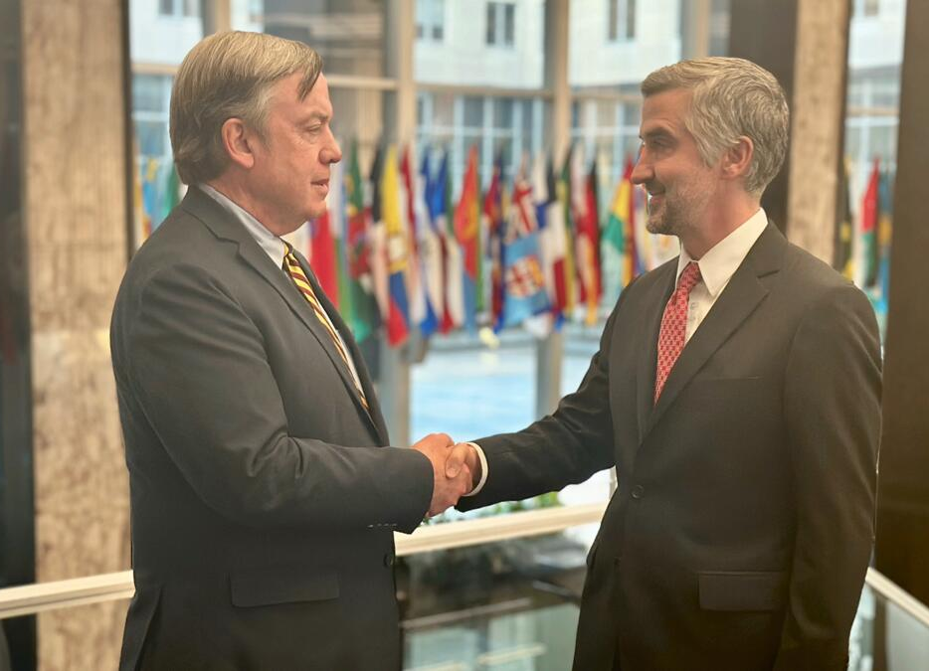
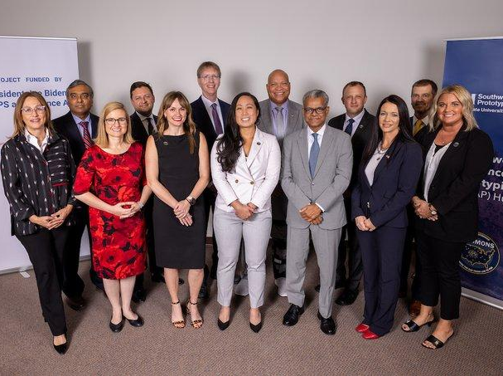
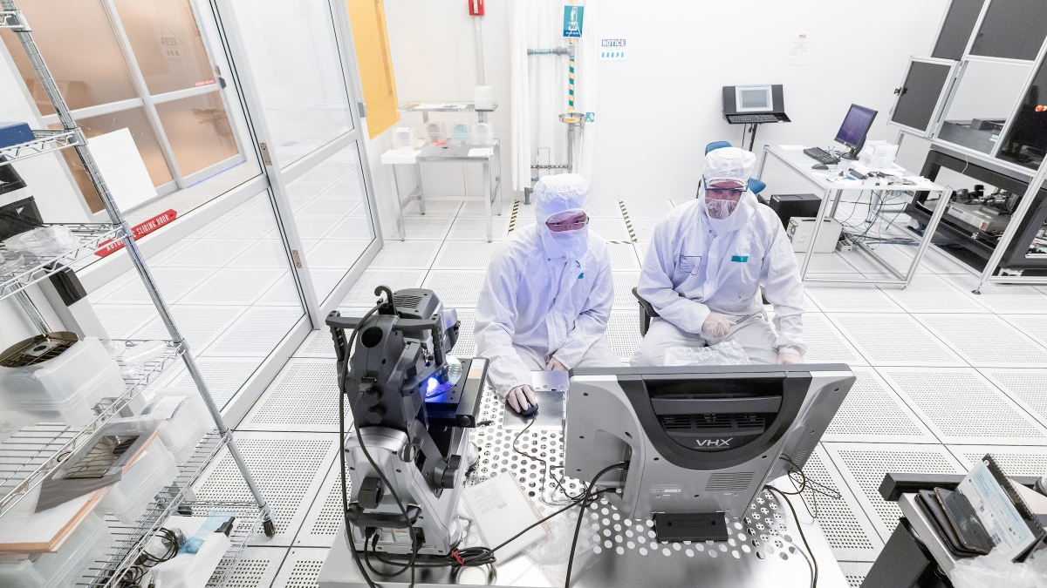
ASU is winning and leading
Enhance research competitiveness to more than $1.5 billion in annual research expenditures
a critical national objective
Total anticipated awards
U.S. Department of State Bureau
U.S. Department of Commerce
of Economic and Business Affairs
$100M
$13.8M
From the first part in the CHIPS National Advanced Packaging Manufacturing Program (NAPMP).
ASU is driving innovation in the domestic microchip packaging ecosystem and expanding capacity for domestic advanced packaging.
ASU is bolstering the assembly, testing and packaging capabilities in International Technology Security and Innovation (ITSI) partner countries in the Americas and Indo-Pacific
ITSI
SHIELD USA
U.S. Department of Defense
U.S. Department of Commerce
$177M
The U.S. Commerce Department and Natcast chose Arizona as the site of the co-located National Semiconductor Technology Center (NSTC) Prototyping and NAPMP Advanced Packaging Piloting Facility, one of three CHIPS for America R&D flagship facilities that represent the greatest national lab investments since the Manhattan Project.
The SWAP Hub’s five projects and 170+ regional and national partners work together to accelerate the lab-to-fab transition between research, development and production, and collaborate to build the microelectronics workforce.
Southwest Prototyping Hub
NSTC / NAPMP Packaging Facility
9
Notes:
Check text

Slide 10
ASU has emerged as a new kind of university
~190,000 degree-seeking students from around Arizona, the U.S. and the world
430,000+ learners advancing their knowledge and careers through ASU
Millions of people connected to ASU through ideas, goals and competitiveness
$1 billion in research expenditures (one of four U.S. universities without a medical school)
ASU faculty, staff and students who are developing new concepts, tools and collaborations across all disciplines and locations – even in space
First Global Futures Laboratory in history
Revolutionary health enterprise (with ASU Health) founded on social and health outcomes
Home to a new digital technology hub in Arizona
10
Notes:
Design

Slide 11
We assess our performance relative to universities
that share fundamental elements of ASU’s design
Universities sharing similar student access, academic environment and knowledge production profiles
Arizona State University
University of Arizona
University of California-Berkeley
University of California-Davis
University of California-San Diego
University of Colorado Boulder
University of Central Florida
Florida State University
University of Florida
University of South Florida-Main Campus
Georgia Institute of Technology-Main Campus
Georgia State University
University of Georgia
University of Illinois at Urbana-Champaign
Indiana University-Bloomington
University of Iowa
University of Kansas
University of Maryland-College Park
Boston University
Michigan State University
University of Minnesota-Twin Cities
Rutgers University-New Brunswick
Syracuse University
University of North Carolina at Chapel Hill
Purdue University-Main Campus
University of Cincinnati-Main Campus
Ohio State University-Main Campus
Pennsylvania State University
University of Pittsburgh-Pittsburgh Campus
Texas A & M University-College Station
The University of Texas at Austin
University of Utah
University of Virginia-Main Campus
Washington State University
University of Wisconsin-Madison
11
Notes:
Universities that share similar student access, academic environment, and knowledge production profiles

