Slide 1
SUN DEVIL ATHLETICS /// WCHA Hockey Proposal PG 1
University Senate Meeting 10.26.20

Slide 2
COVID-19 IMPACT on Student-Athlete Experience
///
SUN DEVIL ATHLETICS /// UNIVERSITY SENATE MEETING 10.26.20

Slide 3
Friday, March 6, 2020:
The NCAA released a statement about COVID-19 - Games and events continued as scheduled.
A COVID-19 Advisory Panel sanctioned by the NCAA
Monday 3/9:
SDA does Full review of all events – discussion about team travel and whether or not to have fans at home events.
Tuesday 3/10:
ASU Men’s Basketball departs for Pac-12 tournament in Las Vegas.
The Ivy League cancelled its conference basketball tournament
Wednesday 3/11:
The NCAA made the decision to ban fans from the 2020 NCAA tournament.
The Pac 12, Big Ten, ACC and Big 12 banned fans from attending their conference. By that night the NBA had 2 COVID positives and postponed season.
Thursday, 3/12:
Announced suspension of men's basketball tournament, Pac-12 sport competitions & Pac-12 championship events.
ASU gymnastics team lands in Baton Rouge, never leaves airport, returns home; Softball team on bus turns around in Blythe, CA (headed to UCLA).
The NCAA eventually cancels the 2020 men’s and women’s NCAA tournament
SUN DEVIL ATHLETICS /// UNIVERSITY SENATE MEETING 10.26.20

Slide 4
Pac-12 March 14, 2020
CEO Group canceled all Pac-12 conference and non-conference sport competitions and Pac-12 championships
Prohibited all organized team athletically-related activities until at least March 29.
NCAA March 30, 2020
The Division I Council voted to allow schools to provide spring-sport student-athletes an additional season of competition and an extension of their period of eligibility.
March 13, 2020 NCAA issues in-person recruiting dead period for all sports.
April 1, 2020 Division I Council extends its recruiting dead period thru May 31st.
SUN DEVIL ATHLETICS /// UNIVERSITY SENATE MEETING 10.26.20

Slide 5
Pac- 12 June 15, 2020
Commissioner announces “majority” of the Pac-12 football programs to allow athletes on-campus voluntary.
SDA – extensive protocols including regular testing implemented.
Pac-12 July 31, 2020
Pac-12 CEO Group approved the 2020 Conference-only fall schedule for football, which features a 10-game slate.
Also approved for Conference-only seasons for men’s & women’s soccer, women’s volleyball, and men’s & women’s cross country.
SUN DEVIL ATHLETICS /// UNIVERSITY SENATE MEETING 10.26.20

Slide 6
Pac-12 August 11, 2020
CEO Group postponed sport competitions - three central concerns cited by the Medical Advisory Committee:
consistent testing capabilities across all Pac-12 universities,
the prevalence of the virus in Pac-12 communities and nationally, and
concerns related to possible cardiac concerns potentially associated COVID-19.
PaC-12 September 3, 2020
Pac-12 Conference announces groundbreaking testing research initiative with Quidel; Rapid-results test could speed the return of sport competitions
Pac-12 September 24, 2020
Pac-12 announces resumption of football, basketball & winter sports seasons.
CEO Group decided the football season on November 6, men’s and women’s basketball on November 25 consistent with the NCAA’s official start date
SUN DEVIL ATHLETICS /// UNIVERSITY SENATE MEETING 10.26.20

Slide 7
Pac-12 October 3, 2020
Pac-12 announced its 2020 football schedule
7-game Conference-only lineup
Saturday, November 7 and
December 18-19 with the Pac-12 Football Championship Game,
North v South champions and a game for the 10 teams.
Sun Devil football kicks off the season November 7th @ USC – 9:00AM PST kickoff
SUN DEVIL ATHLETICS /// UNIVERSITY SENATE MEETING 10.26.20

Slide 8
///
Students (Academic & Mental)
SUN DEVIL ATHLETICS /// UNIVERSITY SENATE MEETING 10.26.20

Slide 9
ARIZONA STATE UNIVERSITY STUDENT-ATHLETES
SAAC meeting every 2 weeks
Zoom meetings with teams
Mental Health Staff from Health Center
Bill Kennedy
Racial injustice
Last week Democratic and Republican explain process
SUN DEVIL ATHLETICS /// UNIVERSITY SENATE MEETING 10.26.20

Slide 10
STUDENT-ATHLETE ACADEMIC PROGRESS REPORT
Cumulative GPA Spring 2020
Cumulative GPA, 3.29 (All Time High)
Female cumulative GPA, 3.49
Male cumulative GPA, 3.11 (All Time High)
80% scholar baller/scholar athlete
Graduation rates of African American SA
ASU ranks 3rd (85%) in the Pac-12
Females 100%, 1st in the PAC-12,
Males 80%, fifth in the PAC-12
2019-2020 FTF Retention Rate Scholarship
90% Retained= enrolled at ASU as of 21st
SUN DEVIL ATHLETICS /// UNIVERSITY SENATE MEETING 10.26.20

Slide 11
STUDENT-ATHLETE WELL BEING
April 27, 2020
Pac-12 Student-Athlete Health and Well-Being Initiative grant funding
Pac-12 SAHWBI Research Grants: Pooling the collective expertise of Pac-12 universities.
Head Trauma: Advancing New Biomarker Tests for Concussion Diagnosis and Recovery (California)
Injury Prevention: Documenting Overuse and Non-Time-Loss Injuries (Oregon State)
This study seeks to report the epidemiology of overuse and non-time-loss injuries across multiple Pac-12 sports while also
identifying potential factors that may influence the occurrence of such injuries.
Injury Prevention: Utilizing Ultrasound Imaging to Detect Precursors of Achilles Tendon, Patellar Tendon and Plantar Fascia Injuries (Utah)
This study seeks to develop a method of using brief preseason ultrasound examinations of the bilateral patellar tendon, Achilles
tendon and plantar fascia to identify precursors to injury of each
Pac-12 Mental Health Coordinating Unit
With the University of Arizona and Dr. Daniel Taylor :
Support student-athlete mental health related programs and research.
2020 Student-Athlete Mental Health Summit
SUN DEVIL ATHLETICS /// UNIVERSITY SENATE MEETING 10.26.20

Slide 12
Sun Devil Athletics
Key Health Points

Slide 13
Overview
The health and safety of student-athletes and personnel has always been a top priority of ASU.
These specifics of return to participation, while new, fit into a long-standing, disciplined, and evidence-based commitment to student-athlete wellbeing.
All efforts are in sync with national (CDC, Pac-12, ACHA), local (AZDHS, MCDHS), and ASU (Biodesign Institute, ASU Sports Medicine, Mayo Clinic) guidance.
All efforts are built around gold-standard public health strategies:
Prevent
Test
Trace
Isolate
Support
SUN DEVIL ATHLETICS /// UNIVERSITY SENATE MEETING 10.26.20

Slide 14
Key health aspects of the plan:
Our phased student-athlete return is tightly managed:
Cohorting of student-athletes at outset to reduce density during participation.
Established expectations for student-athletes in higher-risk vs lower-risk participation.
Establishing departmental baseline at return to ensure that anyone positive or exposed is isolated ahead of participation.
Establishing a culture of care for self and others in the prevention of COVID-19 infections.
Pre-participation physical exam for every student-athlete:
Testing protocols following Pac-12 guidance for high, medium, and lower risk sports.
Physicals and baseline testing allow for all personal health concerns at return (COVID-19 or otherwise) to be managed at return through individualized treatment plans.
Any positive test will be isolated and supported consistent with MCDHS guidance and individualized treatment and support needs. Contact tracing will be immediate upon positive test result.
SUN DEVIL ATHLETICS /// UNIVERSITY SENATE MEETING 10.26.20

Slide 15
Key health aspects of the plan (cont):
All student-athletes get pre-arrival and ongoing education about precautions and expectations.
Daily health screening of all student-athletes and personnel.
Physical spaces will be tightly managed.
Telemedicine and COVID-19 testing available through ASU providers.
ASU and Health Services team have extensive experience managing COVID-19 and preventing the spread of the virus.
Daily debrief amongst sports medicine, performance, and support teams.
SUN DEVIL ATHLETICS /// UNIVERSITY SENATE MEETING 10.26.20

Slide 16
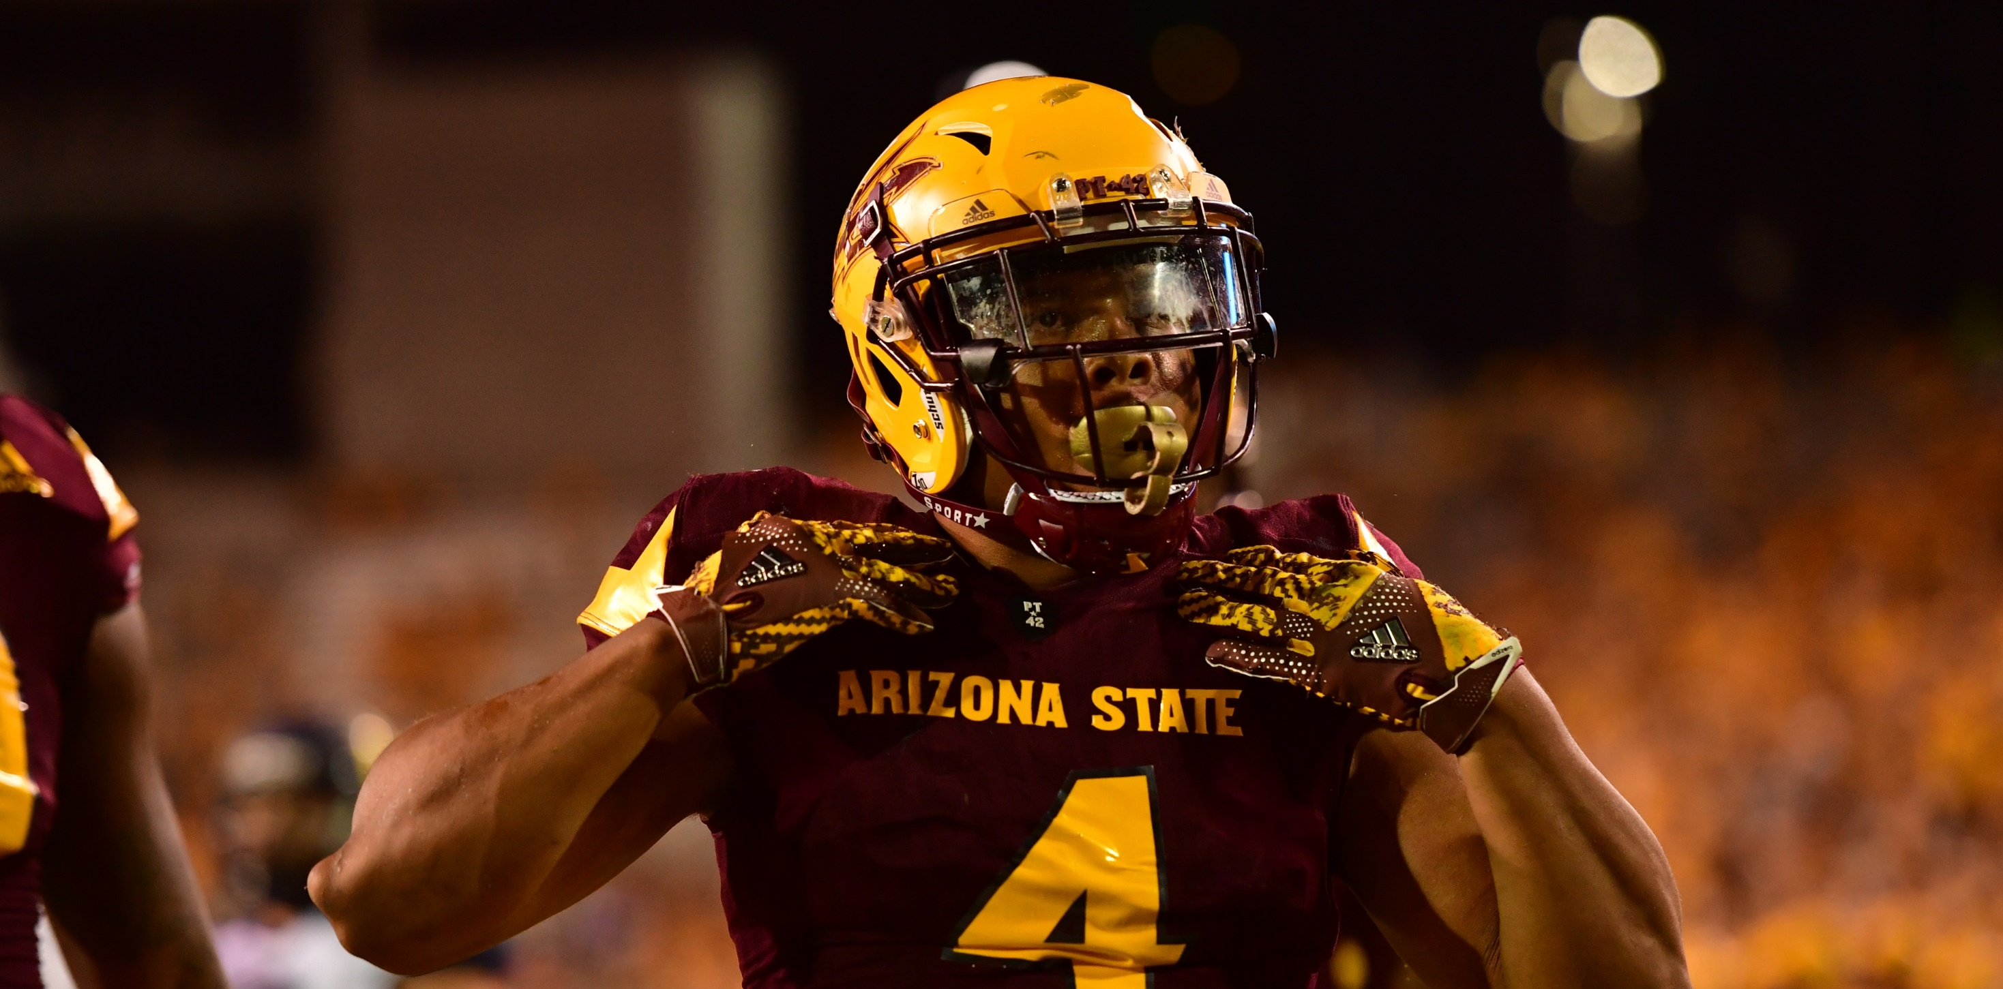
/// QUESTIONS
SUN DEVIL ATHLETICS /// UNIVERSITY SENATE MEETING 10.26.20

