Slide 1

Leadership Development at ASU
Build a leadership development system that produces leaders at every level who can advance ASU into the future.

Slide 2
Our approach to developing leaders
Intentional and focused
Invest in people who will lead ASU into the future
Identify talent pool early
Embed development efforts in the context and culture of ASU
Deploy best practices in this field
Innovate continuously
GOALS
Expand thinking on leadership and leaders
Align with and sustain ASU’s vision and mission
Build strong networks across the institution
Strengthen and support our culture
Develop a leadership pipeline

Slide 3
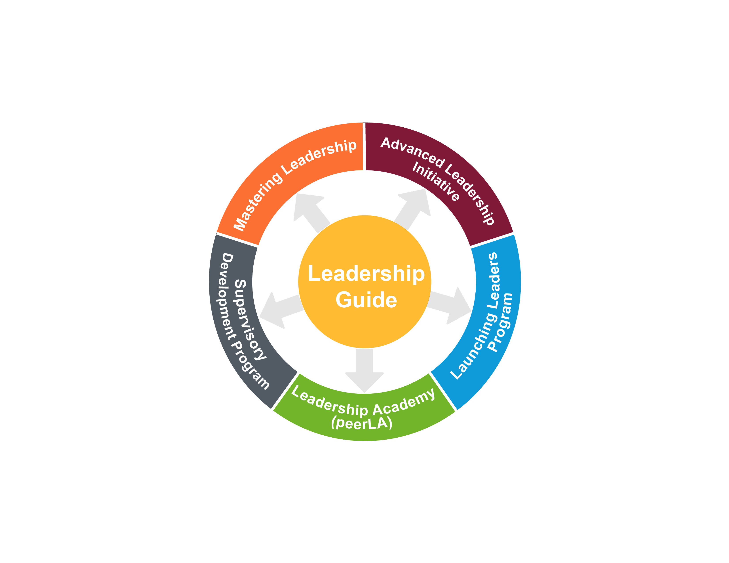
Enterprise-wide Leadership Programs

Slide 4
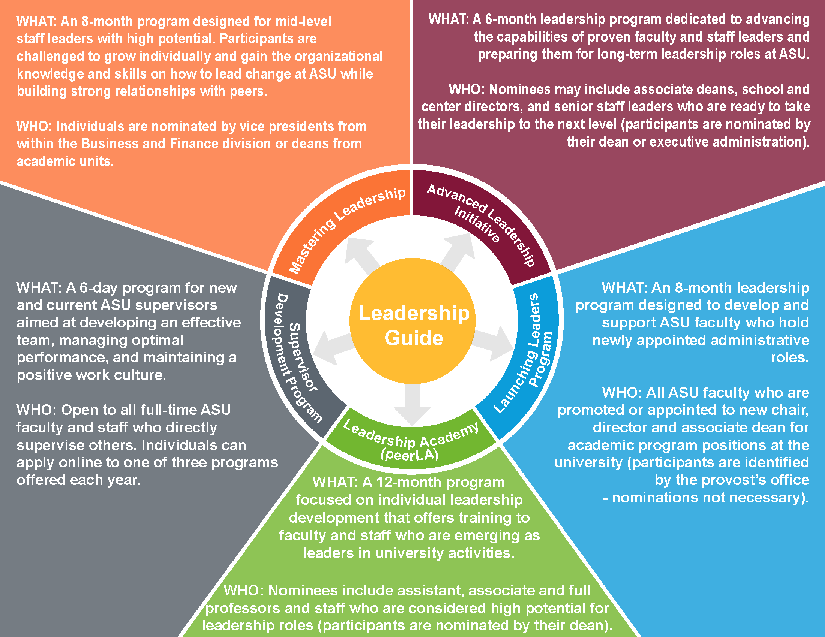

Slide 5
Other Leadership Development Opportunities
LEADERSHIP GUIDE
Toolkits to lead conversations around leadership:
2 hour discussion kit
1 hour discussion kit
Contact: Michael Dolan (michael.dolan@asu.edu)
LEADERSHIP ACADEMY – LEARNING SESSIONS
Twice a semester
Open to senate members

Slide 6
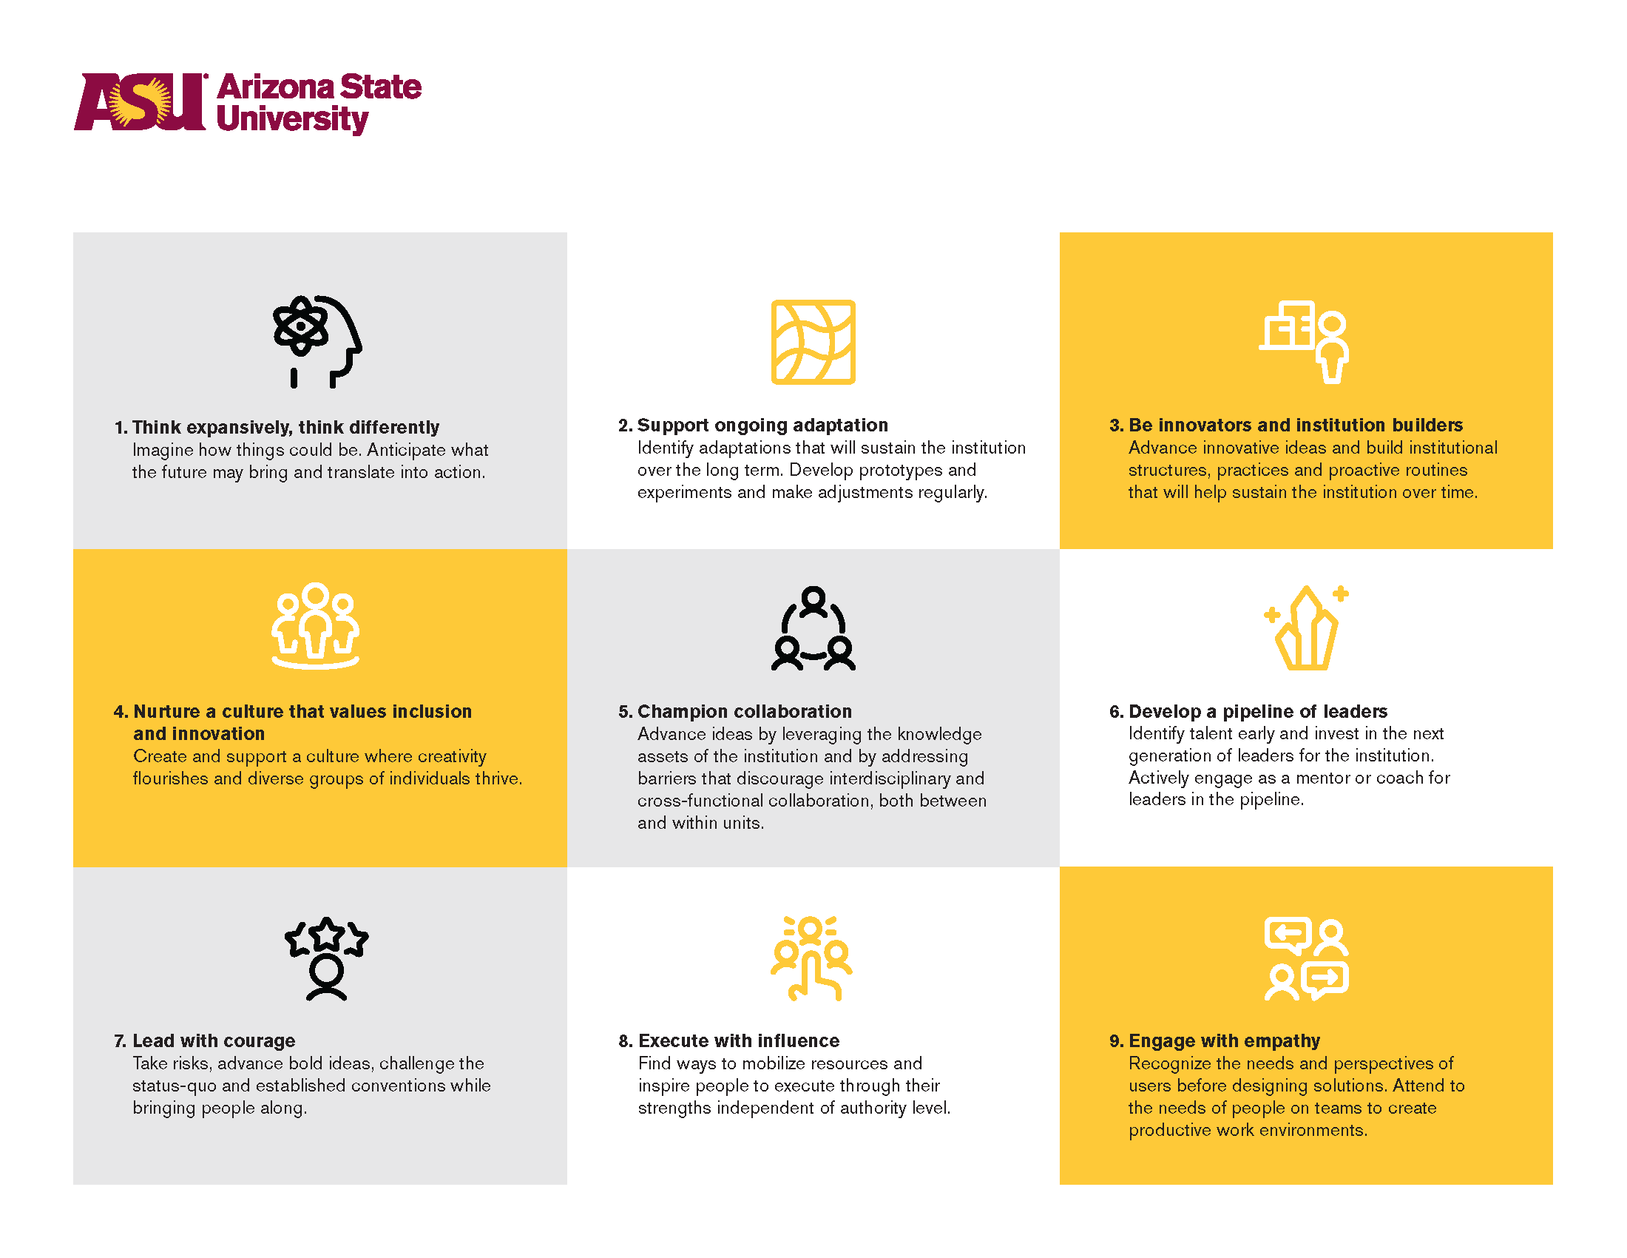
Dimensions of the Leadership Guide

